Slide 1
“The beauty of mathematics shows itself to patient followers’’
The work of Maryam Mirzakhani
Daniel Mathews
School of Mathematical Sciences
Monash University
Nanyang Technological University
26 September 2018

Slide 2
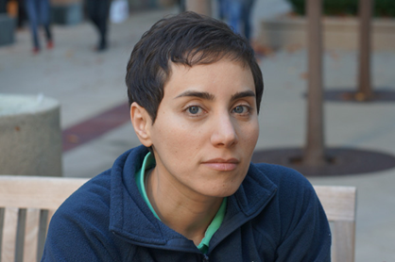
Overview: The work of Maryam Mirzakhani
  Brief biography
  Background to Mirzakhani’s work
  Some results proved by Mirzakhani
  Implications & applications of her work
  Subsequent work by others
  Main mathematical focus: Mirzakhani’s work on the volumes of moduli spaces of hyperbolic surfaces, and applications to dynamics
  (Requires a lot of background!)
Source: Stanford news service

Slide 3
Very brief biography
12 May 1977: Born in Tehran
1994: Iranian team at International Mathematical Olympiad
– Gold medal
1995: Gold medal again…
and perfect score
1996: Publishes first paper
1999: BSc in mathematics from Sharif University of Technology
2004: PhD from Harvard University under Curtis McMullen
Also 2004: Meets Dan
2004-8: Fellow of Clay Mathematics Institute, Professor at Princeton
2007: Results published on volumes of moduli spaces, simple geodesics, Witten’s conjecture
2008-17: Professor at Stanford University
2013: Diagnosed with breast cancer
2014: Awarded Fields medal
14 July 2017: Passed away

Slide 4
Fields medal citation
“Maryam Mirzakhani has made stunning advances in the theory of Riemann surfaces and their moduli spaces, and led the way to new frontiers in this area. Her insights have integrated methods from diverse fields, such as algebraic geometry, topology and probability theory.
In hyperbolic geometry, Mirzakhani established asymptotic formulas and statistics for the number of simple closed geodesics on a Riemann surface of genus g. She next used these results to give a new and completely unexpected proof of Witten’s conjecture, a formula for characteristic classes for the moduli spaces of Riemann surfaces with marked points.
In dynamics, she found a remarkable new construction that bridges the holomorphic and symplectic aspects of moduli space, and used it to show that Thurston’s earthquake flow is ergodic and mixing.
…
Her work has revealed that the rigidity theory of homogeneous spaces (developed by Margulis, Ratner and others) has a definite resonance in the highly inhomogeneous, but equally fundamental realm of moduli spaces, where many developments are still unfolding.”

Slide 5
Fields medal citation
“Maryam Mirzakhani has made stunning advances in the theory of Riemann surfaces and their moduli spaces, and led the way to new frontiers in this area. Her insights have integrated methods from diverse fields, such as algebraic geometry, topology and probability theory.
In hyperbolic geometry, Mirzakhani established asymptotic formulas and statistics for the number of simple closed geodesics on a Riemann surface of genus g. She next used these results to give a new and completely unexpected proof of Witten’s conjecture, a formula for characteristic classes for the moduli spaces of Riemann surfaces with marked points.
In dynamics, she found a remarkable new construction that bridges the holomorphic and symplectic aspects of moduli space, and used it to show that Thurston’s earthquake flow is ergodic and mixing.
…
Her work has revealed that the rigidity theory of homogeneous spaces (developed by Margulis, Ratner and others) has a definite resonance in the highly inhomogeneous, but equally fundamental realm of moduli spaces, where many developments are still unfolding.”

Slide 6
Prominent ideas in Mirzakhani’s work
Surfaces – topology
Geometry – of various flavours
  Hyperbolic
  Conformal
  Complex
Moduli spaces
We’ll try to explain something about these ideas & related theorems
Mirzakhani was a “slow” mathematician!

Slide 7
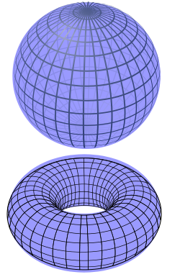
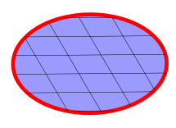
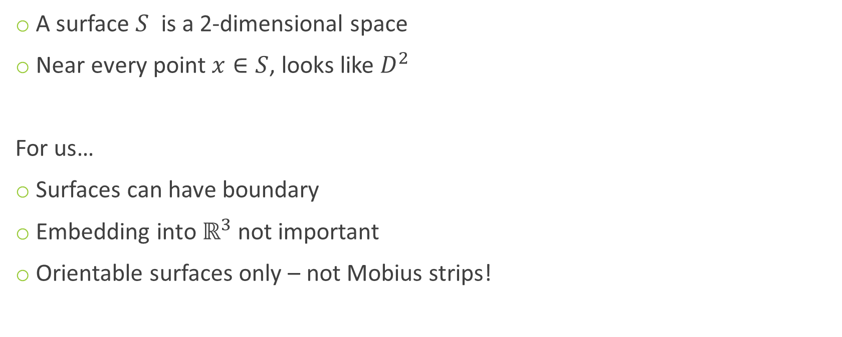
Surfaces
A surface $S$ is a 2-dimensional space
Near every point $x∈S$, looks like $D^{2}$
For us…
Surfaces can have boundary
Embedding into $ℝ^{3}$ not important
Orientable surfaces only – not Mobius strips!
Source: Wikipedia / YassineMrabet / Geek3 / Sbyrnes321

Slide 8
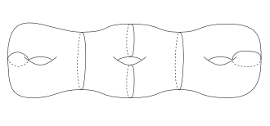
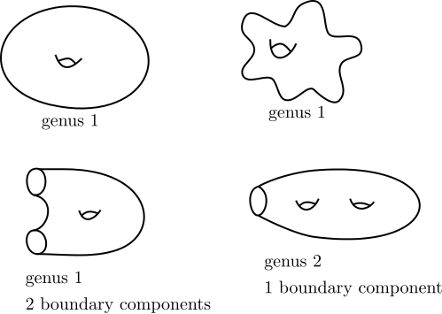
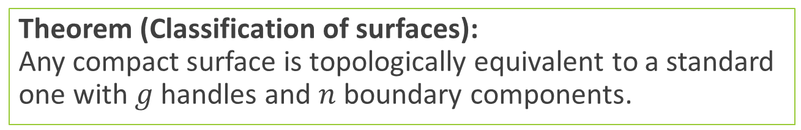
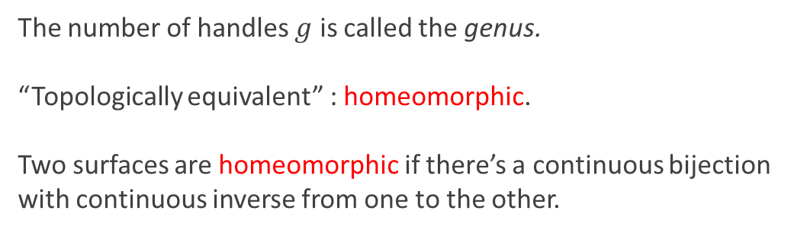
Surfaces
Theorem (Classification of surfaces):
Any compact surface is topologically equivalent to a standard one with $g$ handles and $n$ boundary components.
The number of handles $g$ is called the genus.
“Topologically equivalent” : homeomorphic.
Two surfaces are homeomorphic if there’s a continuous bijection with continuous inverse from one to the other.
Source: lamington.wordpress.com;
picturethismaths.wordpress.com

Slide 9
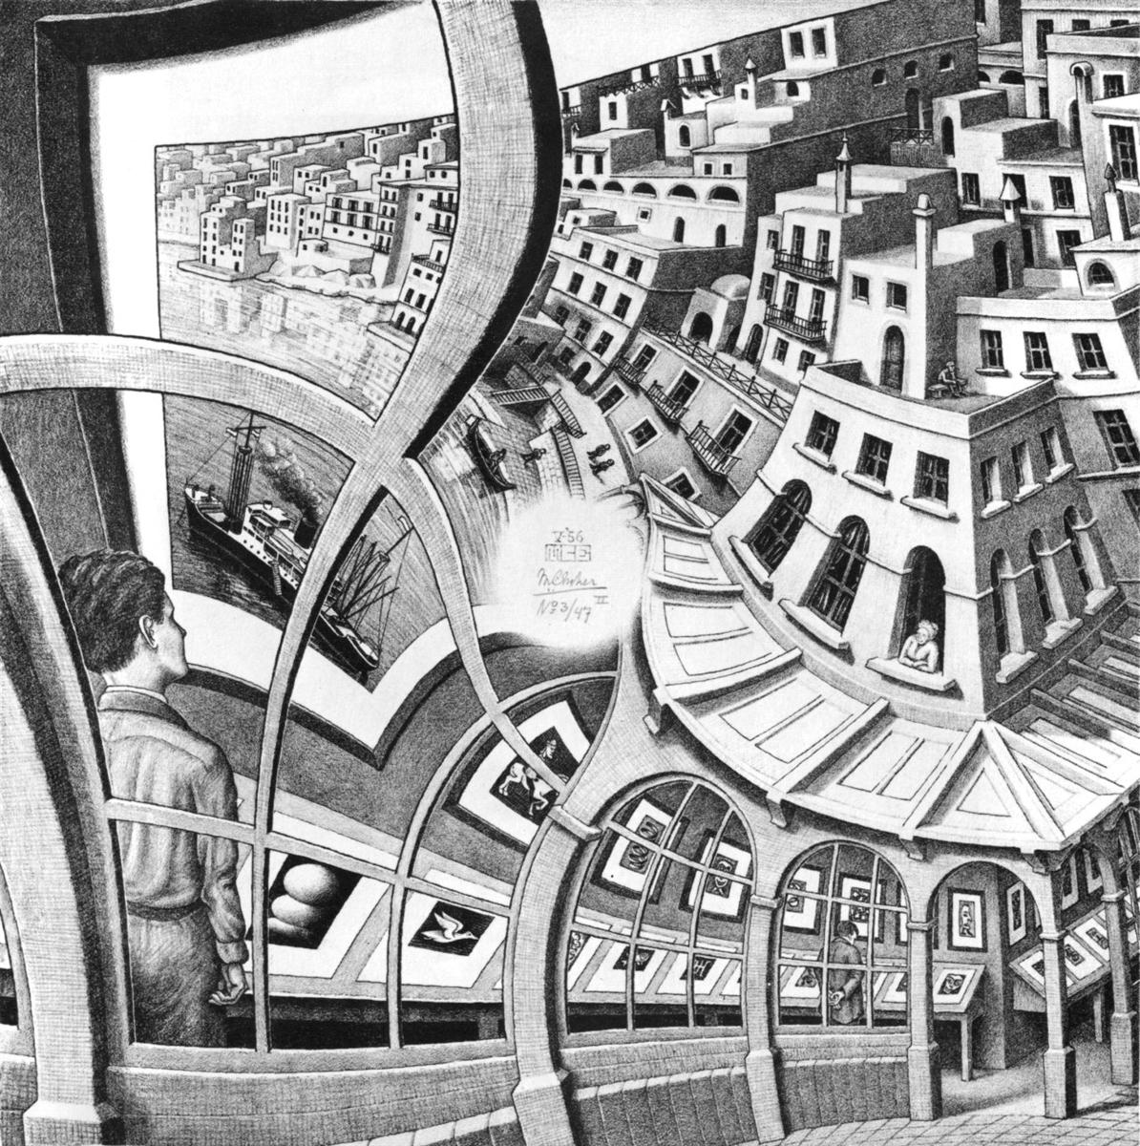
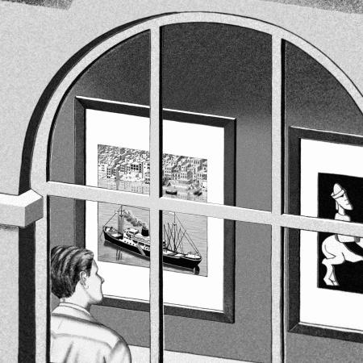
Conformal geometry
M. C. Escher, Print Gallery
All M.C. Escher works © 2017 The M.C. Escher Company - the Netherlands. All rights reserved. Used by permission. www.mcescher.com

Slide 10
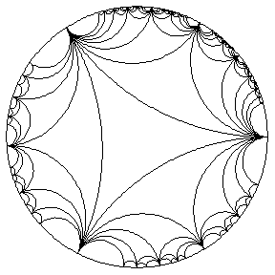
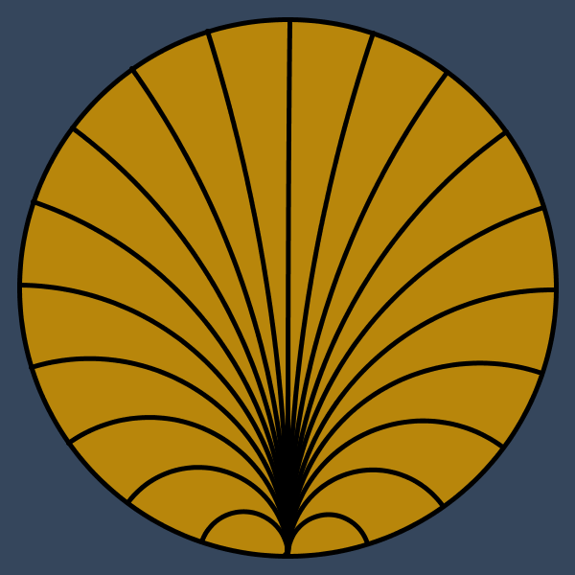
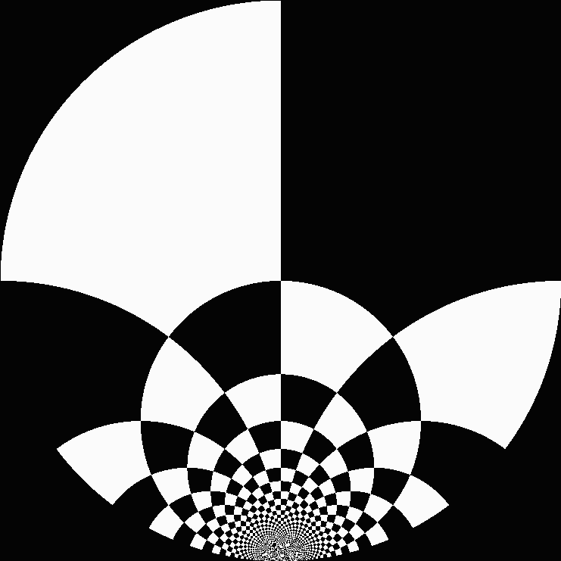
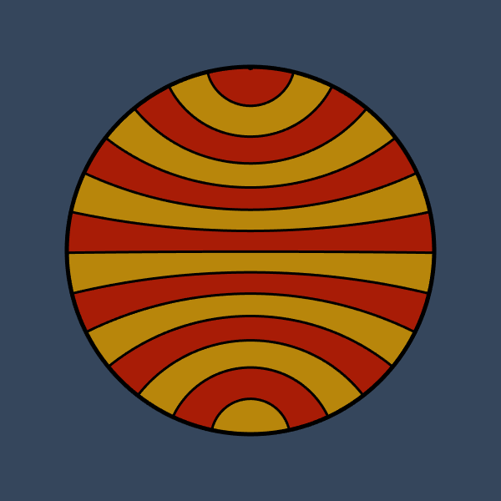

Conformal geometry
(orientation-preserving!)
Geometry where we care about angles but not lengths
A conformal map is a map which preserves angles (and for now, orientation)
A conformal symmetry of a surface $S$ is a bijective conformal map $f :S →S$
Some conformal symmetries of a disc: Turns out there are interestingly many!
“Euclidean symmetries” / isometries: rotations + reflections, a 1-dimensional space
“Smooth symmetries” / diffeomorphisms: an infinite-dimensional space
^
Sources: escape30.tumblr.com; szimmetria-airtemmizs.tumblr.com; hyperbolic-gifs.tumblr.com

Slide 11
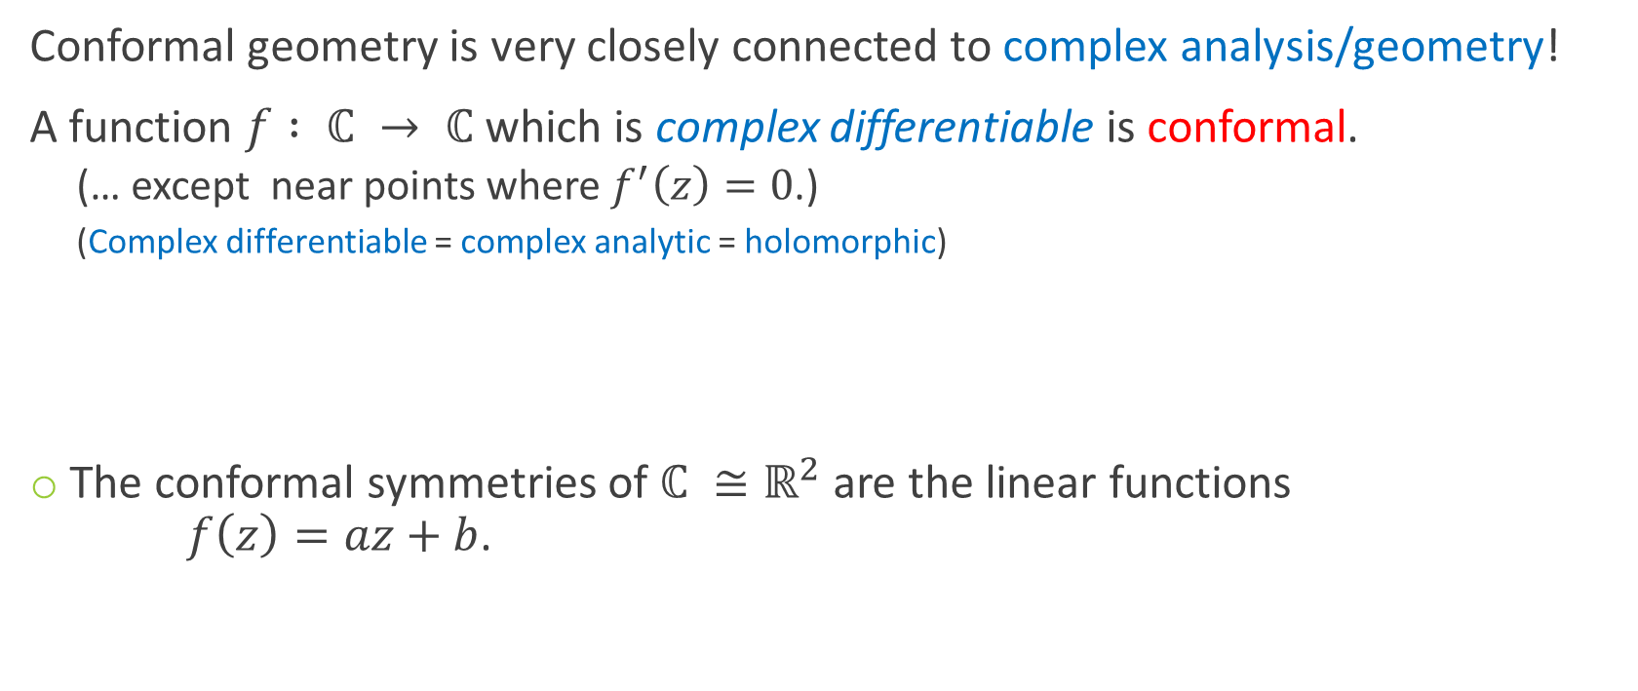
Complex geometry
Conformal geometry is very closely connected to complex analysis/geometry!
A function $f : ℂ → ℂ$ which is complex differentiable is conformal.
  (… except near points where $f^{′}\left(z\right)=0$.)
  (Complex differentiable = complex analytic = holomorphic)
The conformal symmetries of $ℂ ≅ℝ^{2}$ are the linear functions
$f\left(z\right)=az+b$.
(or in fact defined on any “complex 1-dimensional space” or Riemann surface)

Slide 12
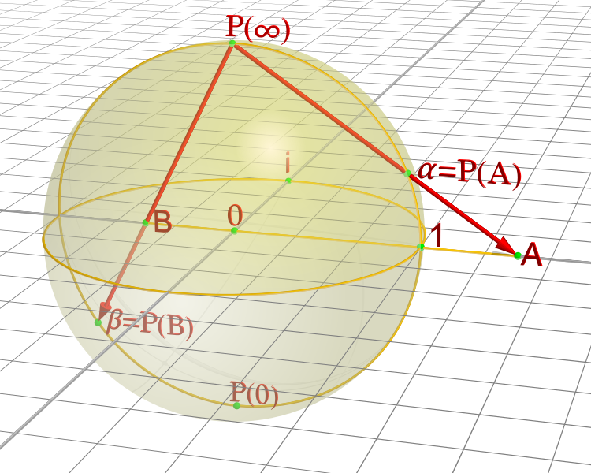

Complex geometry: the Riemann sphere
The next-simplest “complex 1-dimensional space” or Riemann surface after $ℂ$ is the Riemann sphere $ℂ∪\left\{∞\right\}$
Take the complex plane and “compactify”, adding $∞$ to form a sphere!
Source: Leonid2/wikipedia

Slide 13
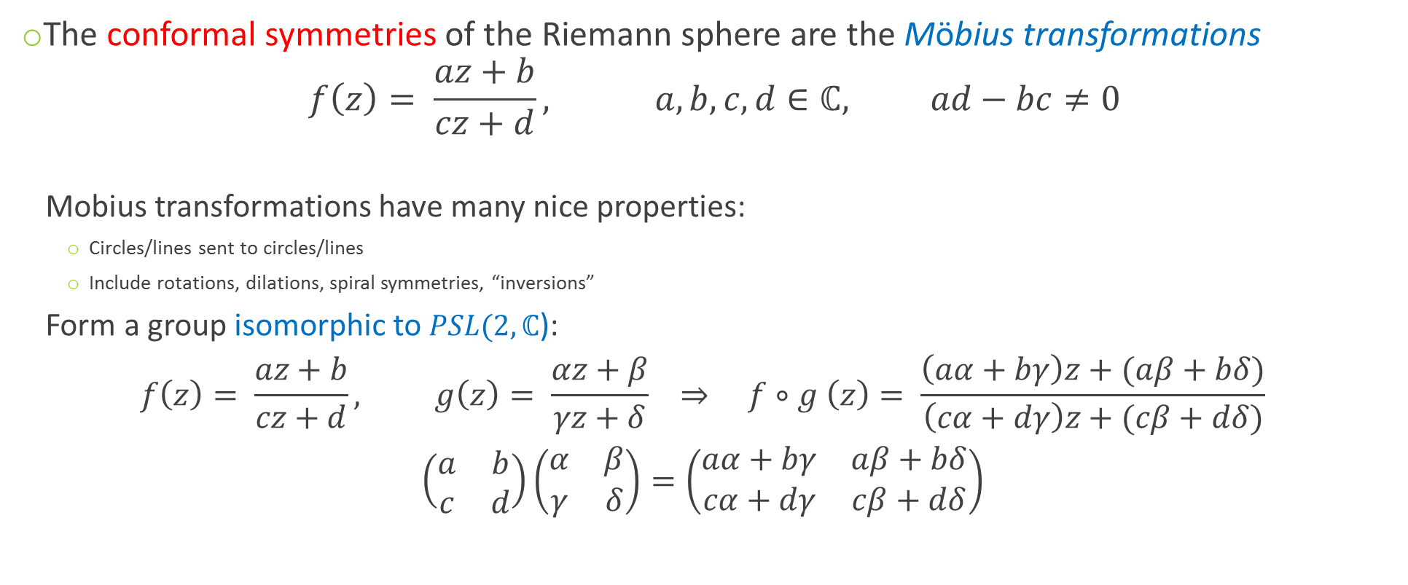
Complex geometry: Möbius transformations
The conformal symmetries of the Riemann sphere are the Möbius transformations
$$f\left(z\right)= \frac{az+b}{cz+d}, a,b,c, d∈ℂ, ad−bc≠0$$
  Mobius transformations have many nice properties:
    Circles/lines sent to circles/lines
    Include rotations, dilations, spiral symmetries, “inversions”
  Form a group isomorphic to $PSL(2,ℂ$):
  $$f\left(z\right)= \frac{az+b}{cz+d}, g\left(z\right)= \frac{αz+β}{γz+δ} ⇒ f∘g \left(z\right)= \frac{\left(aα+bγ\right)z+(aβ+bδ)}{\left(cα+dγ\right)z+(cβ+dδ)}$$
  $$\left(\begin{matrix}a & b \\ c & d\end{matrix}\right)\left(\begin{matrix}α & β \\ γ & δ\end{matrix}\right)=\left(\begin{matrix}aα+bγ & aβ+bδ \\ cα+dγ & cβ+dδ\end{matrix}\right)$$

Slide 14
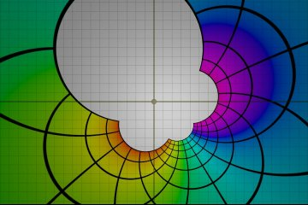
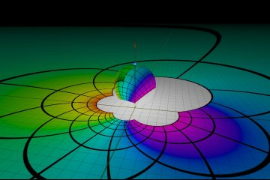
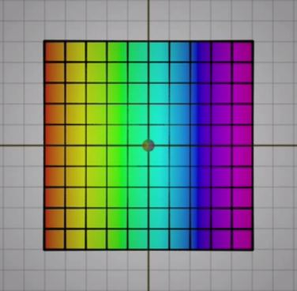
Complex geometry: Möbius transformations
Source: Mobius transformations revealed

Slide 15
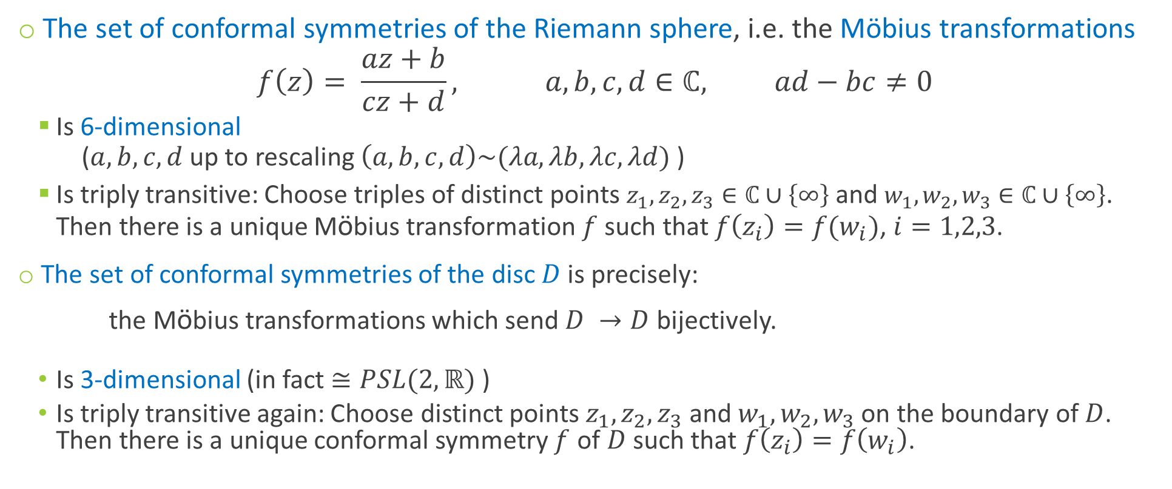
Complex geometry
The set of conformal symmetries of the Riemann sphere, i.e. the Möbius transformations
$$f\left(z\right)= \frac{az+b}{cz+d}, a,b,c, d∈ℂ, ad−bc≠0$$
  Is 6-dimensional
  ($a,b,c,d$ up to rescaling $\left(a,b,c,d\right)\sim (λa,λb,λc,λd)$ )
  Is triply transitive: Choose triples of distinct points $z_{1},z_{2},z_{3}∈ℂ∪\left\{∞\right\}$ and $w_{1},w_{2},w_{3}∈ℂ∪\left\{∞\right\}$.
  Then there is a unique Möbius transformation $f$ such that $f\left(z_{i}\right)=f(w_{i})$, $i=1,2,3$.
The set of conformal symmetries of the disc $D$ is precisely:
the Möbius transformations which send $D →D$ bijectively.
  Is 3-dimensional (in fact $≅PSL(2,ℝ)$ )
  Is triply transitive again: Choose distinct points $z_{1},z_{2},z_{3}$ and $w_{1},w_{2},w_{3}$ on the boundary of $D$.
  Then there is a unique conformal symmetry $f$ of $D$ such that $f\left(z_{i}\right)=f\left(w_{i}\right)$.

Slide 16
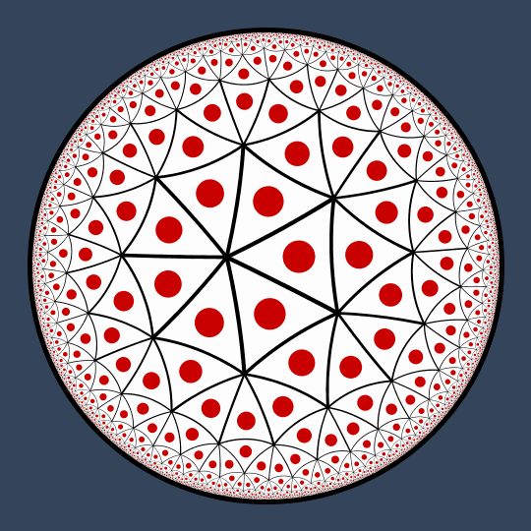
Complex geometry
Sources: szimmetria-airtemmizs.tumblr.com; escape30.tumblr.com

Slide 17
Complex geometry
Sources: szimmetria-airtemmizs.tumblr.com; hyperbolic-gifs.tumblr.com

Slide 18

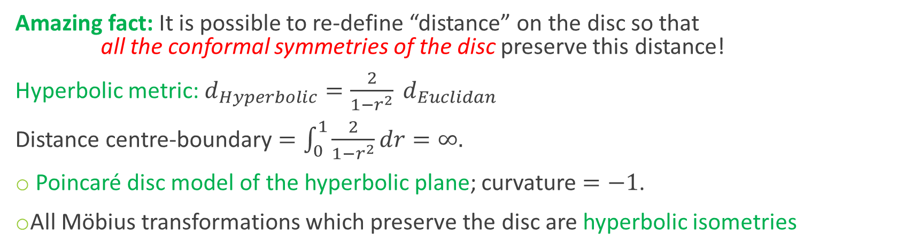
Hyperbolic geometry
Amazing fact: It is possible to re-define “distance” on the disc so that
all the conformal symmetries of the disc preserve this distance!
Hyperbolic metric: $d_{Hyperbolic}=\frac{2}{1−r^{2}} d_{Euclidan}$
Distance centre-boundary $=\int_{0}^{1}{\frac{2}{1−r^{2}}dr}=∞.$
Poincaré disc model of the hyperbolic plane; curvature $=−1$.
All Möbius transformations which preserve the disc are hyperbolic isometries
$→∞$ as $r→1$

Slide 19
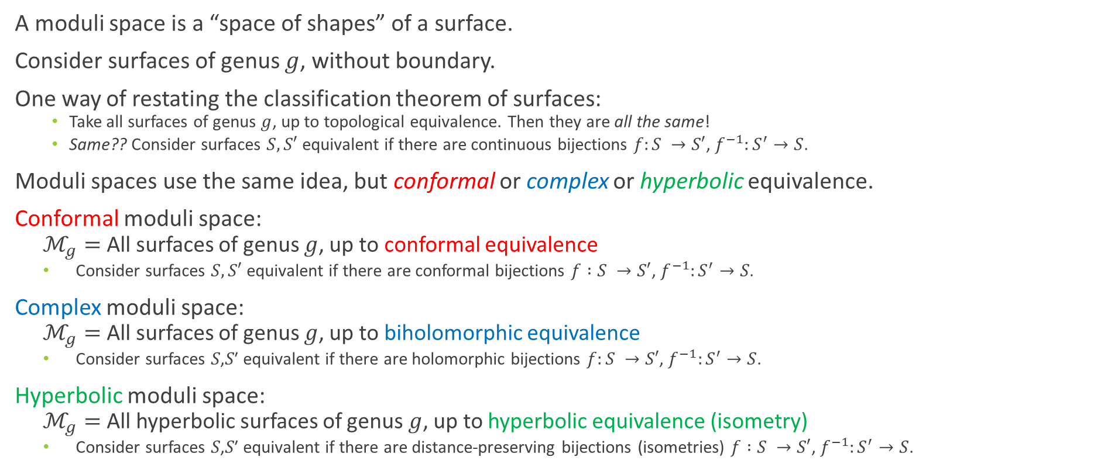
Moduli spaces
A moduli space is a “space of shapes” of a surface.
Consider surfaces of genus $g$, without boundary.
One way of restating the classification theorem of surfaces:
    Take all surfaces of genus $g$, up to topological equivalence. Then they are all the same!
    Same?? Consider surfaces $S,S′$ equivalent if there are continuous bijections $f:S →S′$, $f^{−1}:S^{′}→S$.
Moduli spaces use the same idea, but conformal or complex or hyperbolic equivalence.
Conformal moduli space:
  $ℳ_{g}=$All surfaces of genus $g$, up to conformal equivalence
  Consider surfaces $S,S′$ equivalent if there are conformal bijections $f :S →S′$, $f^{−1}:S^{′}→S$.
Complex moduli space:
  $ℳ_{g}=$All surfaces of genus $g$, up to biholomorphic equivalence
  Consider surfaces 𝑆,𝑆′ equivalent if there are holomorphic bijections $f:S →S′$, $f^{−1}:S^{′}→S$.
Hyperbolic moduli space:
  $ℳ_{g}=$All hyperbolic surfaces of genus $g$, up to hyperbolic equivalence (isometry)
  Consider surfaces 𝑆,𝑆′ equivalent if there are distance-preserving bijections (isometries) $f :S →S′$, $f^{−1}:S^{′}→S$.
All the same thing!
(More or less…)

Slide 20
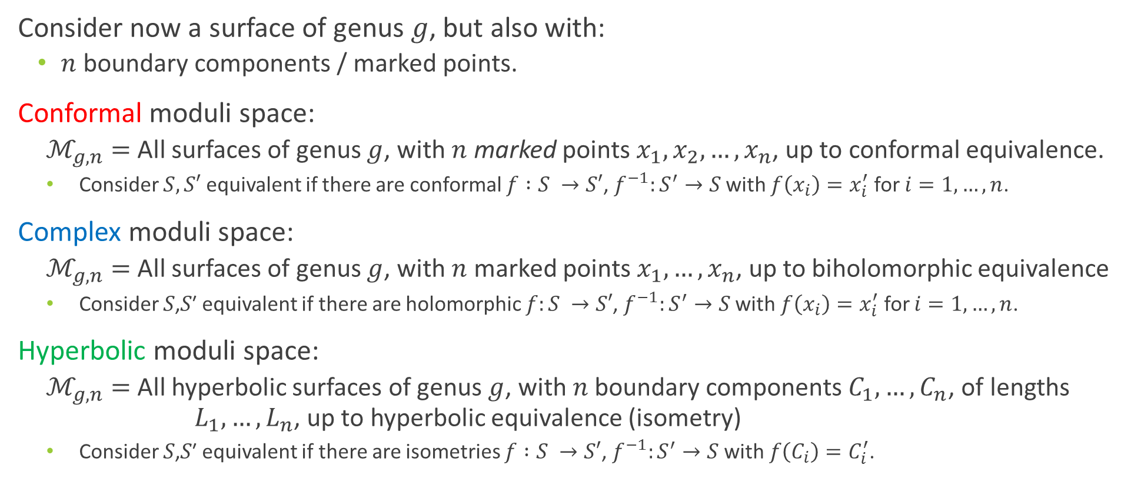
Moduli spaces – now with boundary!
Consider now a surface of genus $g$, but also with:
  $n$ boundary components / marked points.
Conformal moduli space:
  $ℳ_{g,n}=$All surfaces of genus $g$, with $n$ marked points $x_{1},x_{2},…, x_{n}$, up to conformal equivalence.
  Consider $S,S′$ equivalent if there are conformal $f :S →S′$, $f^{−1}:S^{′}→S$ with $f\left(x_{i}\right)=x_{i}^{′}$ for $i=1,…,n$.
Complex moduli space:
  $ℳ_{g,n}=$All surfaces of genus $g$, with $n$ marked points $x_{1},…, x_{n}$, up to biholomorphic equivalence
  Consider 𝑆,𝑆′ equivalent if there are holomorphic $f:S →S′$, $f^{−1}:S^{′}→S$ with $f\left(x_{i}\right)=x_{i}^{′}$ for $i=1, …, n$.
Hyperbolic moduli space:
  $ℳ_{g,n}=$All hyperbolic surfaces of genus $g$, with $n$ boundary components $C_{1},…, C_{n}$, of lengths $L_{1},…, L_{n}$, up to hyperbolic equivalence (isometry)
  Consider 𝑆,𝑆′ equivalent if there are isometries $f :S →S′$, $f^{−1}:S^{′}→S$ with $f\left(C_{i}\right)=C_{i}^{′}$.

Slide 21
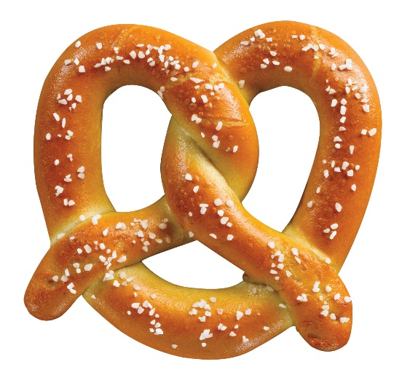
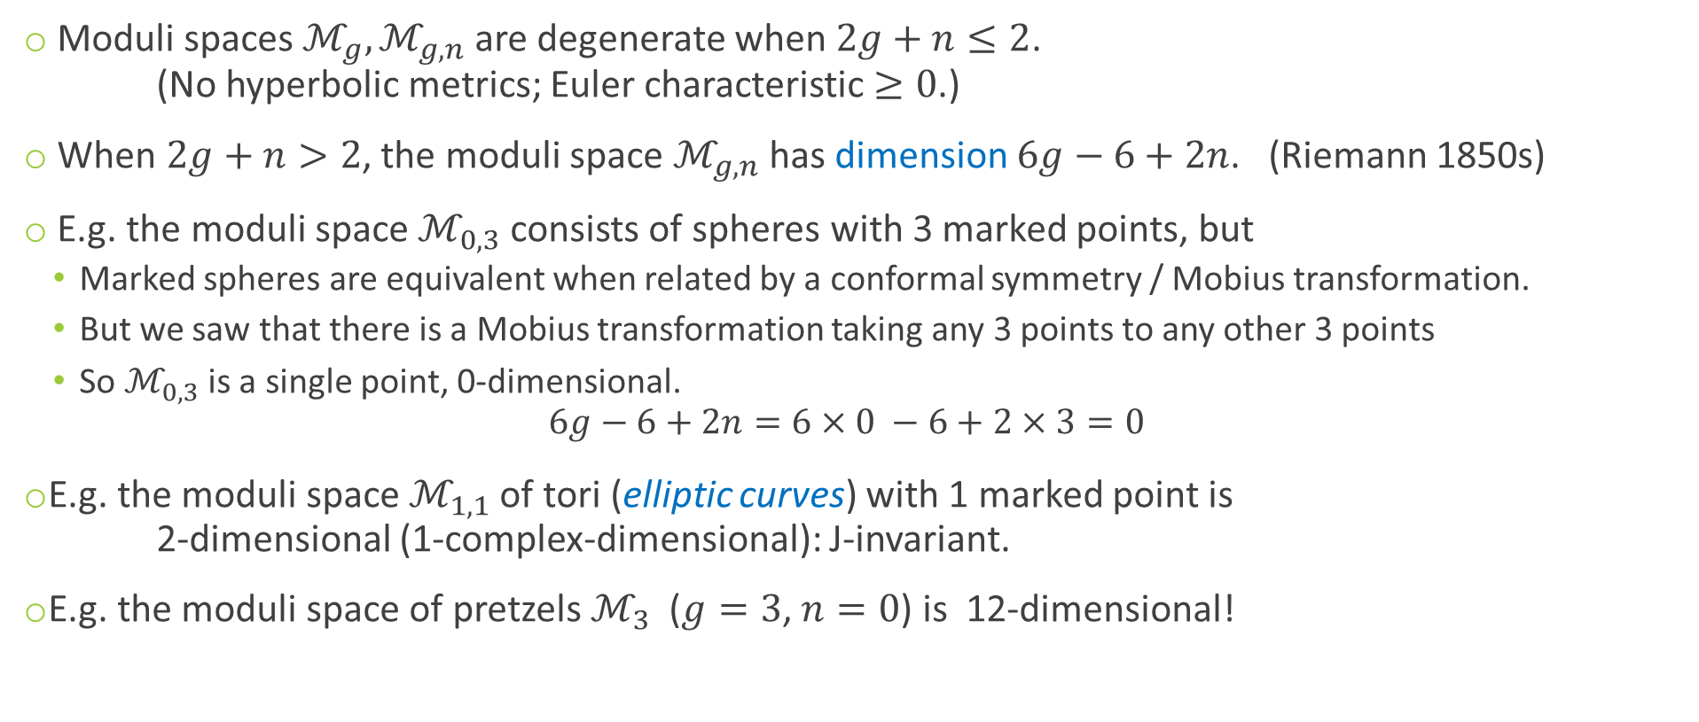
Moduli spaces pre-Mirzakhani
Moduli spaces $ℳ_{g}, ℳ_{g,n}$ are degenerate when $2g+n≤2$.
(No hyperbolic metrics; Euler characteristic $≥0$.)
When $2g+n>2$, the moduli space $ℳ_{g,n}$ has dimension $6g−6+2n$. (Riemann 1850s)
E.g. the moduli space $ℳ_{0,3}$ consists of spheres with 3 marked points, but
  Marked spheres are equivalent when related by a conformal symmetry / Mobius transformation.
  But we saw that there is a Mobius transformation taking any 3 points to any other 3 points
  So $ℳ_{0,3}$ is a single point, 0-dimensional.
  $6g−6+2n=6×0 −6+2×3=0$
E.g. the moduli space $ℳ_{1,1}$ of tori (elliptic curves) with 1 marked point is
2-dimensional (1-complex-dimensional): J-invariant.
E.g. the moduli space of pretzels $ℳ_{3}$ ($g=3$, $n=0$) is 12-dimensional!
Source: foodimentary.com

Slide 22
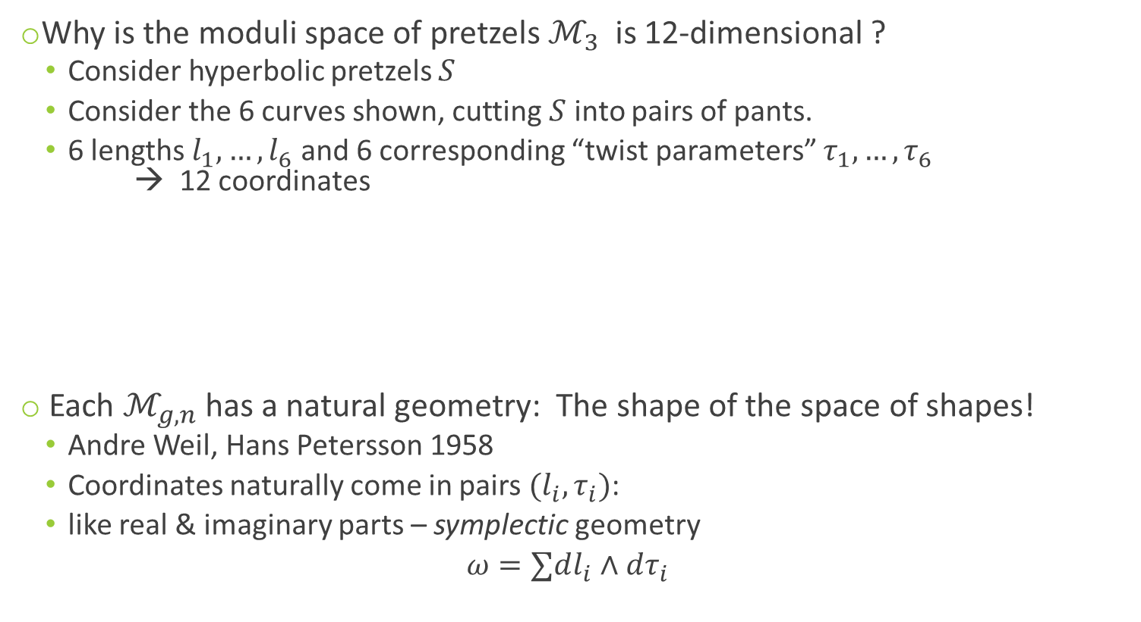
Moduli spaces pre-Mirzakhani
Why is the moduli space of pretzels $ℳ_{3}$ is 12-dimensional ?
  Consider hyperbolic pretzels $S$
  Consider the 6 curves shown, cutting $S$ into pairs of pants.
  6 lengths $l_{1},…, l_{6}$ and 6 corresponding “twist parameters” $τ_{1},…, τ_{6}$
  → 12 coordinates
Each $ℳ_{g,n}$ has a natural geometry: The shape of the space of shapes!
  Andre Weil, Hans Petersson 1958
  Coordinates naturally come in pairs $(l_{i}, τ_{i})$:
  like real & imaginary parts – symplectic geometry
  $$ω=∑dl_{i}∧dτ_{i}$$
Sources: foodimentary.com, lamington.wordpress.com

Slide 23
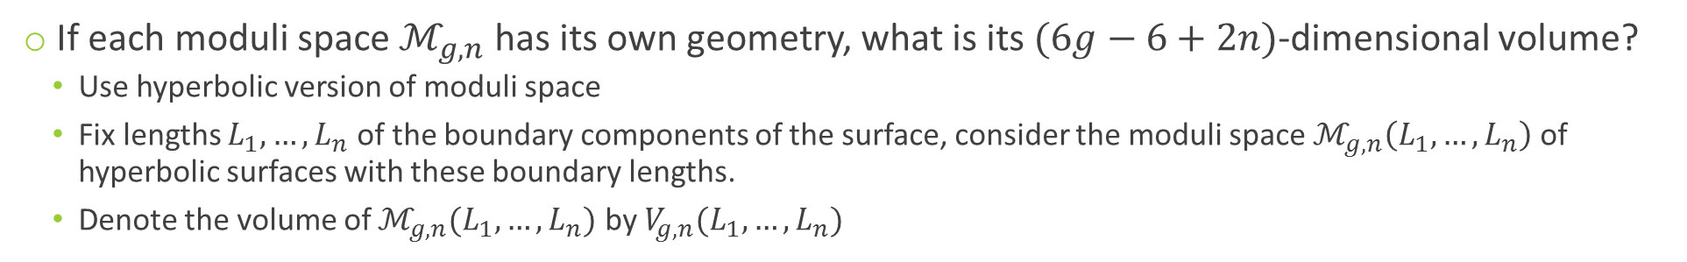
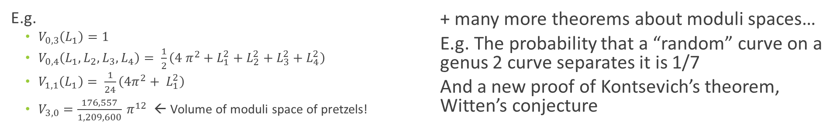
Moduli spaces post-Mirzakhani
If each moduli space $ℳ_{g,n}$ has its own geometry, what is its $(6g−6+2n)$-dimensional volume?
  Use hyperbolic version of moduli space
  Fix lengths $L_{1},…, L_{n}$ of the boundary components of the surface, consider the moduli space $ℳ_{g,n}\left(L_{1},…, L_{n}\right)$ of hyperbolic surfaces with these boundary lengths.
  Denote the volume of $ℳ_{g,n}(L_{1},…, L_{n})$ by $V_{g,n}(L_{1},…, L_{n})$
Theorem (Mirzakhani 2004):
Each $V_{g,n}(L_{1},…, L_{n})$ is a polynomial function of $L_{1},…, L_{n}$.
Moreover, there is a recursive formula to calculate each $V_{g,n}\left(L_{1},…, L_{n}\right)$.
E.g.
  $V_{0,3}\left(L_{1}\right)=1$
  $V_{0,4}\left(L_{1},L_{2},L_{3},L_{4}\right)= \frac{1}{2}\left(4 π^{2}+L_{1}^{2}+L_{2}^{2}+L_{3}^{2}+L_{4}^{2}\right)$
  $V_{1,1}\left(L_{1}\right)= \frac{1}{24}\left(4π^{2}+ L_{1}^{2}\right)$
  $V_{3,0}=\frac{176,557}{1,209,600} π^{12}$ ← Volume of moduli space of pretzels!
  + many more theorems about moduli spaces…
  E.g. The probability that a “random” curve on a genus 2 curve separates it is 1/7
  And a new proof of Kontsevich’s theorem, Witten’s conjecture

Slide 24
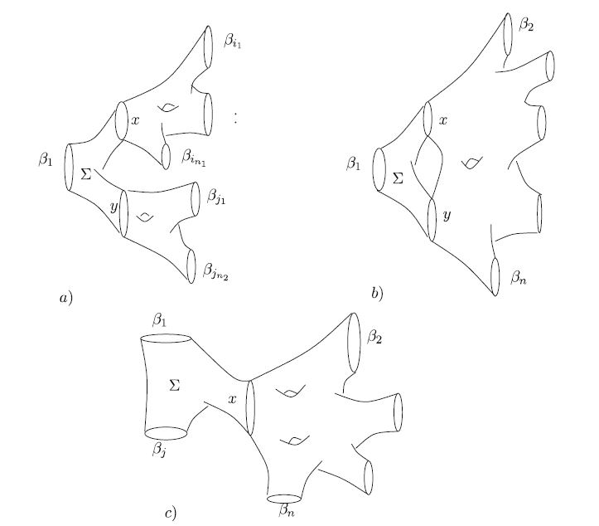
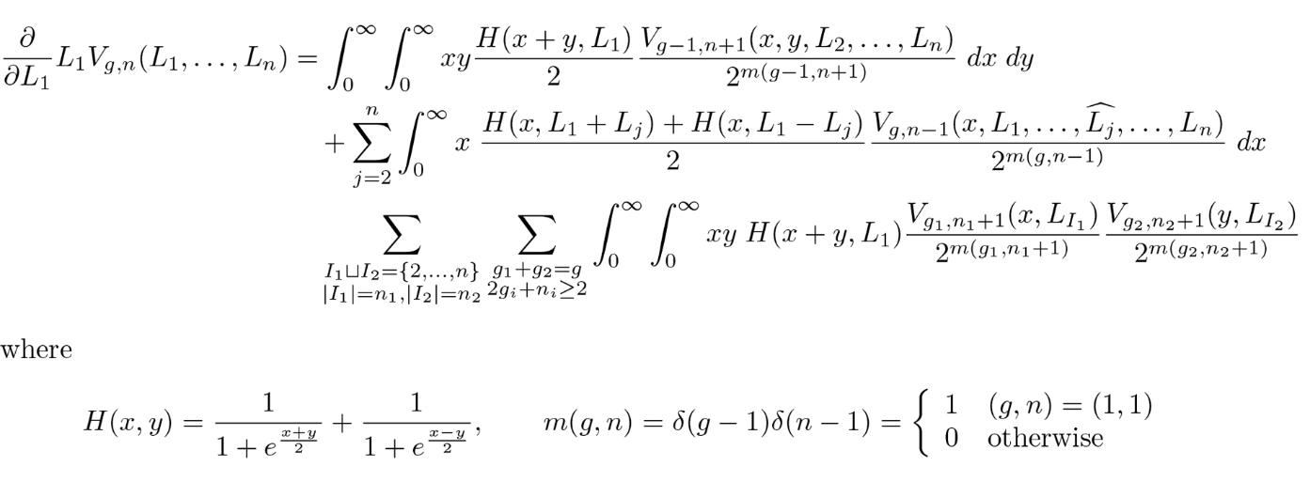
Moduli spaces post-Mirzakhani
Theorem (Mirzakhani 2004):
Each $V_{g,n}(L_{1},…, L_{n})$ is a polynomial function of $L_{1},…, L_{n}$.
Moreover, there is a recursive formula to calculate each $V_{g,n}\left(L_{1},…, L_{n}\right)$.
One key idea: Express $V_{g,n}$ in terms of polynomials for simpler surfaces, such as $V_{g−1,n+1}$, $V_{g,n−1}$.

Slide 25
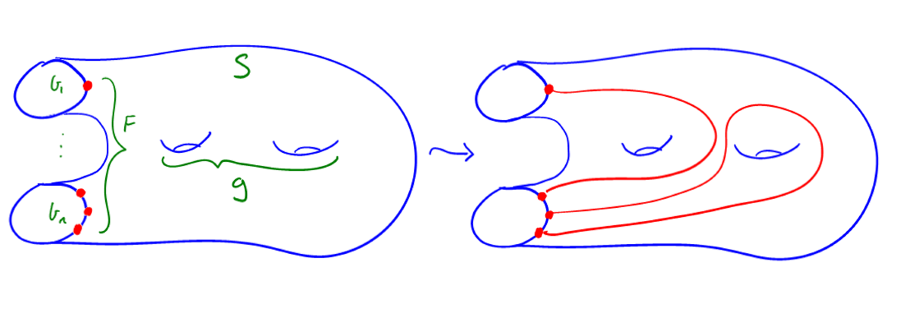
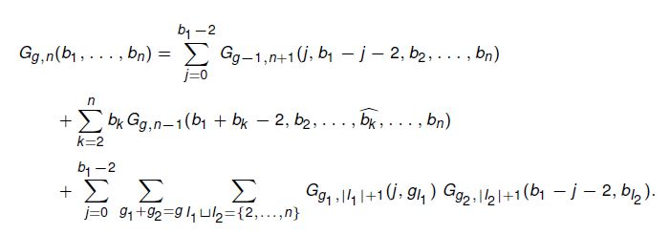
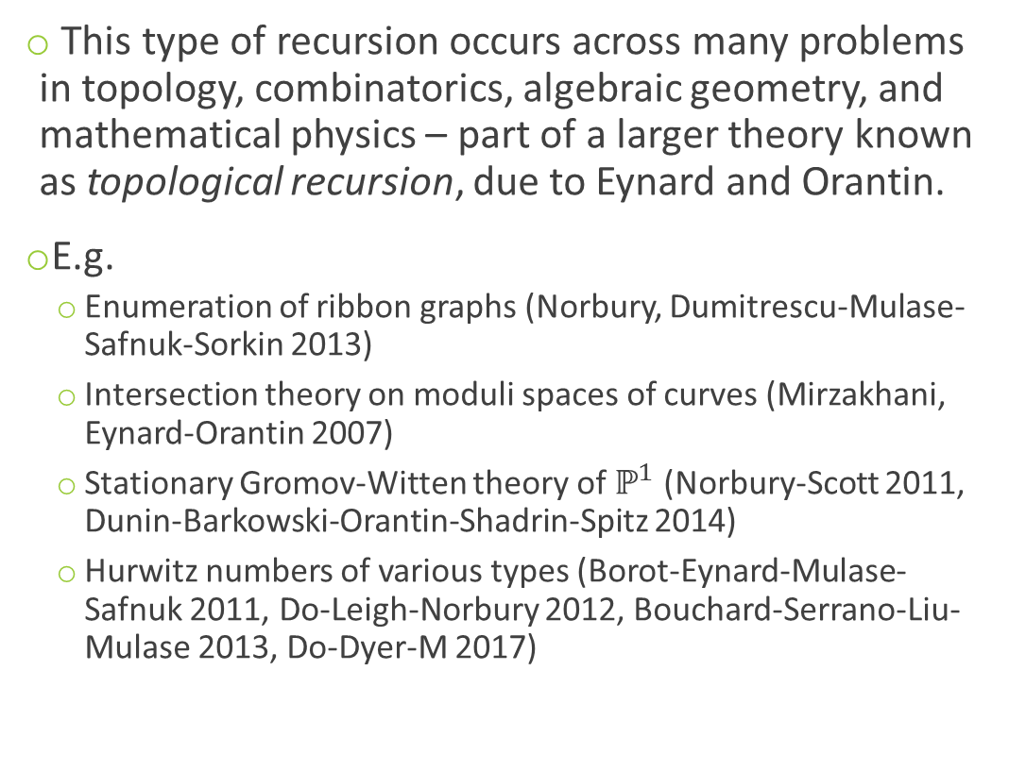

Topological recursion
An elementary example:
Counting Curves on Surfaces (Do-Koyama-M 2017)
Let $G_{g,n}\left(b_{1},…, b_{n}\right)=$# ways to draw curves on a surface of genus $g$, with $b_{1},…, b_{n}$ endpoints on the $n$ boundary components
Then $G_{0,1}\left(2b\right)=\frac{1}{b+1} \left(\begin{aligned}2b \\ b\end{aligned}\right)$ (Catalan numbers) and
This type of recursion occurs across many problems in topology, combinatorics, algebraic geometry, and mathematical physics – part of a larger theory known as topological recursion, due to Eynard and Orantin.
E.g.
  Enumeration of ribbon graphs (Norbury, Dumitrescu-Mulase-Safnuk-Sorkin 2013)
  Intersection theory on moduli spaces of curves (Mirzakhani, Eynard-Orantin 2007)
  Stationary Gromov-Witten theory of $ℙ^{1}$ (Norbury-Scott 2011, Dunin-Barkowski-Orantin-Shadrin-Spitz 2014)
  Hurwitz numbers of various types (Borot-Eynard-Mulase-Safnuk 2011, Do-Leigh-Norbury 2012, Bouchard-Serrano-Liu-Mulase 2013, Do-Dyer-M 2017)

Slide 26



The prime number theorem & geodesics
  How many loops are there on a surface?
  How many “shortest curve” loops, or geodesics, are there on a surface?
  How many geodesics are there on a surface of distance less than $L$?
Just like the prime number theorem!
Theorem:
The number of prime numbers $≤N$ is approximately $\frac{N }{log N}$ as $N→∞$.
Theorem (Delsarte, Huber, Selberg, …, 1940s):
The number of geodesic loops of length $≤L$ is approximately $e^{L}/L$ as $L →∞$.
Theorem (Mirzakhani 2004):
The number of simple geodesic loops of length $≤L$ is approximately $L^{6g−6+2n}$ as $L →∞$.

Slide 27
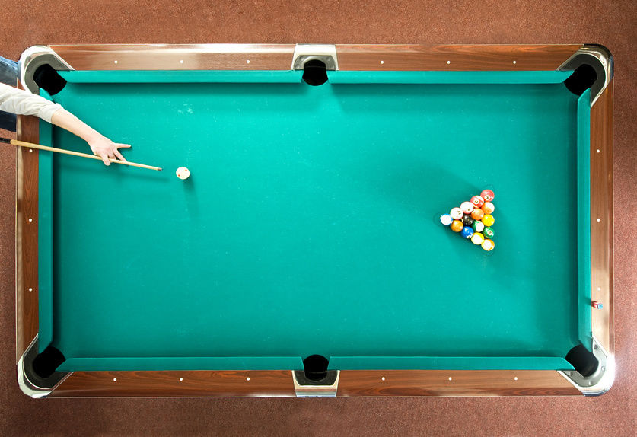
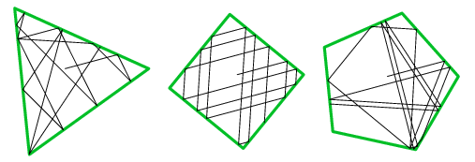
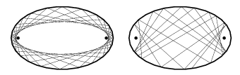
Mathematical billiards
Studies dynamics of billiards balls on billiard tables
No jumping, no spin, no friction
  Balls bounce off walls and continue indefinitely
  But tables can have interesting geometry!
Breakthroughs based on Mirzakhani’s work!
Alex Eskin, Mirzakhani, and Amir Mohammadi (2013) proved a very difficult (“titanic”) theorem about the structure of orbits of certain group actions in certain moduli spaces.
Samuel Lelièvre, Thierry Monteil, and Barak Weiss then used this work to prove a major result in mathematical billiards (2016):
  “Everything is illuminated”
Source: mathworld.wolfram.com

Slide 28
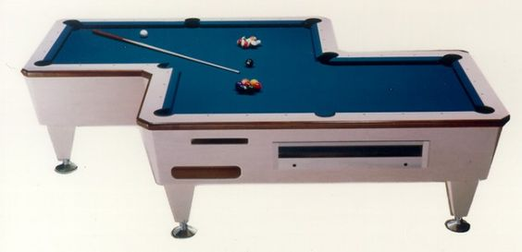
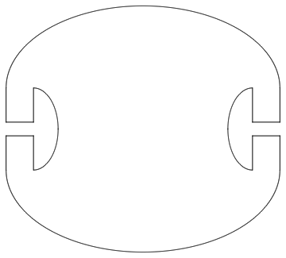
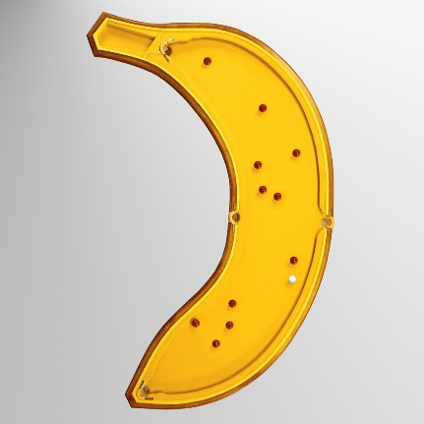
The illumination problem
Problem: Given a billiard table, can you hit a billiard ball from any point to any other point?
(Connected, planar billiard tables!)
Equivalently, given a room with mirrored walls, if you light a candle at one point, does it illuminate the whole room?
On some billiard tables this is easy…
On some it is a little harder…
Yes!
The Penrose unilluminable room.
L & R Penrose, New Scientist Christmas puzzles 1958:
  Can you design a billiard table where
  you can’t hit a ball from any point to any other?
Source: mathworld.wolfram.com; carlopool.com; thegreenhead.com

Slide 29
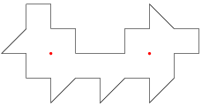
The illumination problem
But the question remains:
  Given a polygonal billiard table, can you hit a billiard ball
  from any point to any other point?
George Tokarsky (1995): There is a polygonal room
with two points that don’t illuminate each other!
But the question still remains:
  Given a polygonal billiard table, can you hit a billiard ball
  from any point to almost any other point?
YES! … sort of
Theorem (Lelièvre-Monteil-Weiss 2016, applying results of Eskin-Mirzakhani-Mohammadi 2015-16):
Let $P$ be a polygonal billiard table with all angles rational multiples of $π$.
Then for all $x∈P$, you can hit a billiard ball from $x$ to every point of $P$, except for possibly finitely many exceptions.

Slide 30

Thanks for listening!
“I don't think that everyone should become a mathematician, but I do believe that many students don't give mathematics a real chance. I did poorly in math for a couple of years in middle school; I was just not interested in thinking about it. I can see that without being excited mathematics can look pointless and cold. The beauty of mathematics only shows itself to more patient followers.”
– Maryam Mirzakhani, 2014

