Slide 1
“I liked doing what I wasn’t supposed to do’’
The life and mathematics of Karen Uhlenbeck
Daniel Mathews, September 2019

Slide 2
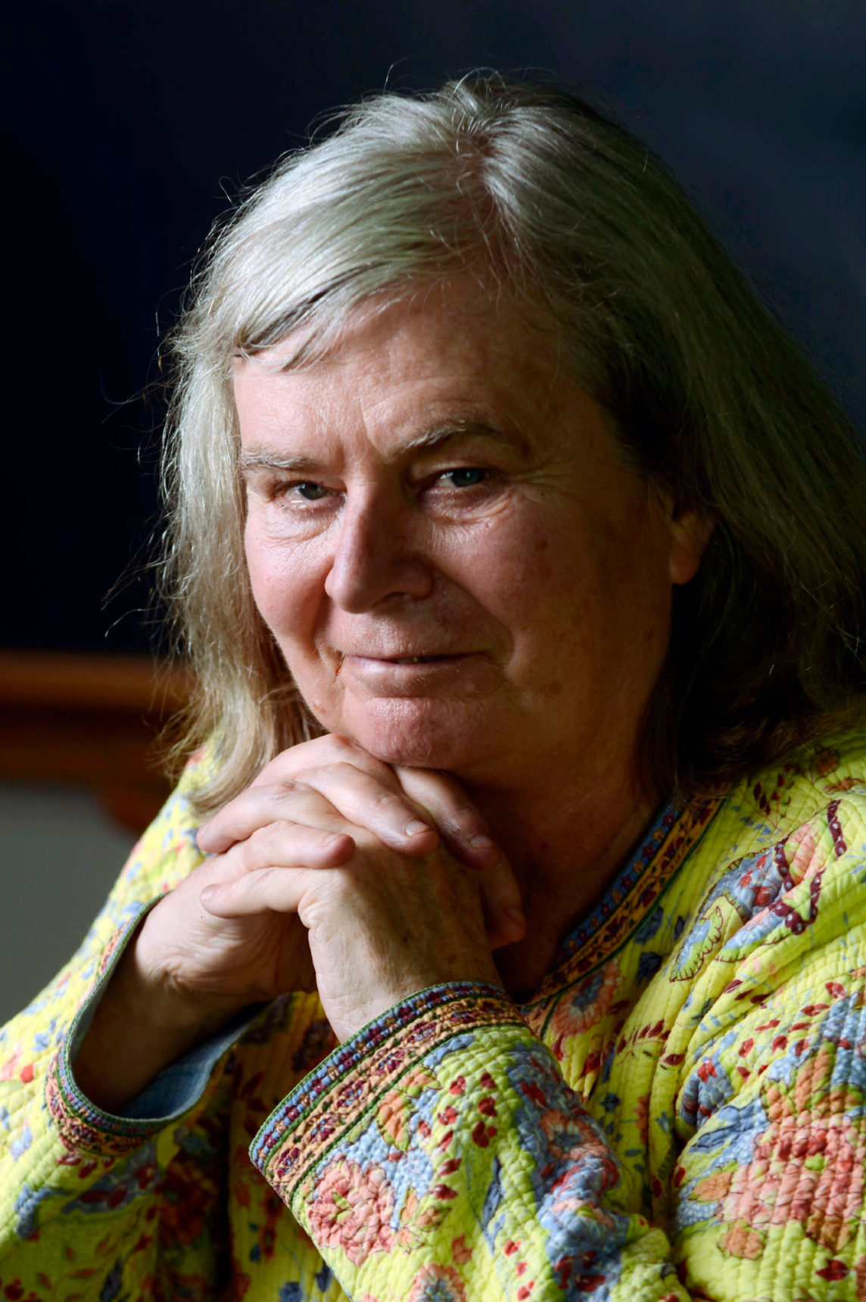
Very brief biography
1942: Born Karen Keskulla, Cleveland
1964: BA University of Michigan
1965: Started graduate studies at NYU
1966: Re-started at Brandeis U
1968: PhD thesis “The Calculus of Variations and Global Analysis” under Richard Palais
1969-70: Temporary, MIT, UC Berkeley
1971: Faculty position at UIUC
1976: University of Illinois at Chicago
1981: Published with Jonathan Sacks "The existence of minimal immersions of 2-spheres"
1983: Moved to U Chicago
MacArthur Fellow
1985: Fellow of AAAS
1986: Member of National Academy of Sciences
1988: U Texas at Austin
1990: Plenary speaker at ICM
1991: Co-founded Park City Mathematics Institute & Women and Mathematics Program at IAS Princeton.
2001: Guggenheim fellow
2019: Abel Prize

Slide 3

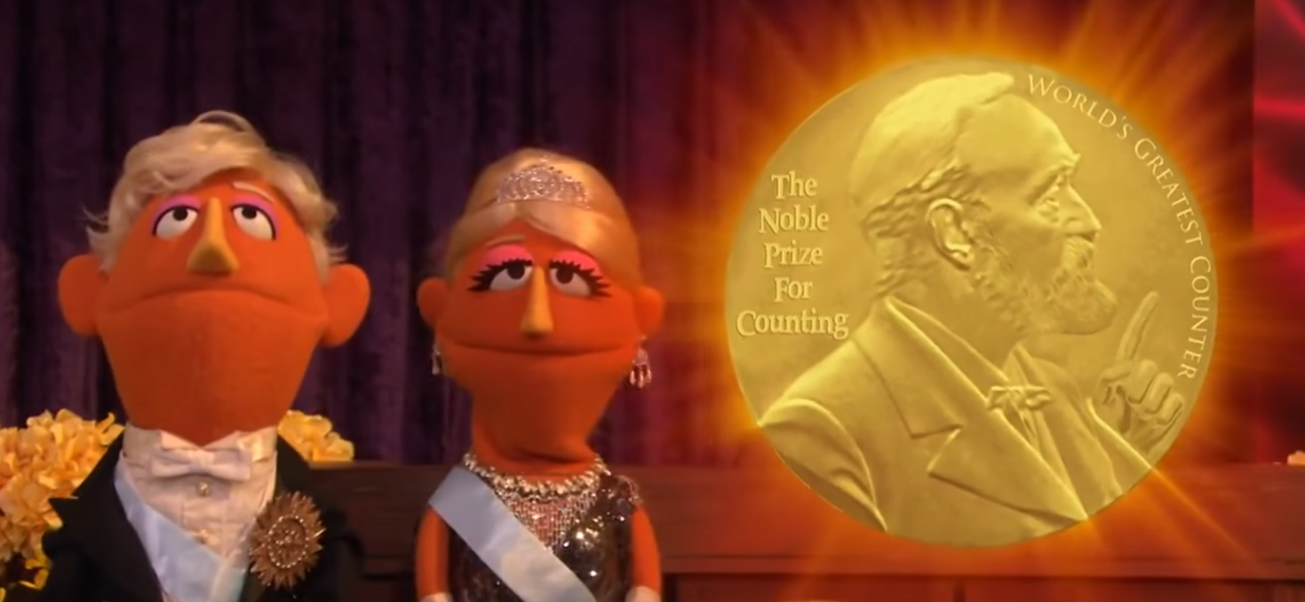
A maths Nobel

Slide 4

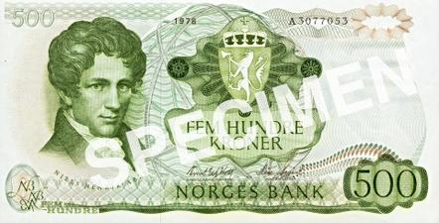
A maths Nobel
“The Abel Prize recognizes contributions to the field of mathematics that are of extraordinary depth and influence.”
Awarded annually by the King of Norway to one or more outstanding mathematicians.
Niels Henrik Abel (1802-1829): Norwegian mathematician who pioneered variety of fields.
  First complete proof of the impossibility of solving quantic equations in general
  Elliptic functions, Abelian functions, Abelian groups…
“Nobel Prize in mathematics”
  Proposed by Sophus Lie in 1899 upon learning Nobel prizes would not include mathematics.
  Established in 2001 by Norwegian government “to give the mathematicians their own
  equivalent of a Nobel Prize”.
Karen Uhlenbeck: first woman to win the prize, 2019.

Slide 5
Abel prize citation
“Karen Keskulla Uhlenbeck is a founder of modern Geometric Analysis. Her perspective has permeated the field and led to some of the most dramatic advances in mathematics in the last 40 years.
Geometric analysis is a field of mathematics where techniques of analysis and differential equations are interwoven with the study of geometrical and topological problems. … Uhlenbeck’s major contributions include foundational results on minimal surfaces and harmonic maps, Yang-Mills theory, and integrable systems.
Minimal surfaces and bubbling analysis
… two foundational papers on minimising harmonic maps. They gave a profound understanding of singularities of solutions of non-linear elliptic partial differential equations. …
The methods used in these revolutionary papers are now in the standard toolbox of every geometer and analyst. They have been applied with great success in many other partial differential equations and geometric contexts.
Gauge theory and Yang-Mills equations …
Integrable systems and harmonic mappings …
Karen Uhlenbeck’s pioneering results have had fundamental impact on contemporary analysis, geometry and mathematical physics, and her ideas and leadership have transformed the mathematical landscape as a whole.”

Slide 6
Abel prize citation
“Karen Keskulla Uhlenbeck is a founder of modern Geometric Analysis. Her perspective has permeated the field and led to some of the most dramatic advances in mathematics in the last 40 years.
Geometric analysis is a field of mathematics where techniques of analysis and differential equations are interwoven with the study of geometrical and topological problems. … Uhlenbeck’s major contributions include foundational results on minimal surfaces and harmonic maps, Yang-Mills theory, and integrable systems.
Minimal surfaces and bubbling analysis
… two foundational papers on minimising harmonic maps. They gave a profound understanding of singularities of solutions of non-linear elliptic partial differential equations. …
The methods used in these revolutionary papers are now in the standard toolbox of every geometer and analyst. They have been applied with great success in many other partial differential equations and geometric contexts.
Gauge theory and Yang-Mills equations …
Integrable systems and harmonic mappings …
Karen Uhlenbeck’s pioneering results have had fundamental impact on contemporary analysis, geometry and mathematical physics, and her ideas and leadership have transformed the mathematical landscape as a whole.”

Slide 7
Abel prize citation
“Karen Keskulla Uhlenbeck is a founder of modern Geometric Analysis. Her perspective has permeated the field and led to some of the most dramatic advances in mathematics in the last 40 years.
Geometric analysis is a field of mathematics where techniques of analysis and differential equations are interwoven with the study of geometrical and topological problems. … Uhlenbeck’s major contributions include foundational results on minimal surfaces and harmonic maps, Yang-Mills theory, and integrable systems.
Minimal surfaces and bubbling analysis
… two foundational papers on minimising harmonic maps. They gave a profound understanding of singularities of solutions of non-linear elliptic partial differential equations. …
The methods used in these revolutionary papers are now in the standard toolbox of every geometer and analyst. They have been applied with great success in many other partial differential equations and geometric contexts.
Gauge theory and Yang-Mills equations …
Integrable systems and harmonic mappings …
Karen Uhlenbeck’s pioneering results have had fundamental impact on contemporary analysis, geometry and mathematical physics, and her ideas and leadership have transformed the mathematical landscape as a whole.”

Slide 8
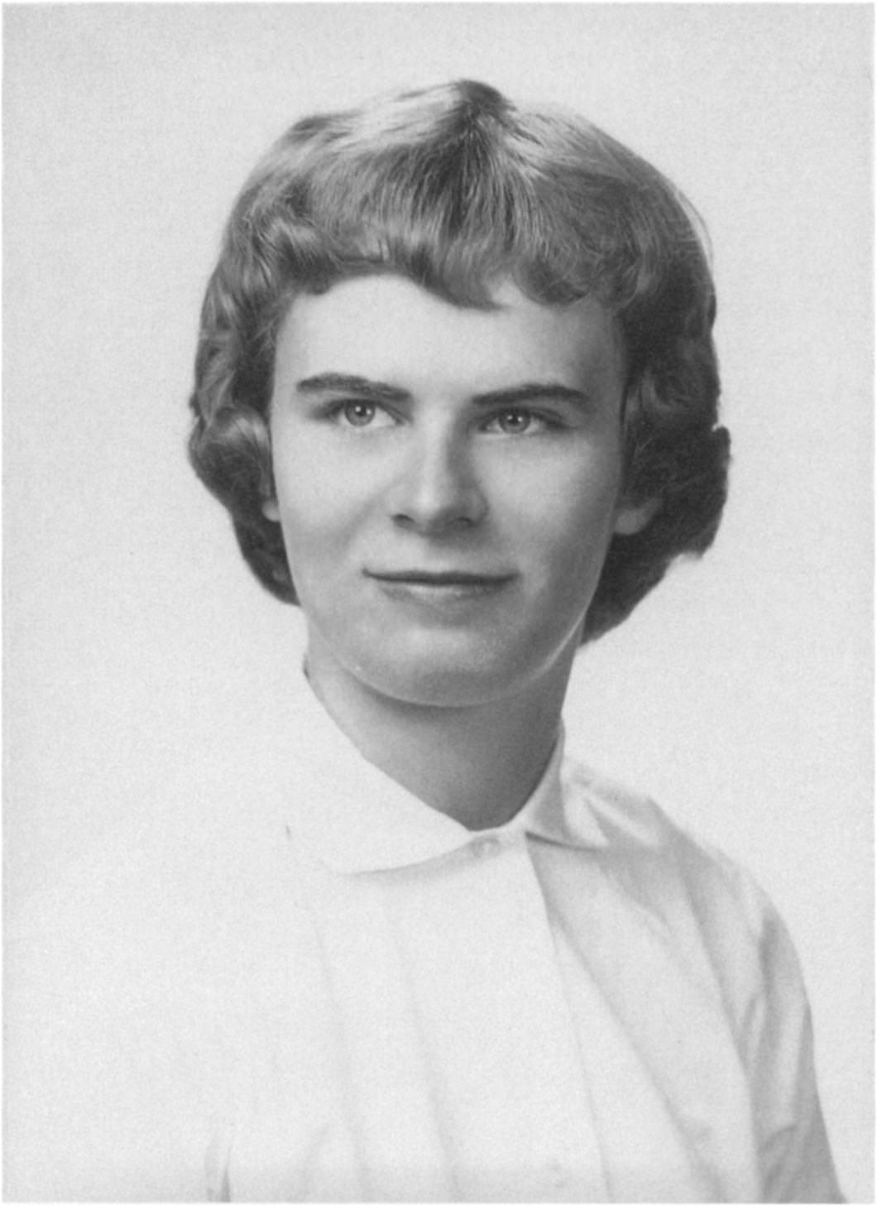
Early years
“I was very much a tomboy. The boy down the street and I played football and baseball for the better part of my life, right through high school. It was not a very respectable thing to do.”
“As a child I read a lot. I read everything, including all the books in our house three times over. I’d go to the library and then stay up all night reading. I used to read under the desk in school. My whole family were and still are avid readers; we lived in the country so there wasn’t a whole lot else to do. I was particularly interested in reading about science. I was about twelve years old when my father began bringing home Fred Hoyle’s books on astrophysics. I found them very inspiring. I also remember a little paperback book called One, Two, Three, Infinity by George Gamow, and I remember the excitement of understanding this very sophisticated argument that there were two different kinds of infinities. I read all of the books on science in the local library and was frustrated when there was nothing left to read.”
“I did not feel like I was supposed to do anything interesting except date boys. That was what girls did.”
Source: Celebratio Mathematica

Slide 9
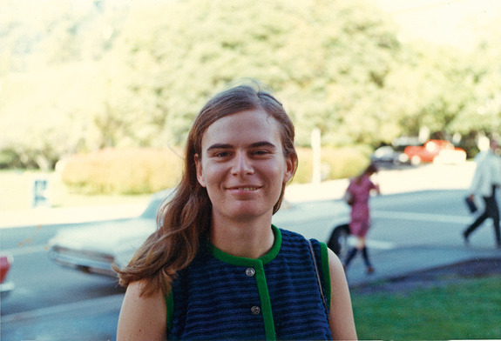
College and PhD
“I learned about mathematics in my freshman honors course at the University of Michigan. I still remember the thrill of taking limits to compute derivatives, and the little boxes used in proving the Heine–Borel theorem. The structure, elegance and beauty of mathematics struck me immediately, and I lost my heart to it. “
"The main thing that turned me away from physics was just not having good experience in the lab. And a lot of that had to do with the fact that you had a lab partner... I actually dropped my physics major the time when I was going to a lecture in which they took attendance, and I was absolutely offended by this.“
Moving to Boston, Uhlenbeck applied to Brandeis, avoiding Harvard and MIT:
“It was self-preservation, not lack of confidence. I was pretty sharp, without being conscious of it, of how difficult things were for professional women. (I knew all about being socially awkward!) At the time, I may have thought that if I were brilliant enough, I would succeed at Harvard. Now I do not believe that — I believe the social pressures of surviving in an environment that would question every move would have done any woman in, unless she were particularly interested in the combat. I knew I was not interested in the battle of proving social things, so I (wisely in retrospect) avoided it.”
Source: ias.edu/George M. Bergman/Archives of the Mathematisches Forschungsinstitut Oberwolfach

Slide 10
Why mathematics?
“I can’t say that I was really interested in mathematics as a child or adolescent, mostly because one doesn’t really understand what mathematics is until at least halfway through college.”
“I was taking a course… teaching like R. L. Moore. In this class I had an “aha” moment when I realized I could do what was in the books. I didn’t have to learn it, so to speak — I could create it myself. Those kinds of courses are tremendously valuable, for probably all kinds of students, because they make you realize that you can think your way through something.”
“If you obey the rules, you could do almost anything you wanted.”
"I was either going to become a forest ranger or do some sort of research in science. That’s what interested me. I did not want to teach. I regarded anything to do with people as being sort of a horrible profession. … I felt that I didn’t get along with people very well.“
“I have always known that I was a really good mathematician. I have a natural bent for abstraction and I love ideas of all sorts. I value time to be by myself and think, about math or other things, it doesn’t matter. The noise of the world is a difficult thing for me to deal with. I have always had a hard time handling external stimuli.”

Slide 11
Navigating a male space
“I was one of the people who benefited from Sputnik. There was a handful of women in my graduate program, although I was not close friends with any of them. It was evident that you wouldn’t get ahead in mathematics if you hung around with women.
We were told that we couldn’t do math because we were women. If anything, there was a tendency to not be friendly with other women. There was blatant, overt discouragement, but also subtle encouragement. A lot of people appreciated good students, male or female, and I was a very good student.
I liked doing what I wasn’t supposed to do, it was a sort of legitimate rebellion. There were no expectations because we were women, so anything we did well was considered successful.”

Slide 12
Doing mathematics
“I was hard to understand. I still am hard to understand. I was not socialized.”
“You choose to do your own thing [in mathematics], and what you do is very private and personal, and three other people in the world may understand that.”
“I find that I am bored with anything I understand. My excuse is that I am too poor an expositor to want to spend time on formal matters.”
“there’s really no way to get into communication with modern physics without just sitting through a lot of it so that it stops sounding like garbage. You can’t logically work your way through this nonsense. You just sit through enough and suddenly what they’re saying seems logical and starts fitting together. It’s a different language.”
“I also work a lot with inequalities. I don’t name each term in an inequality with a word, but I think of them somehow as individuals. After you work at it a while, they are very personal. They are your good friends.”
“As a young academic I worked by myself a lot. In fact, that was one of the attractions of mathematics… I wanted a career where I didn’t have to work with other people. … As my career advanced, however, I found I had a lot to learn from other people of all sorts.”

Slide 13
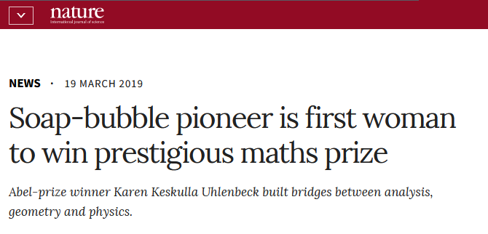
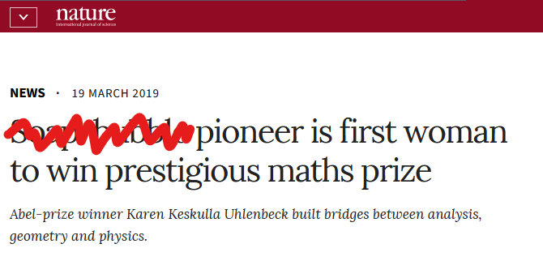

A tiny part of Uhlenbeck’s mathematics
Disclaimers / preliminary considerations
  No trivialising analogies
  Hard functional analysis!
    Sequences of functions
    Enormous spaces of functions
  No assumed knowledge beyond high school
  No epsilons!
  Approximate truth by varyingly apt analogies, vagaries, oversimplifications, and occasional white lies.
Goal: To convey roughly the gist of the philosophy of some ideas in one influential paper, and ramifications.
$$ε$$

Slide 14
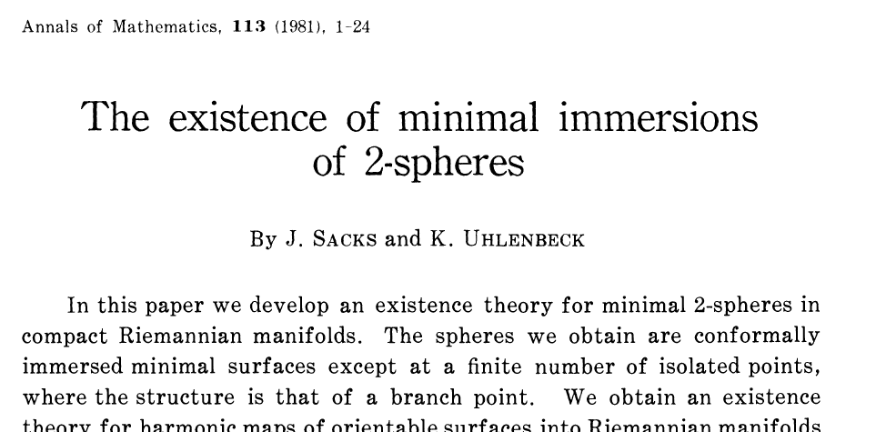
One influential paper

Slide 15
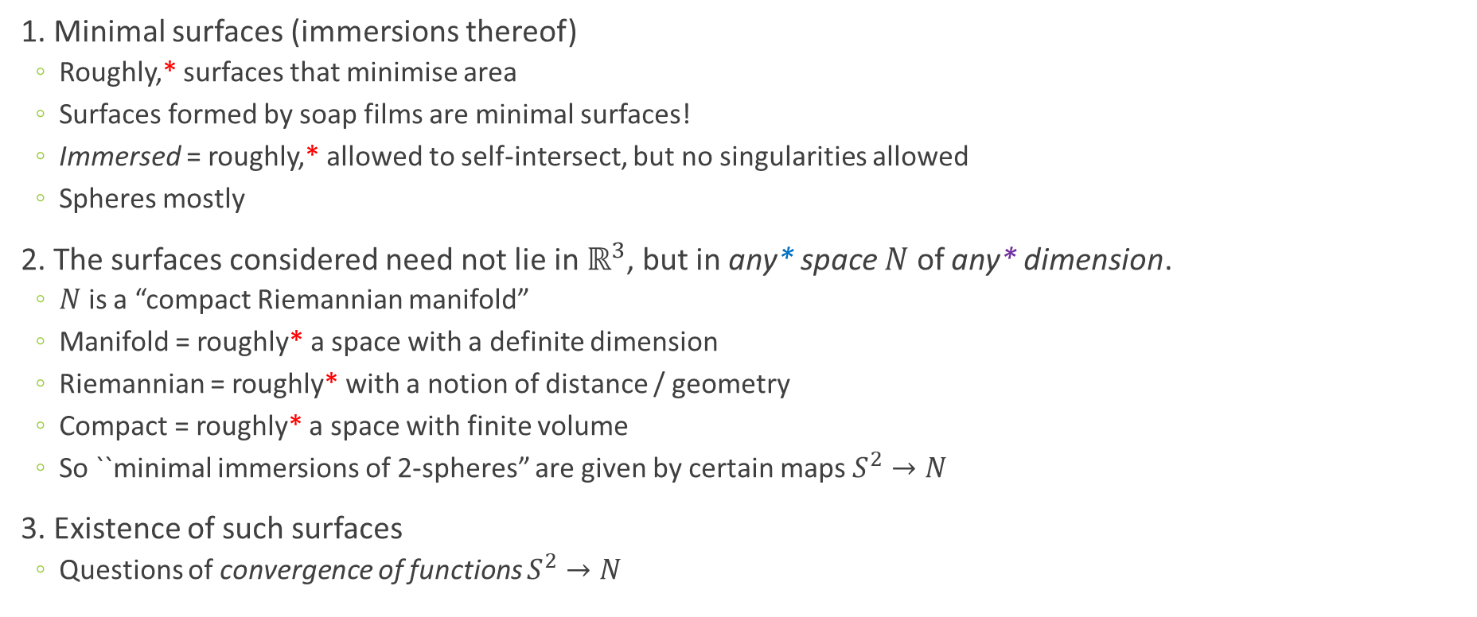
Three important notions
1. Minimal surfaces (immersions thereof)
  Roughly,* surfaces that minimise area
  Surfaces formed by soap films are minimal surfaces!
  Immersed = roughly,* allowed to self-intersect, but no singularities allowed
  Spheres mostly
2. The surfaces considered need not lie in $ℝ^{3}$, but in any* space $N$ of any* dimension.
  $N$ is a “compact Riemannian manifold”
  Manifold = roughly* a space with a definite dimension
  Riemannian = roughly* with a notion of distance / geometry
  Compact = roughly* a space with finite volume
  So ``minimal immersions of 2-spheres” are given by certain maps $S^{2}→N$
3. Existence of such surfaces
  Questions of convergence of functions $S^{2}→N$
* very roughly, as in, not
* not actually any
* well, any finite dimension

Slide 16
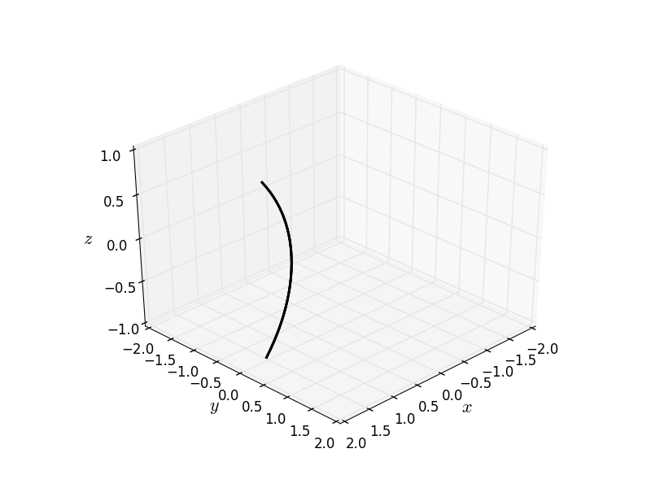
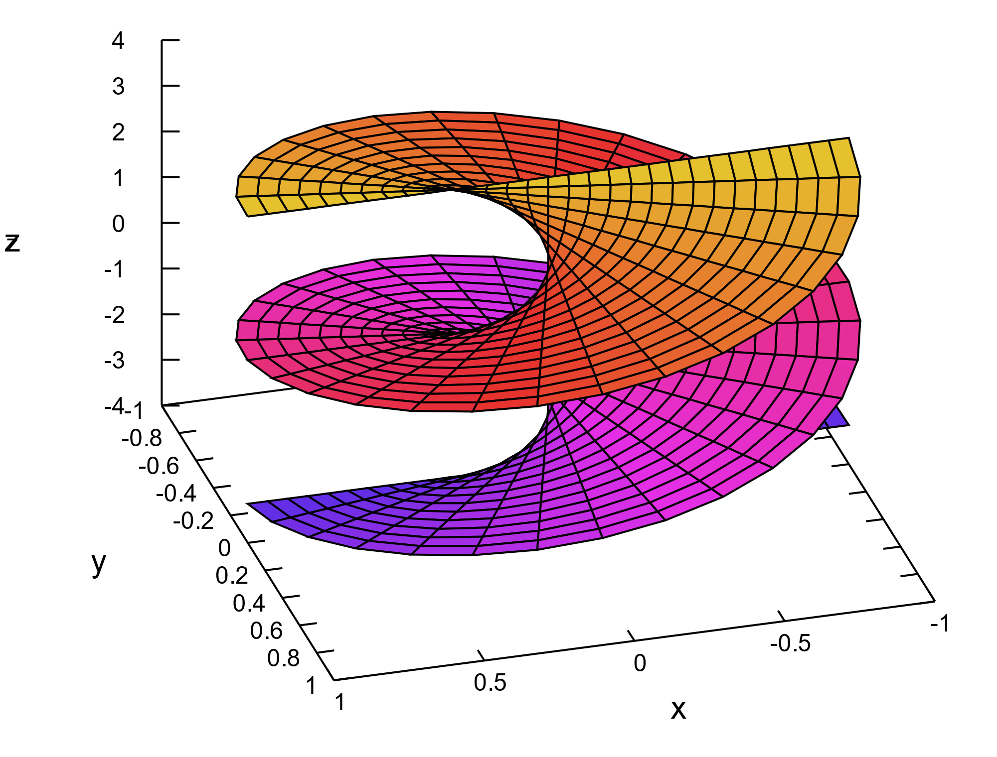
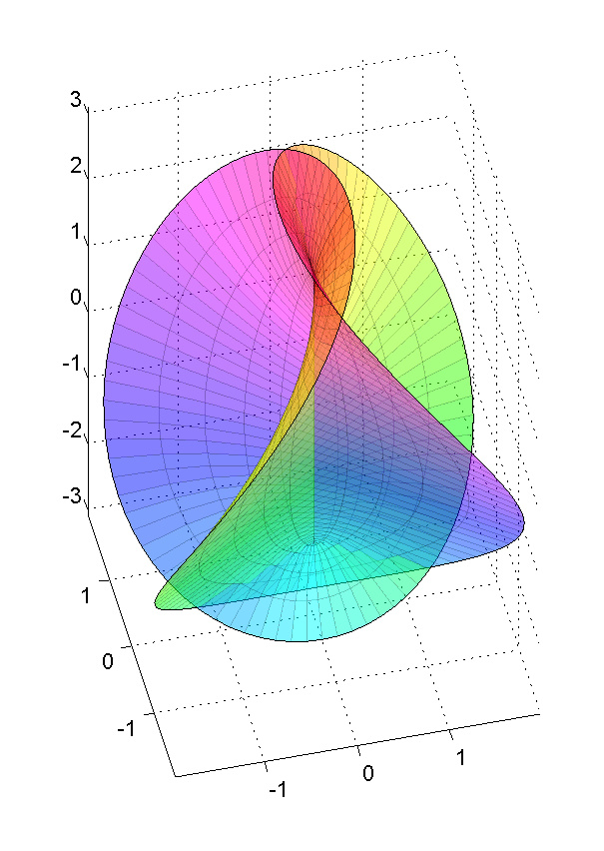
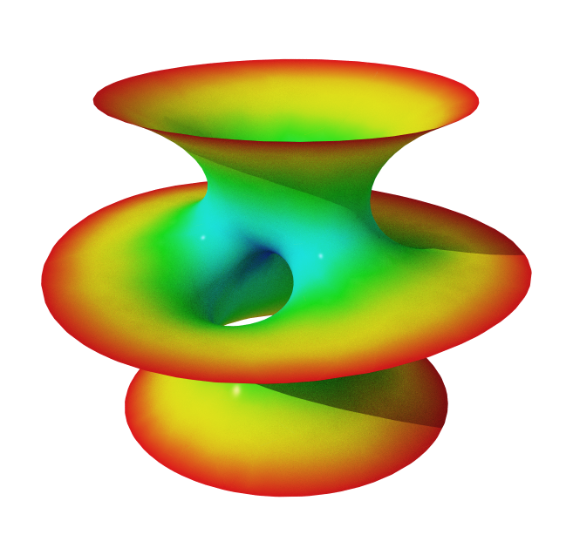
Minimal surfaces
A minimal surface is a surface that locally minimises its area.
Soap bubbles form minimal surfaces!
  Catenoid (Euler 1744)
  Helicoid (Euler 1774)
  Hennenberg surface (Hennenberg 1875) (immersed)
  Costa’s minimal surface (Costa 1981)
Sources: Catenoid, Helicoid – Wikipedia/Krishnavedala CC BY-SA 3.0
catenoid animation – Wikipedia/Nicoguaro CC BY 4.0
Hennenberg, Costa – Wikipedia/Anders Sandberg CC BY-SA 3.0.

Slide 17
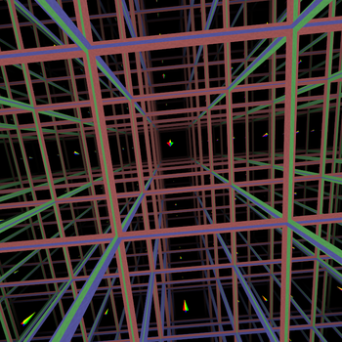
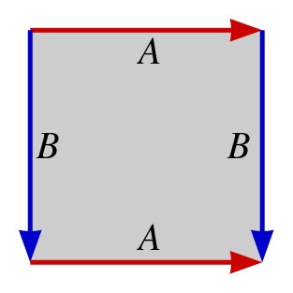
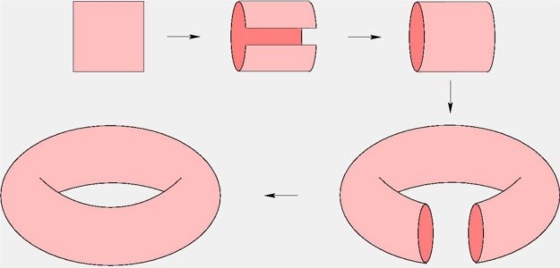
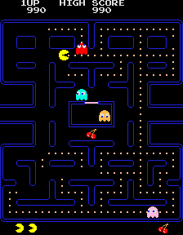
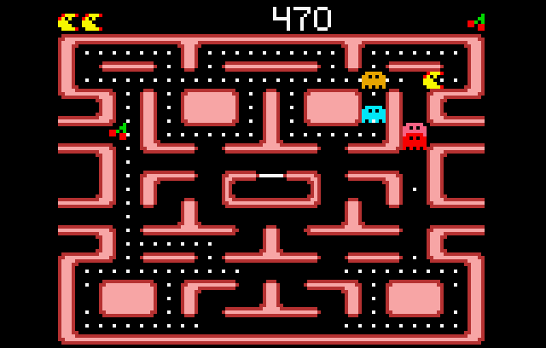

What do general spaces look like?
Minimal surfaces in a space (“compact Riemannian manifold”) $N$, but what can such spaces look like?
Some examples in 3D with nice geometry:
The 3-torus, by analogy with the 2-torus

Slide 18
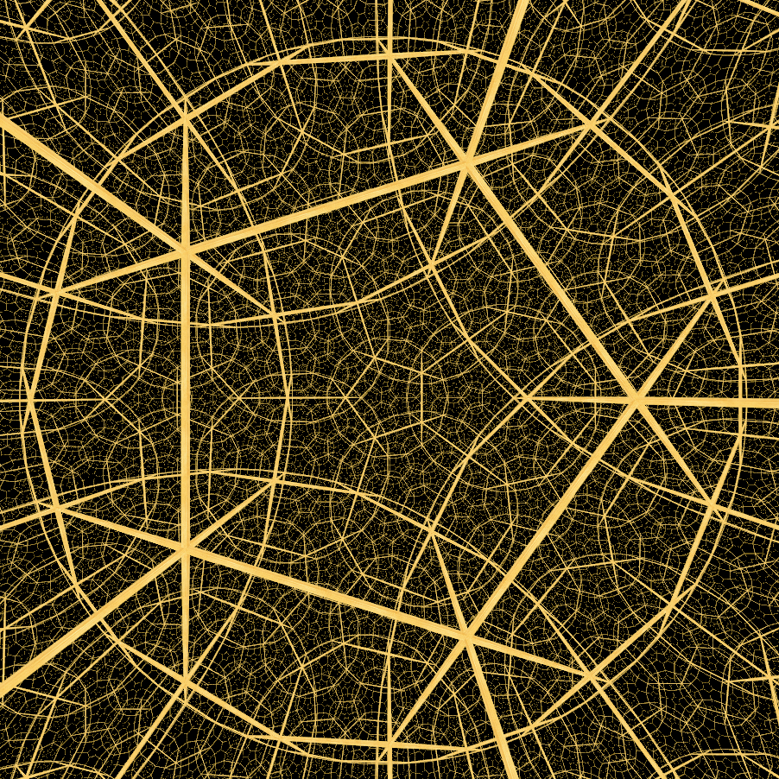
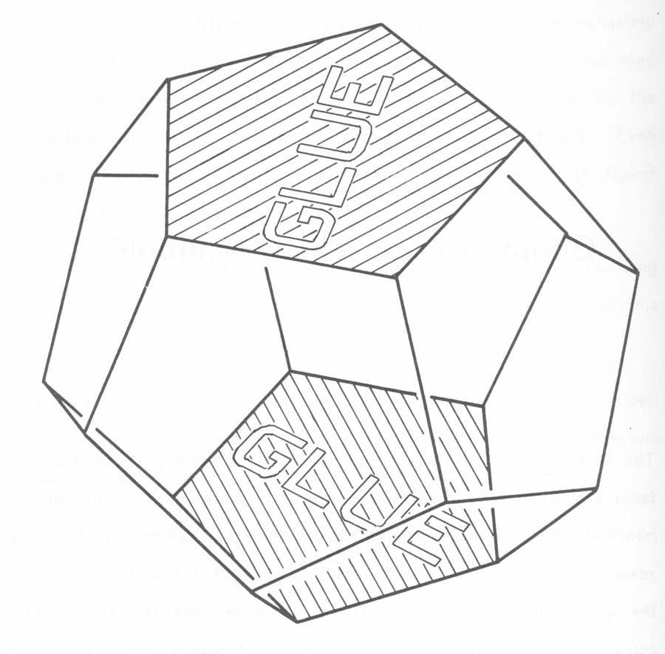
What do general spaces look like?
Seifert-Weber dodecahedral space
Has hyperbolic geometry!
Similarly, starting from any* polyhedron and identifying faces in pairs,* any* 3-dimensional space can be constructed.
The examples drawn here have nice geometry – always exists in 3 dimensions (geometrization theorem) – but Uhlenbeck’s work applies to any number of dimensions and any metric/geometry.
* not actually any
* conditions apply
* well, any compact one

Slide 19
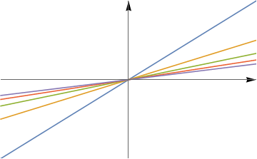
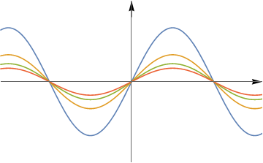

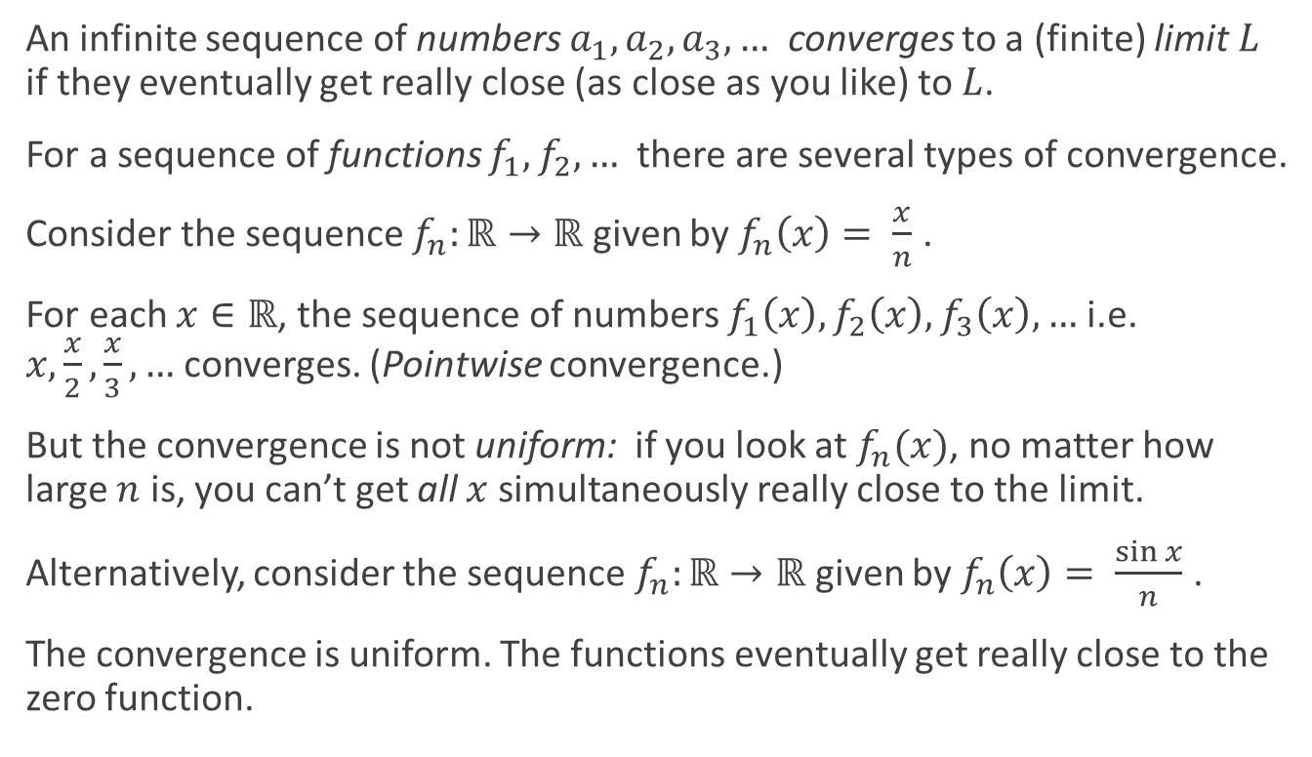
Convergence of functions
$$ε$$
An infinite sequence of numbers $a_{1},a_{2},a_{3},…$ converges to a (finite) limit $L$ if they eventually get really close (as close as you like) to $L$.
For a sequence of functions $f_{1},f_{2},…$ there are several types of convergence.
Consider the sequence $f_{n}:ℝ→ℝ$ given by $f_{n}\left(x\right)= \frac{x}{n}$ .
For each $x∈ℝ$, the sequence of numbers $f_{1}\left(x\right), f_{2}\left(x\right), f_{3}\left(x\right), …$ i.e. $x,\frac{x}{2},\frac{x}{3},…$ converges. (Pointwise convergence.)
But the convergence is not uniform: if you look at $f_{n}(x)$, no matter how large $n$ is, you can’t get all $x$ simultaneously really close to the limit.
Alternatively, consider the sequence $f_{n}:ℝ→ℝ$ given by $f_{n}\left(x\right)= \frac{\sin{x}}{n}$ .
The convergence is uniform. The functions eventually get really close to the zero function.

Slide 20


When must sequences converge?
Do we expect a randomly chosen sequence of real numbers $a_{1},a_{2},…$ to converge?
Do we expect a randomly chosen sequence of real numbers $a_{1},a_{2},…$ such that all $\left|a_{n}\right|<6$ to converge?
Bolzano-Weierstrass theorem (1817): any sequence $a_{n}$ of reals which is bounded (e.g. by 6) has a convergent subsequence.
$$ε$$

Slide 21

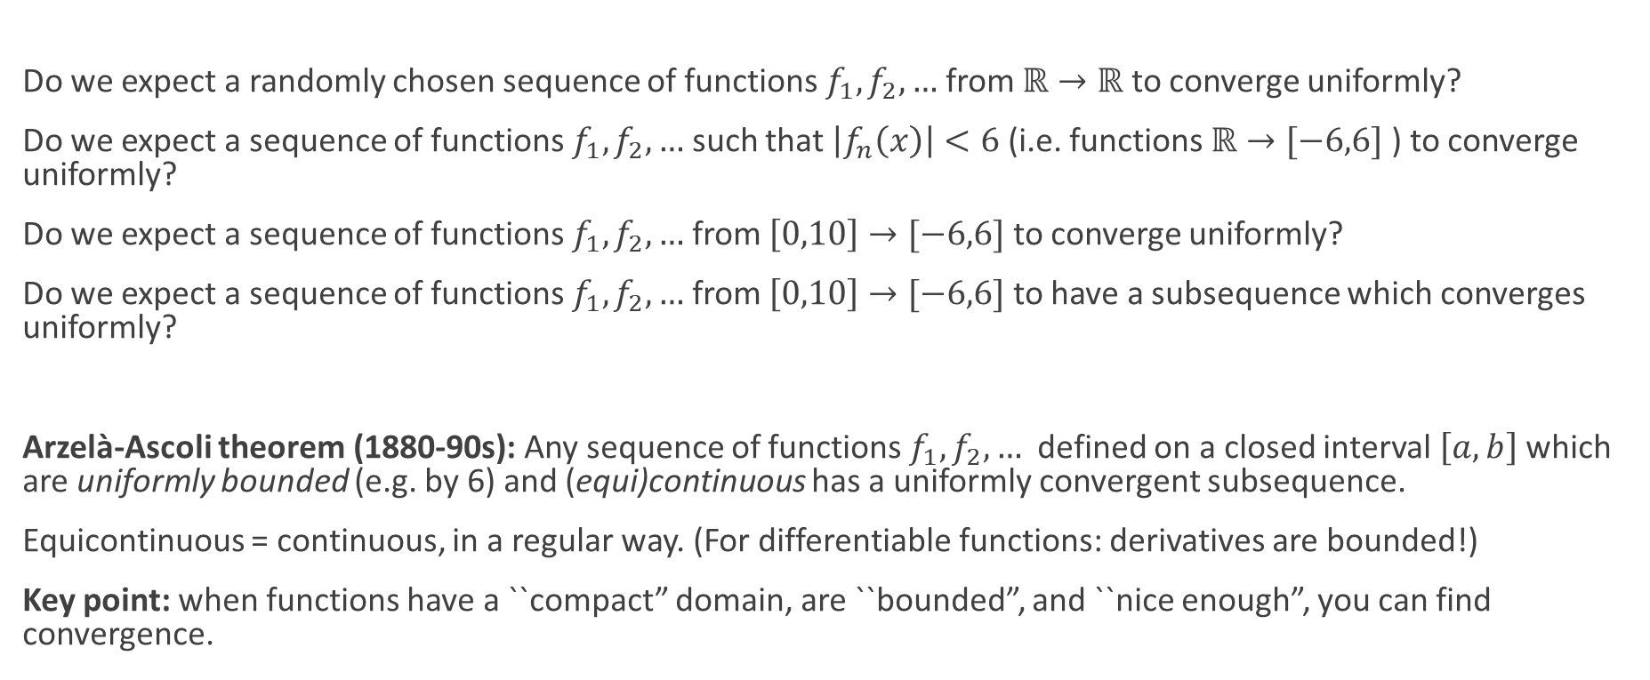
When must sequences converge?
$$ε$$
Do we expect a randomly chosen sequence of functions $f_{1},f_{2},…$ from $ℝ→ℝ$ to converge uniformly?
Do we expect a sequence of functions $f_{1},f_{2},…$ such that $\left|f_{n}\left(x\right)\right|<6$ (i.e. functions $ℝ→[−6,6]$ ) to converge uniformly?
Do we expect a sequence of functions $f_{1},f_{2},…$ from $\left[0,10\right]→[−6,6]$ to converge uniformly?
Do we expect a sequence of functions $f_{1},f_{2},…$ from $\left[0,10\right]→[−6,6]$ to have a subsequence which converges uniformly?
Arzelà-Ascoli theorem (1880-90s): Any sequence of functions $f_{1},f_{2},…$ defined on a closed interval $\left[a,b\right]$ which are uniformly bounded (e.g. by 6) and (equi)continuous has a uniformly convergent subsequence.
Equicontinuous = continuous, in a regular way. (For differentiable functions: derivatives are bounded!)
Key point: when functions have a ``compact” domain, are ``bounded”, and ``nice enough”, you can find convergence.

Slide 22
Uhlenbeck’s approach to minimal surfaces
Does any similar convergence behaviour apply to minimal surfaces?
Apply Arzelà-Ascoli to minimal surfaces?
  Arzela-Ascoli works for higher dimensions in domain and co-domain
  BUT the theorem only refers to continuity
  Nothing about derivatives, let alone minimising area etc.
Sacks & Uhlenbeck use high technology (and have to invent some new technology):
  functional analysis
  calculus of variations
  differential geometry
  harmonic functions
Sacks & Uhlenbeck consider minimal surfaces as critical points of a function on a massively infinitely-dimensional space of functions.
  To see how, first consider minimal curves

Slide 23
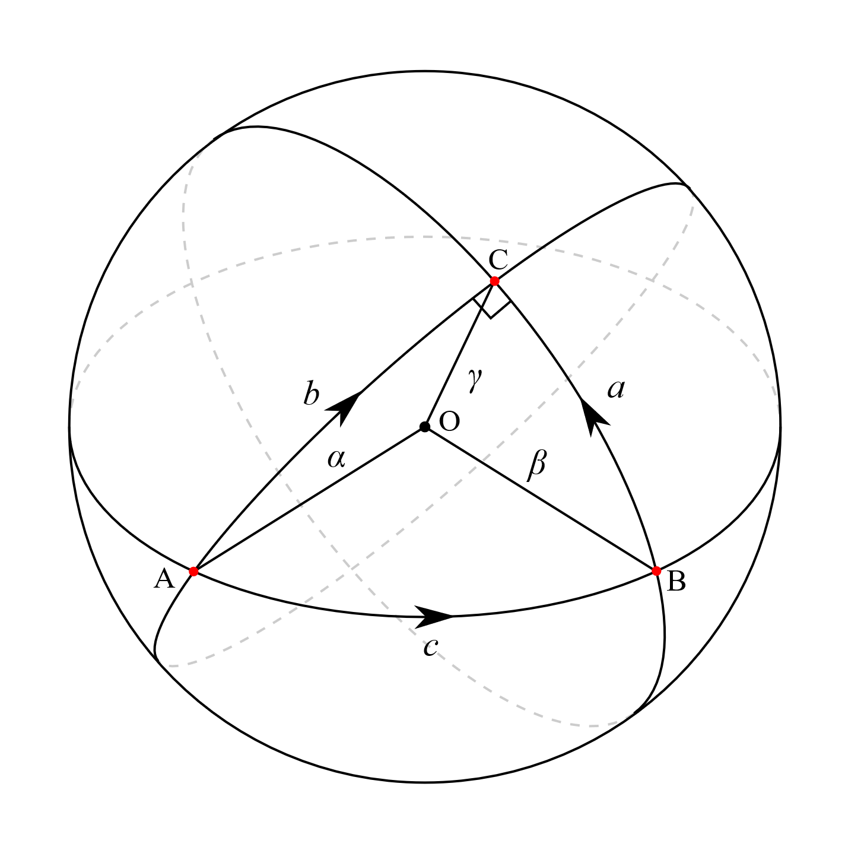
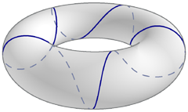

Minimal curves: Geodesics
Geodesics are curves which are locally distance-minimising.
Consider a (curved) surface $S$ and two points $p,q$ on it.
A shortest curve on $S$ from $p$ to $q$ is an example of a geodesic.
On a sphere, the geodesics are precisely the great circles.
Source: Wikipedia/Pbroks13/StanneredRt66lt; Enrique Soriano on grasshopper3d.com

Slide 24
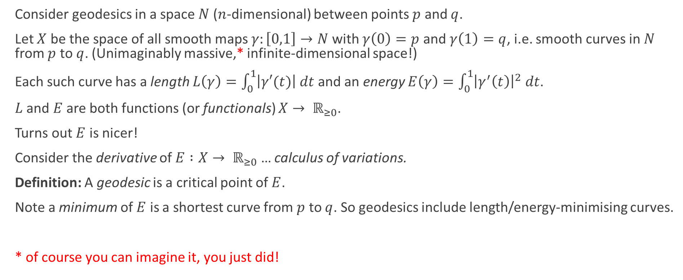
Geodesics as critical points
Consider geodesics in a space $N$ ($n$-dimensional) between points $p$ and $q$.
Let $X$ be the space of all smooth maps $γ:\left[0,1\right]→N$with $γ\left(0\right)=p$ and $γ\left(1\right)=q$, i.e. smooth curves in $N$ from $p$ to $q$. (Unimaginably massive,* infinite-dimensional space!)
Each such curve has a length $L\left(γ\right)=\int_{0}^{1}{\left|γ′(t)\right| dt}$and an energy $E\left(γ\right)=\int_{0}^{1}{{\left|γ^{′}\left(t\right)\right|}^{2} dt}$.
$L$ and $E$ are both functions (or functionals) $X→ ℝ_{≥0}$.
Turns out $E$ is nicer!
Consider the derivative of $E :X→ ℝ_{≥0}$ … calculus of variations.
Definition: A geodesic is a critical point of $E$.
Note a minimum of $E$ is a shortest curve from $p$ to $q$. So geodesics include length/energy-minimising curves.
* of course you can imagine it, you just did!

Slide 25
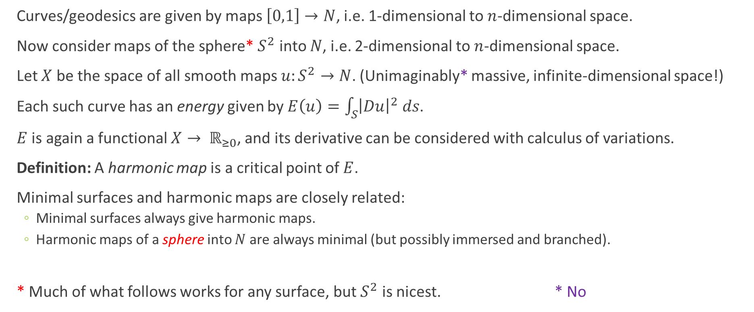
Surfaces as critical points: harmonic maps
Curves/geodesics are given by maps $\left[0,1\right]→N$, i.e. 1-dimensional to $n$-dimensional space.
Now consider maps of the sphere* $S^{2}$ into $N$, i.e. 2-dimensional to $n$-dimensional space.
Let $X$ be the space of all smooth maps $u:S^{2}→N$. (Unimaginably* massive, infinite-dimensional space!)
Each such curve has an energy given by $E\left(u\right)=\int_{S}{{\left|Du\right|}^{2} ds}$.
$E$ is again a functional $X→ ℝ_{≥0}$, and its derivative can be considered with calculus of variations.
Definition: A harmonic map is a critical point of $E$.
Minimal surfaces and harmonic maps are closely related:
  Minimal surfaces always give harmonic maps.
  Harmonic maps of a sphere into $N$ are always minimal (but possibly immersed and branched).
* Much of what follows works for any surface, but $S^{2}$ is nicest. * No

Slide 26

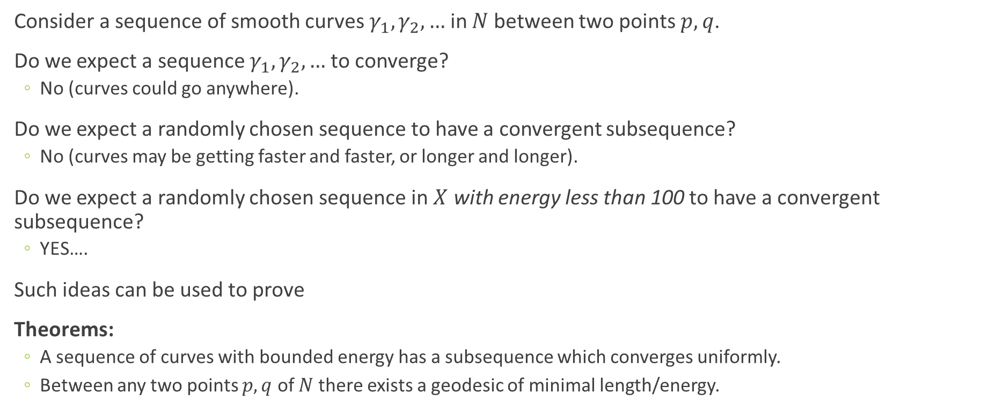
Convergence of curves
$$ε$$
Consider a sequence of smooth curves $γ_{1},γ_{2},…$ in $N$ between two points $p,q$.
Do we expect a sequence $γ_{1},γ_{2},…$ to converge?
  No (curves could go anywhere).
Do we expect a randomly chosen sequence to have a convergent subsequence?
  No (curves may be getting faster and faster, or longer and longer).
Do we expect a randomly chosen sequence in $X$ with energy less than 100 to have a convergent subsequence?
  YES….
Such ideas can be used to prove
Theorems:
  A sequence of curves with bounded energy has a subsequence which converges uniformly.
  Between any two points $p,q$ of $N$ there exists a geodesic of minimal length/energy.

Slide 27
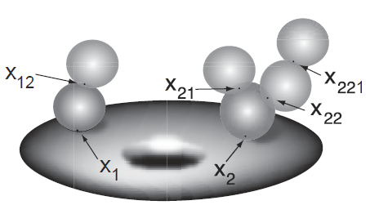
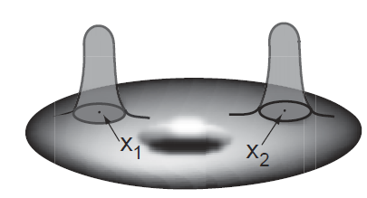
Convergence of surfaces: bubbling
For surfaces, it’s not as simple: a sequence of surfaces with bounded energy may behave badly.
Sacks and Uhlenbeck figured out just how bad this behaviour may be:
It’s now called bubbling.
We’ll try to illustrate an example of sphere bubbling.
Source: T Parker, “What is… a Bubble Tree?”

Slide 28
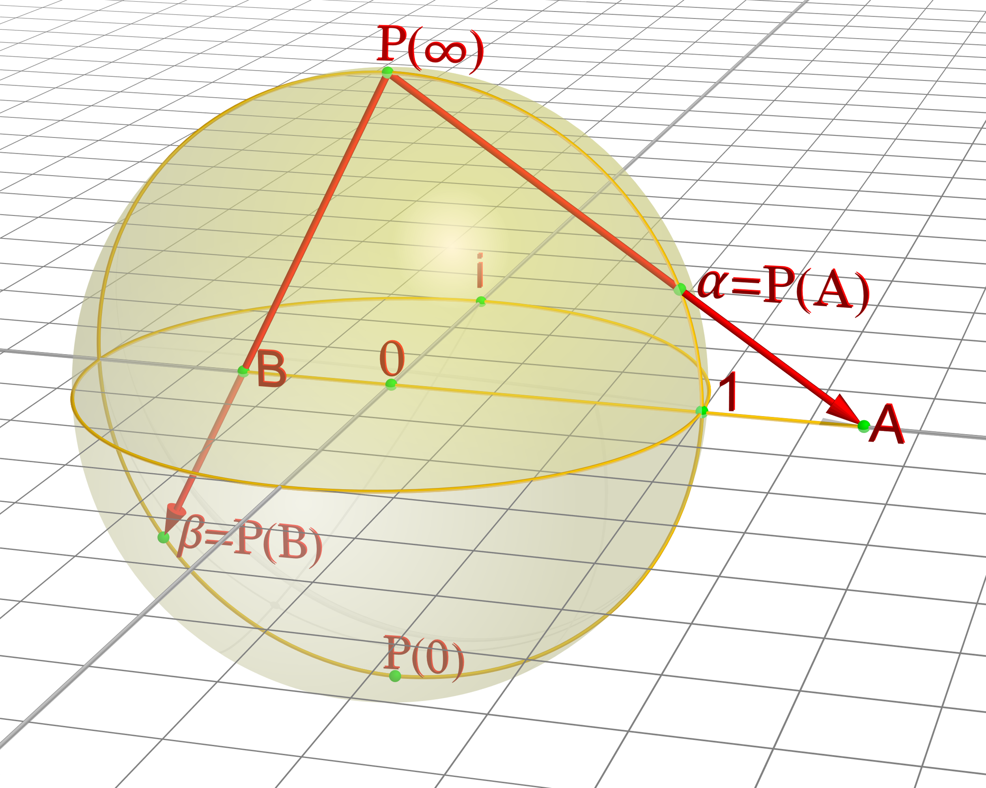
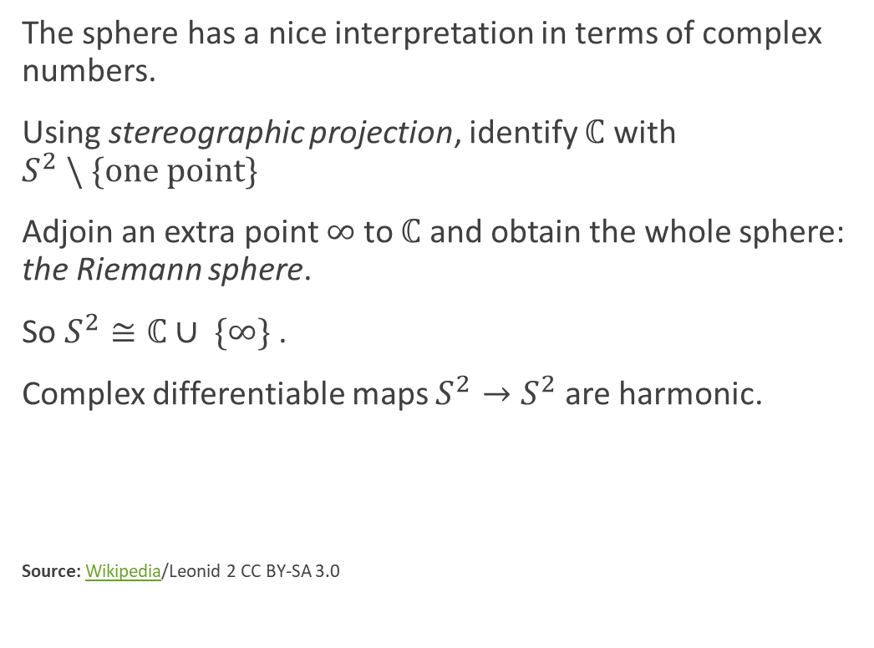
The Riemann sphere
The sphere has a nice interpretation in terms of complex numbers.
Using stereographic projection, identify $ℂ$ with $S^{2} \backslash \{one point\}$
Adjoin an extra point $∞$ to $ℂ$ and obtain the whole sphere: the Riemann sphere.
So $S^{2}≅ℂ∪ \{∞\}$.
Complex differentiable maps $S^{2}→S^{2}$ are harmonic.
Source: Wikipedia/Leonid 2 CC BY-SA 3.0

Slide 29
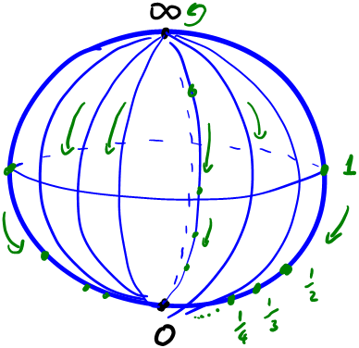
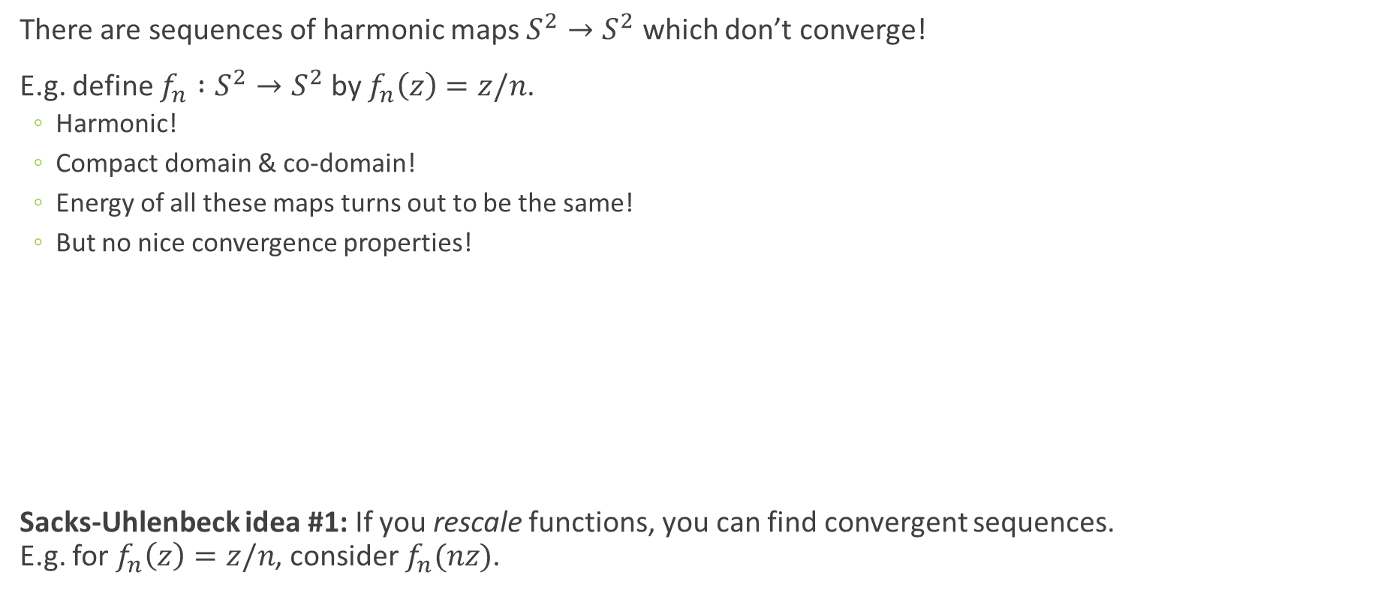
Rescaling
There are sequences of harmonic maps $S^{2}→S^{2}$ which don’t converge!
E.g. define $f_{n} :S^{2}→S^{2}$ by $f_{n}\left(z\right)=z/n$.
  Harmonic!
  Compact domain & co-domain!
  Energy of all these maps turns out to be the same!
  But no nice convergence properties!
Sacks-Uhlenbeck idea #1: If you rescale functions, you can find convergent sequences.
E.g. for $f_{n}\left(z\right)=z/n$, consider $f_{n}(nz)$.

Slide 30
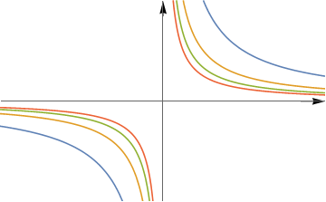
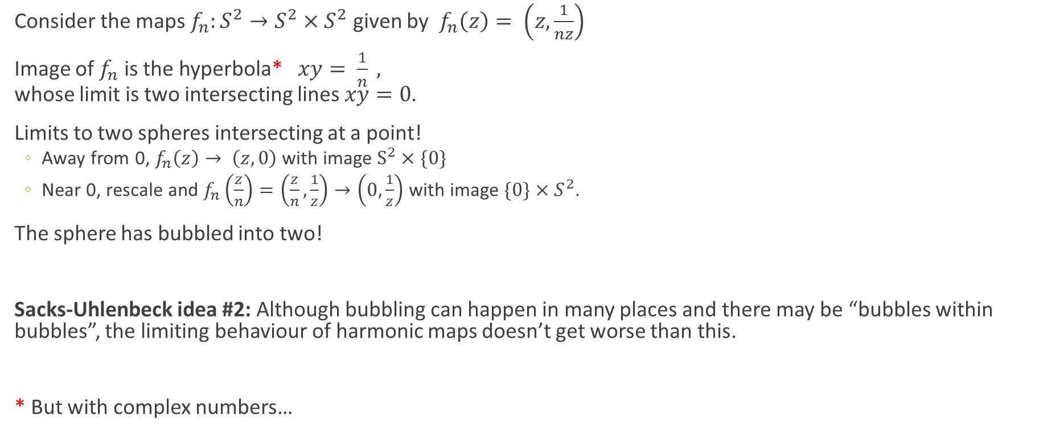
The simplest bubble
Consider the maps $f_{n}:S^{2}→S^{2}×S^{2}$ given by $f_{n}\left(z\right)= \left(z,\frac{1}{nz}\right)$
Image of $f_{n}$ is the hyperbola* $xy= \frac{1}{n} ,$
whose limit is two intersecting lines $xy=0$.
Limits to two spheres intersecting at a point!
  Away from 0, $f_{n}\left(z\right)→ \left(z,0\right)$ with image $S^{2}×\{0\}$
  Near 0, rescale and $f_{n}\left(\frac{z}{n}\right)=\left(\frac{z}{n},\frac{1}{z}\right)→\left(0,\frac{1}{z}\right)$ with image ${\{0\}×S}^{2}$.
The sphere has bubbled into two!
Sacks-Uhlenbeck idea #2: Although bubbling can happen in many places and there may be “bubbles within bubbles”, the limiting behaviour of harmonic maps doesn’t get worse than this.
* But with complex numbers…

Slide 31
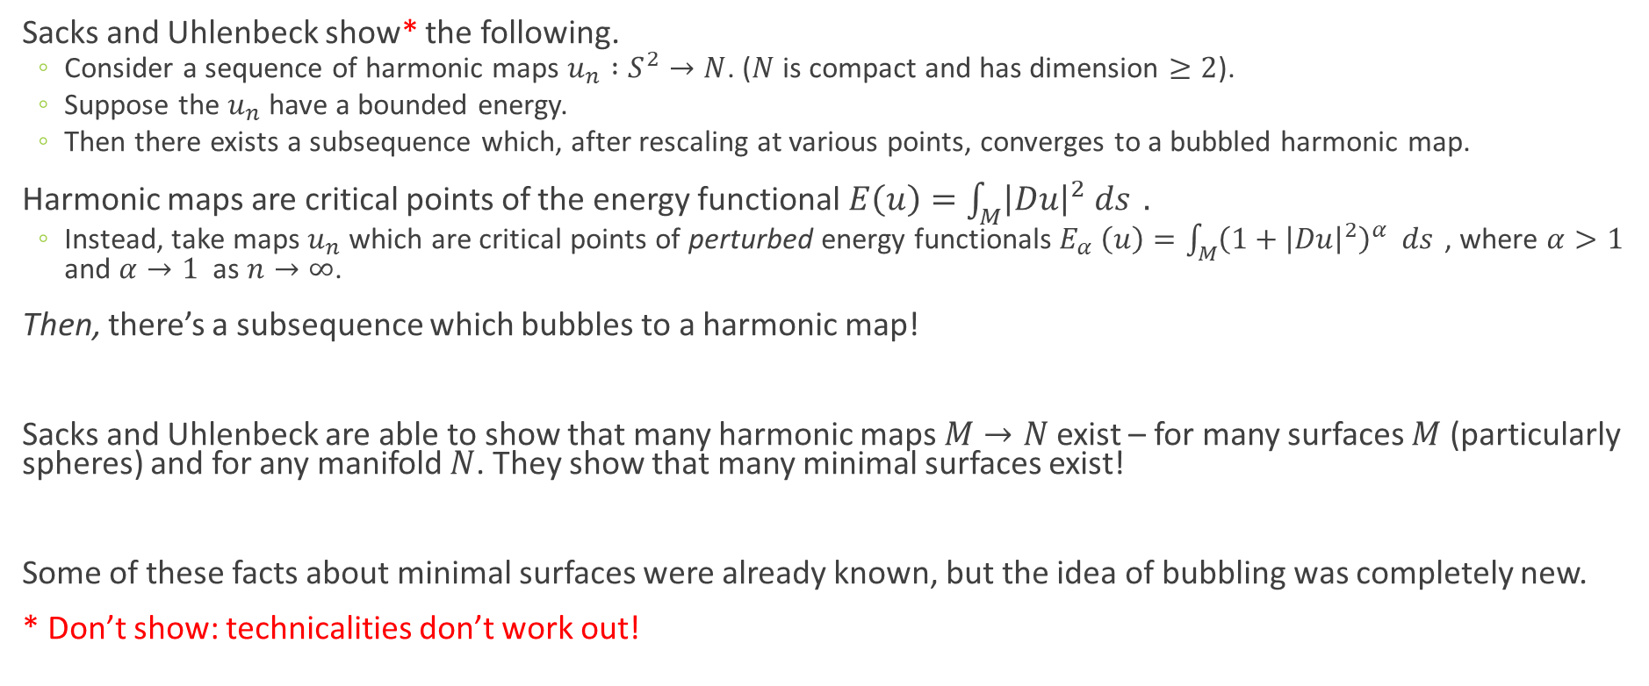
Sacks-Uhlenbeck bubbling
Sacks and Uhlenbeck show* the following.
  Consider a sequence of harmonic maps $u_{n} :S^{2}→N$. ($N$ is compact and has dimension $≥2$).
  Suppose the $u_{n}$ have a bounded energy.
  Then there exists a subsequence which, after rescaling at various points, converges to a bubbled harmonic map.
Harmonic maps are critical points of the energy functional $E\left(u\right)=\int_{M}{{\left|Du\right|}^{2} ds }.$
  Instead, take maps $u_{n}$ which are critical points of perturbed energy functionals$E_{α} \left(u\right)=\int_{M}{{\left(1+{\left|Du\right|}^{2}\right)}^{α}} ds$ , where $α>1$ and $α→1$ as $n→∞$.
Then, there’s a subsequence which bubbles to a harmonic map!
Sacks and Uhlenbeck are able to show that many harmonic maps $M→N$exist – for many surfaces $M$ (particularly spheres) and for any manifold $N$. They show that many minimal surfaces exist!
Some of these facts about minimal surfaces were already known, but the idea of bubbling was completely new.
* Don’t show: technicalities don’t work out!

Slide 32
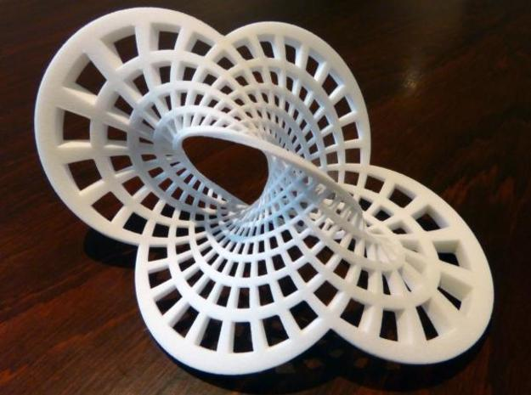
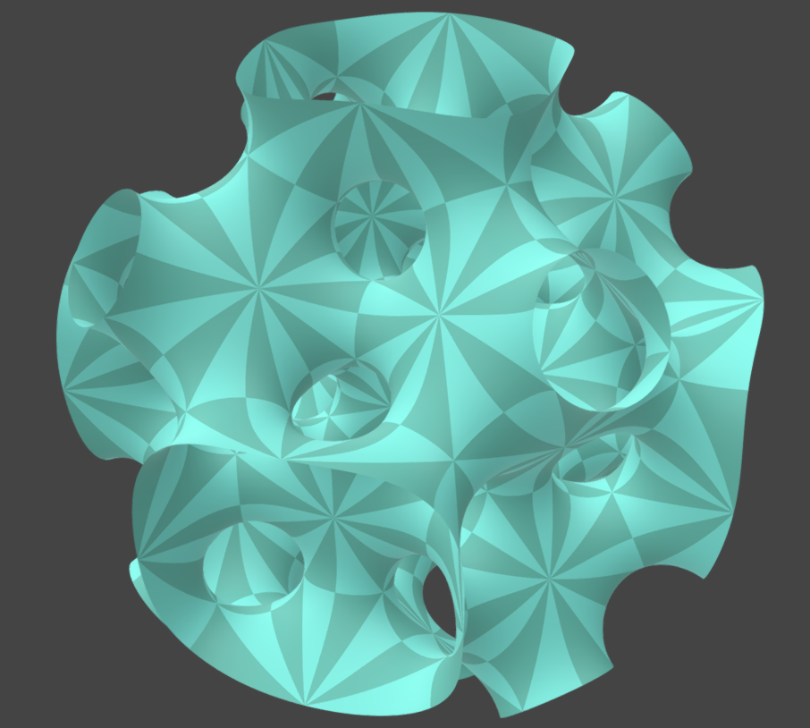
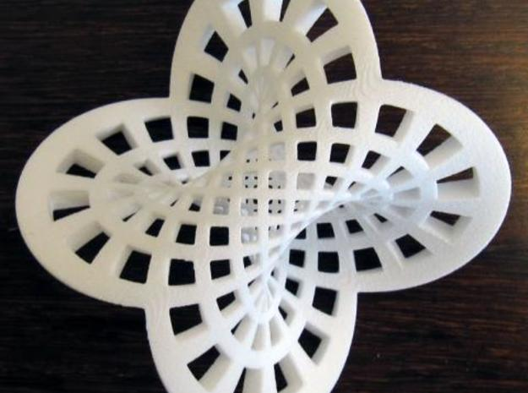
Minimal surfaces in the 3-sphere
  Clifford torus
  Round Mobius strip
  Half-343-KPS surface
Source: Henry Segerman, Saul Schleimer

Slide 33
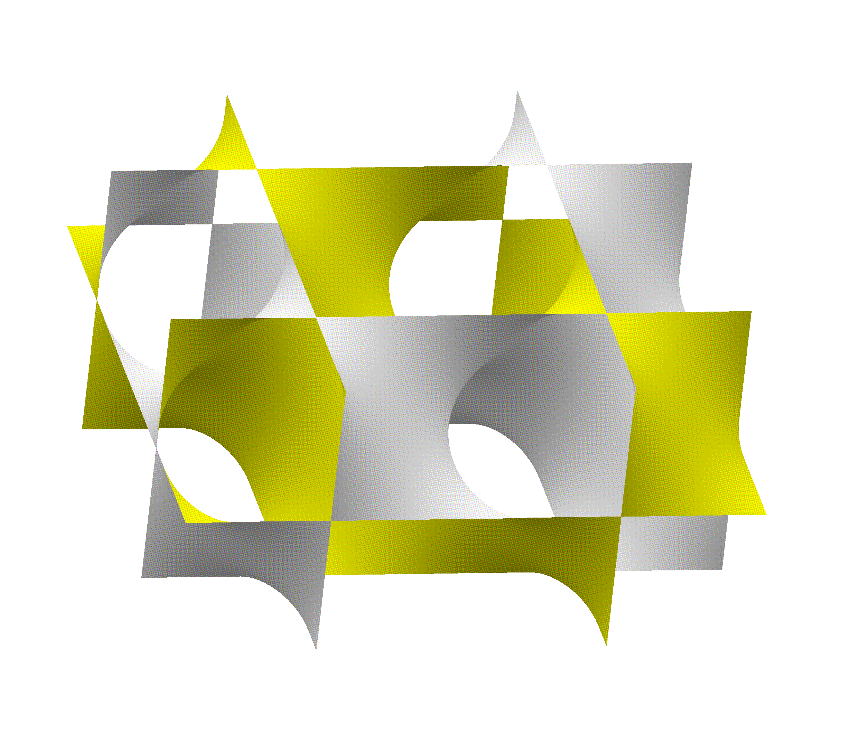


Minimal surfaces in the 3-torus
  Schwarz P surface
  Schwarz D surface
  Gyroid
Sources: Schwarz surfaces – Wikipedia / Andrews Sandberg CC BY-SA 3.0; Gygoid – Wikipedia / Catsquisher

Slide 34
On success
“I didn’t mind being a woman doing math, not supposed to be doing it, working on the fringes, succeeding in a small way, and sort of being incomprehensible and not having many students. In many ways that was much more comfortable. I was really sort of doing it for myself.
Then [when I started getting awards and public recognition] I had to make a major reevaluation of who I am. Getting the MacArthur is really sort of traumatic in some ways. I just never thought of myself in any way like that.”
“Once I became a member of the mathematical elite I found it a pain … to be a woman. There are two choices for me. I can either ignore the fact that I’m a woman or I can become a rabid animal. … I don’t see any in-between reaction to the situation.”

Slide 35
Where are all the women?
“I wasn’t interested in politics. But at some point, I thought, Here I am, in my 40s, successful — Where are all the women? We women mathematicians thought, yes, it has been a little difficult, people weren’t so friendly to us, but things are going to change. But in the early 1990s, many of the women roughly in my generation were at that point the last women hired in their department. We didn’t see large numbers of women coming after us. I felt I did owe something for my success. So Chuu-Lian Terng and I started working together on integrable systems, and we also started working in the Women in Math program.”

Slide 36
Applications of Uhlenbeck’s work
Just within the Monash School of Mathematics
Geometry & PDEs – E.g. Julie Clutterbuck
Willmore surfaces – E.g. Yann Bernard
Yang-Mills theory – E.g. Todd Oliynyk
Pseudoholomorphic curves / symplectic geometry – E.g. Urs Fuchs, Brett Parker, (Dan…)

Slide 37

Thanks for listening!
New Yorker interviewer, March 2019:
“Doctor, thank you so much for talking. I was hoping you were going to be an absent-minded, crazy mathematician, but instead you’re a normal, lovely human being. So unfortunately this won’t be as exciting.”
Karen Uhlenbeck:
“Sorry about that!
I want to add something. Some of the young women are absent-minded, crazy mathematicians. But in my day you couldn’t afford to be!”
Source: Quanta

