Slide 1
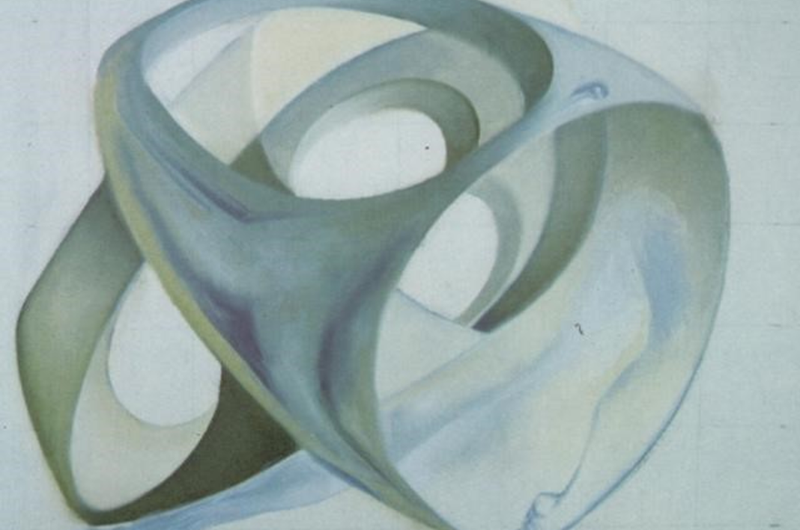
The rough idea of topological data analysis
Or,
The Persistence of Memory of Topological Contortion
Daniel V. Mathews  Daniel.Mathews@monash.edu
MDFI Lightning Talk  Remembrance Day 2021
Salvador Dalí,
The persistence of memory
Topological contortion of a female figure

Slide 3
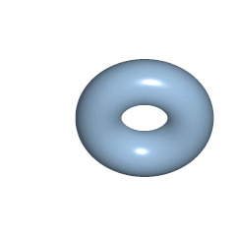
Why Topological Data Analysis?
Disclaimers:
I’m not a TDA practitioner!
I do things related to TDA.
I’m a topologist! I like TDA!
Happy to chat about it!
TDA experts in Australia:
Dr Vanessa Robins, ANU
Dr Katharine Turner, ANU
TDA: A recent and fast-growing field!
Problem:
Amount / variety / dimensionality of data
Desire:
Identify / extract / understand underlying structure
Method:
Use topology! Algebraically calculate the shape of the data.
Robust! Qualitative! Insightful! Sometimes quantitative!
A key mathematical tool: Persistent Homology (also many others)
What is Homology?
Homology = “Holology”
How many “holes” are there of different dimensions?
(… abstract algebra …)
$β_{n}=\dim{H_{n}}=$# n-dimensional holes
What is Topology?
=

Slide 4
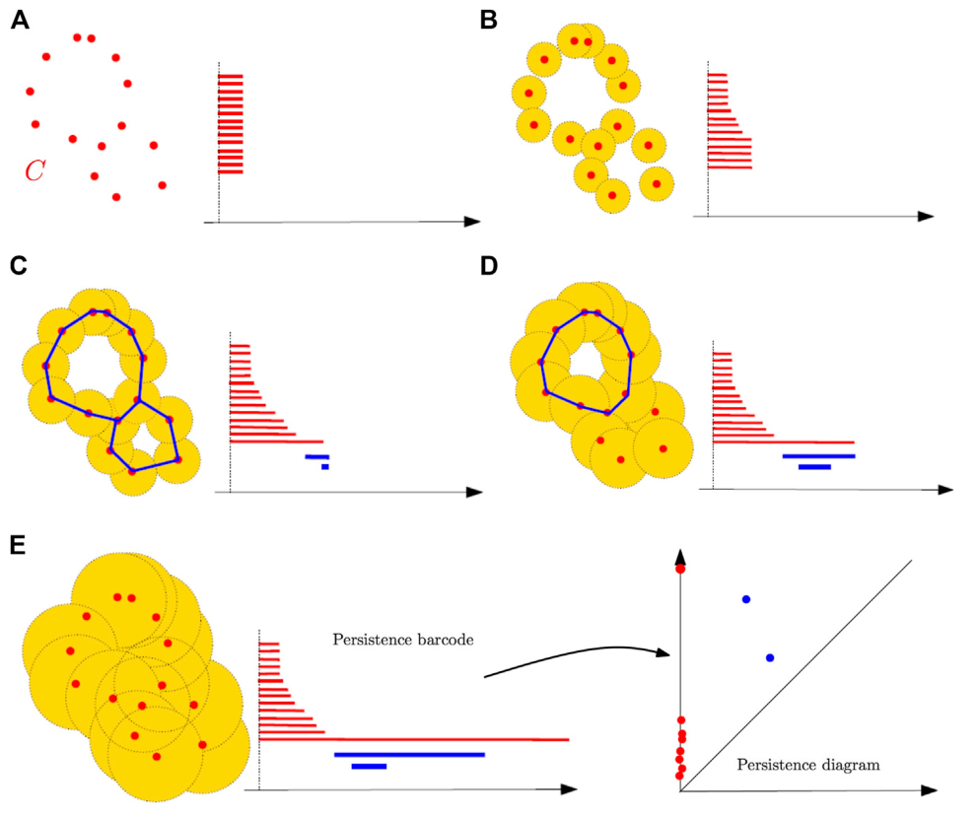
Persistent Homology après Salvador Dalí
Given:
A data set with distances
Expand:
Discs of radius r… Increase r
Topological contortions:
What homology / holes appear?
Record:
The birth and death of holes of diverse dimensions
Applications:
Medical
Diagnostic factors
Pathological phenotypes
Cancer classification
Graphics/modelling
Shape segmentation
Image analysis
Biology
Bacteria classification
Viral evolution
…
Birth
Death
1-D hole
– Chazal & Michel, An Introduction to Topological Data Analysis: Fundamental and Practical Aspects for Data Scientists
Increasing r
Contemplate: … The Persistence of Memory of Topological Contortion

