Slide 1
“The beauty of mathematics shows itself to patient followers’’
The work of Maryam Mirzakhani
Daniel Mathews, May 12, 2022

Slide 2
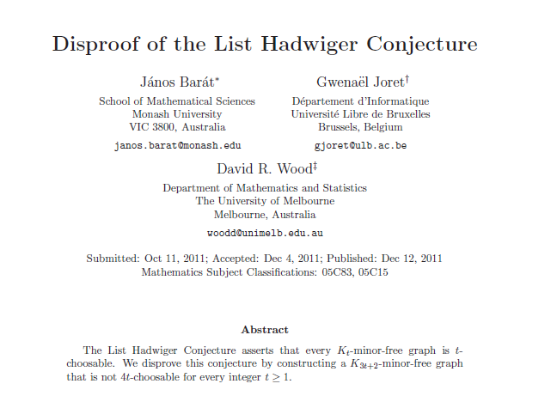

Very brief biography
May 12, 1977: Born in Tehran
1994: Iranian team at International Mathematical Olympiad
– Gold medal
1995: Gold medal again…
and perfect score
Publishes first paper
1999: BSc in mathematics from Sharif University of Technology
2004: PhD from Harvard University under Curtis McMullen
Also 2004: Meets Dan
2004-8: Fellow of Clay Mathematics Institute, Professor at Princeton
2006: Meets N. Do
2008-17: Professor at Stanford University
2011: Influences D. Wood
2013: Diagnosed with breast cancer
2014: Awarded Fields medal
2017: Passed away
May 12, 2019 onwards: Celebrating Women in Mathematics

Slide 3
Fields medal citation
“Maryam Mirzakhani has made stunning advances in the theory of Riemann surfaces and their moduli spaces, and led the way to new frontiers in this area. Her insights have integrated methods from diverse fields, such as algebraic geometry, topology and probability theory.
In hyperbolic geometry, Mirzakhani established asymptotic formulas and statistics for the number of simple closed geodesics on a Riemann surface of genus g. She next used these results to give a new and completely unexpected proof of Witten’s conjecture, a formula for characteristic classes for the moduli spaces of Riemann surfaces with marked points.
In dynamics, she found a remarkable new construction that bridges the holomorphic and symplectic aspects of moduli space, and used it to show that Thurston’s earthquake flow is ergodic and mixing.
…
Her work has revealed that the rigidity theory of homogeneous spaces (developed by Margulis, Ratner and others) has a definite resonance in the highly inhomogeneous, but equally fundamental realm of moduli spaces, where many developments are still unfolding.”

Slide 4
Fields medal citation
“Maryam Mirzakhani has made stunning advances in the theory of Riemann surfaces and their moduli spaces, and led the way to new frontiers in this area. Her insights have integrated methods from diverse fields, such as algebraic geometry, topology and probability theory.
In hyperbolic geometry, Mirzakhani established asymptotic formulas and statistics for the number of simple closed geodesics on a Riemann surface of genus g. She next used these results to give a new and completely unexpected proof of Witten’s conjecture, a formula for characteristic classes for the moduli spaces of Riemann surfaces with marked points.
In dynamics, she found a remarkable new construction that bridges the holomorphic and symplectic aspects of moduli space, and used it to show that Thurston’s earthquake flow is ergodic and mixing.
…
Her work has revealed that the rigidity theory of homogeneous spaces (developed by Margulis, Ratner and others) has a definite resonance in the highly inhomogeneous, but equally fundamental realm of moduli spaces, where many developments are still unfolding.”

Slide 5
Prominent ideas in Mirzakhani’s work
Surfaces – topology!
Geometry – but not like you think
  Hyperbolic
  Conformal
  Complex
Moduli spaces
We’ll try to explain something about these ideas, and some theorems proved by Mirzakhani + collaborators + subsequent research
Mirzakhani was a “slow” mathematician!

Slide 6
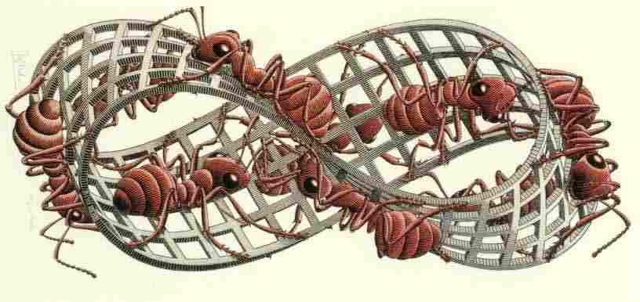

Surfaces
A surface $S$ is a 2-dimensional space
Near every point $x∈S$, looks like $D^{2}$
For us…
Surfaces can have boundary
Embedding into $ℝ^{3}$ not important
Orientable surfaces only

Slide 7
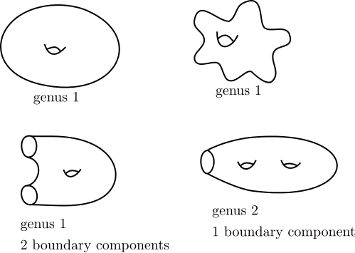
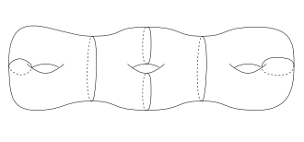
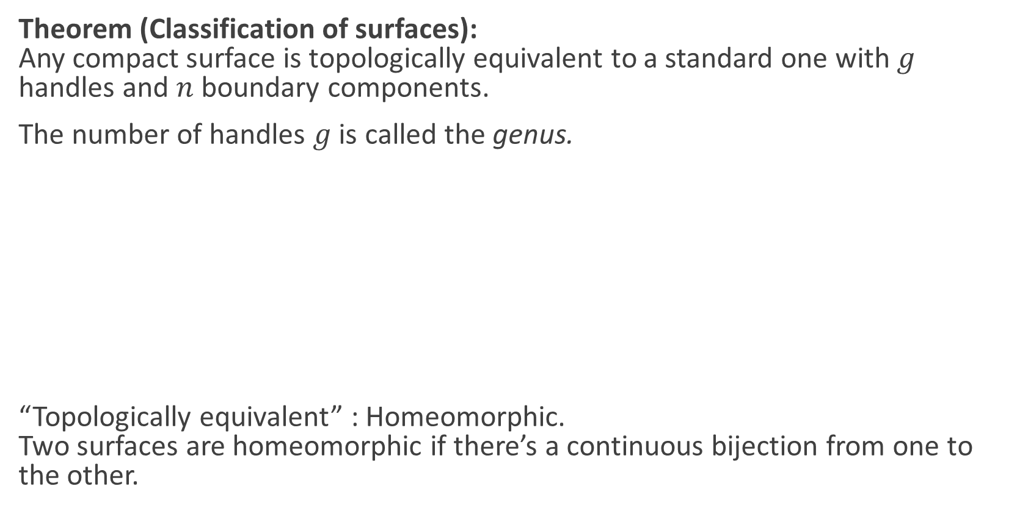
Surfaces
Theorem (Classification of surfaces):
Any compact surface is topologically equivalent to a standard one with $g$ handles and $n$ boundary components.
The number of handles $g$ is called the genus.
“Topologically equivalent” : Homeomorphic.
Two surfaces are homeomorphic if there’s a continuous bijection from one to the other.
Source: picturethismaths.wordpress.com

Slide 8
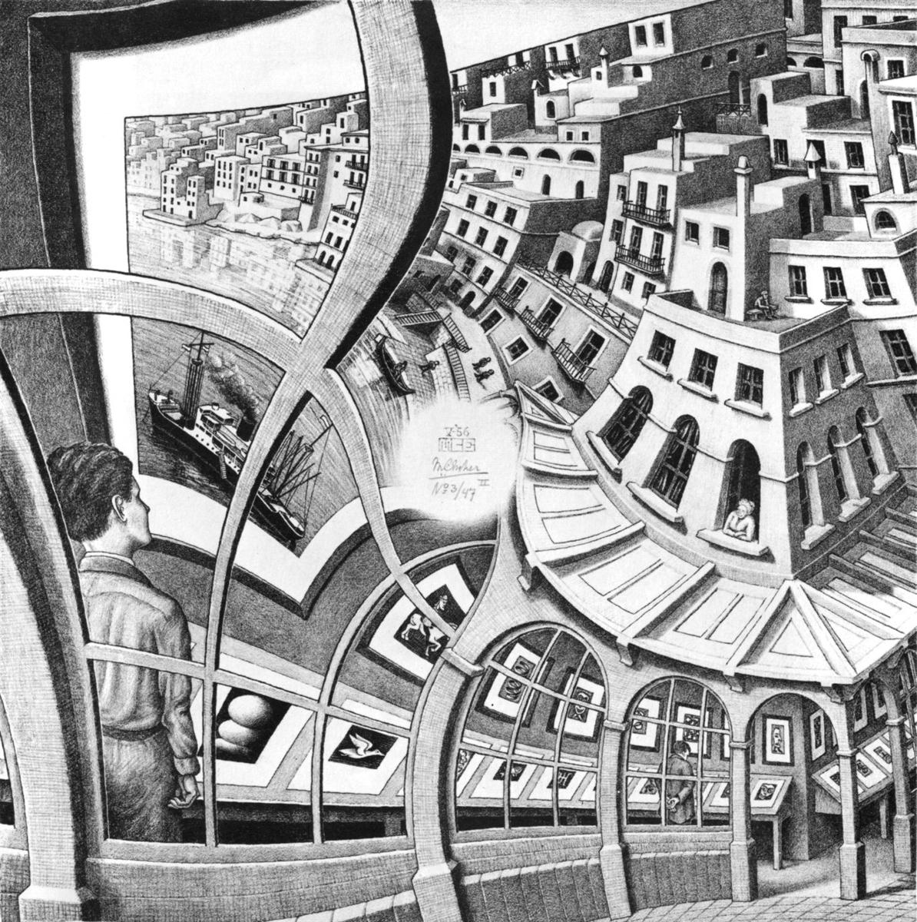
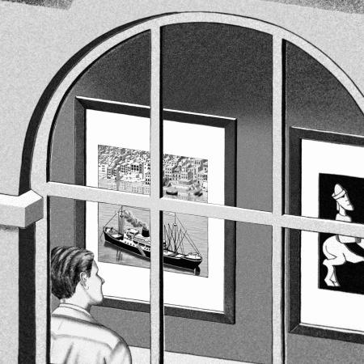
Conformal geometry
M. C. Escher, Print Gallery

Slide 9
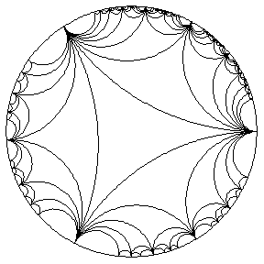
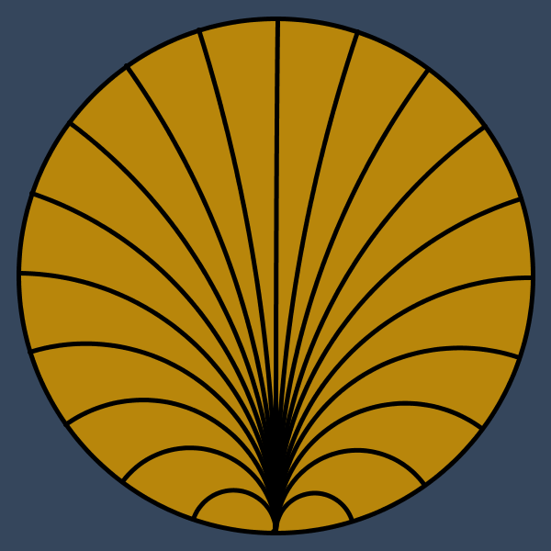
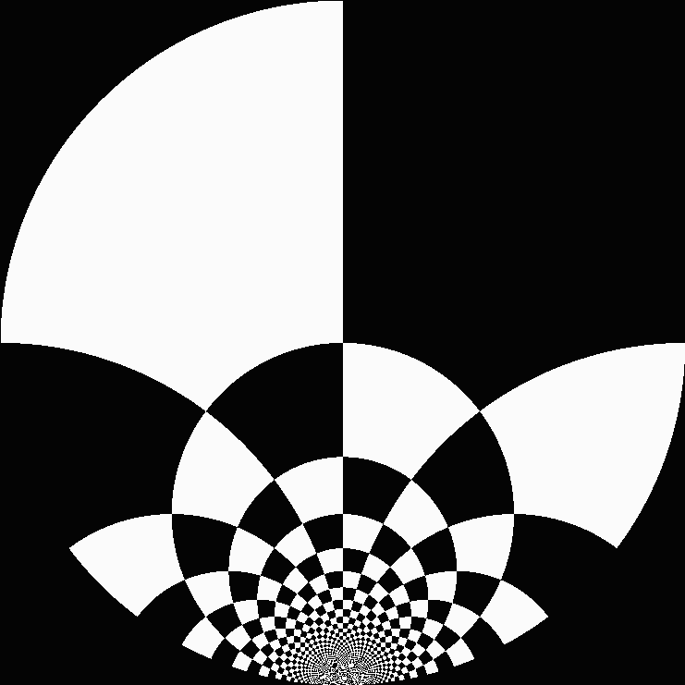
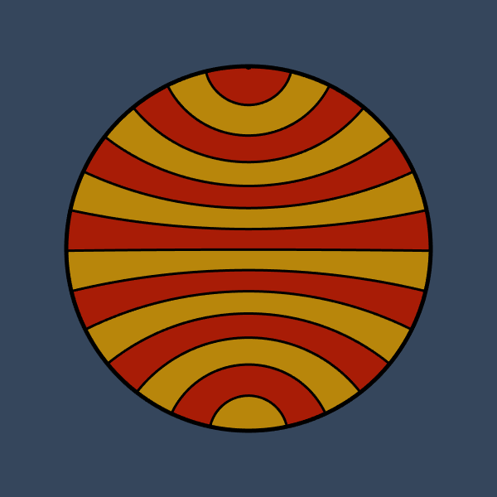

Conformal geometry
(orientation-preserving!)
Geometry where we care about angles but not lengths
A conformal map is a map which preserves angles
A conformal symmetry of a surface $S$ is a bijective conformal map $f :S →S$
Some conformal symmetries of a disc: Turns out there are interestingly many!
^
Sources: escape30.tumblr.com; szimmetria-airtemmizs.tumblr.com; hyperbolic-gifs.tumblr.com

Slide 10
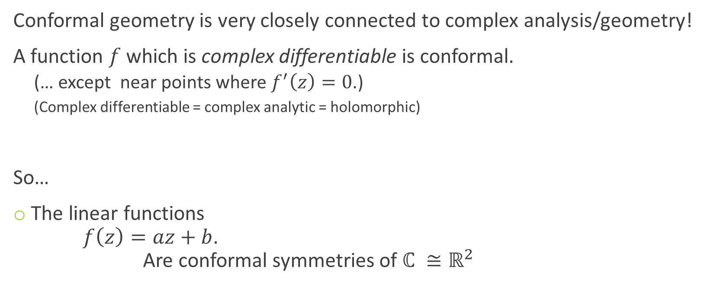
Complex geometry
Conformal geometry is very closely connected to complex analysis/geometry!
A function $f$which is complex differentiable is conformal.
  (… except near points where $f^{′}\left(z\right)=0$.)
  (Complex differentiable = complex analytic = holomorphic)
So…
The linear functions
$f\left(z\right)=az+b$.
Are conformal symmetries of $ℂ ≅ℝ^{2}$

Slide 11
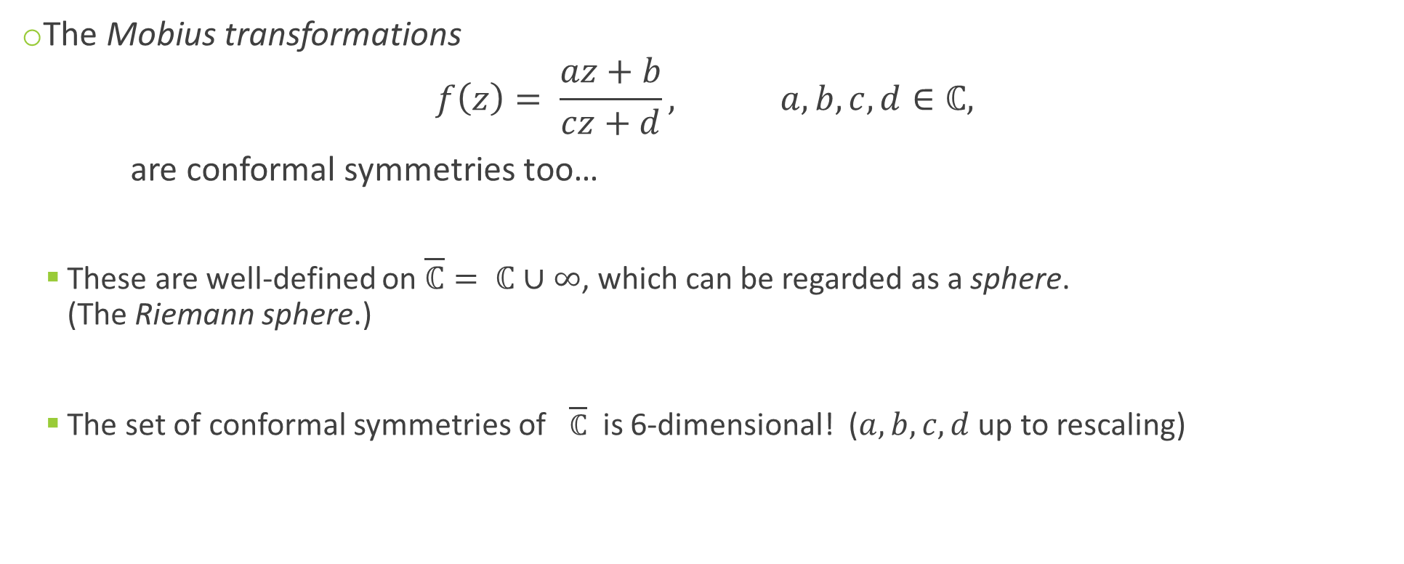
Complex geometry
The Mobius transformations
$$f\left(z\right)= \frac{az+b}{cz+d}, a,b,c, d∈ℂ,$$
are conformal symmetries too…
  These are well-defined on $\overline{ℂ}= ℂ∪∞$, which can be regarded as a sphere.
  (The Riemann sphere.)
  The set of conformal symmetries of $\overline{ℂ}$ is 6-dimensional! ($a,b,c,d$ up to rescaling)

Slide 12
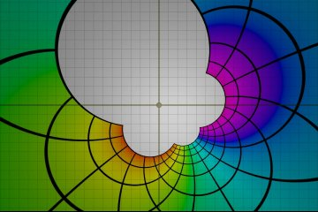
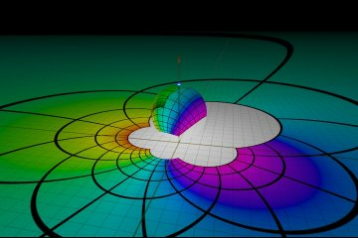
Complex geometry
Source: Mobius transformations revealed

Slide 13
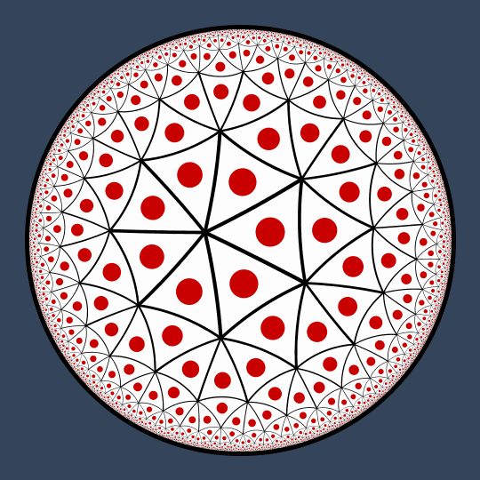
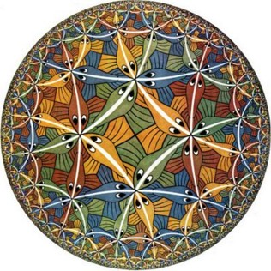
Complex geometry
Sources: szimmetria-airtemmizs.tumblr.com; M.C. Escher; escape30.tumblr.com

Slide 14
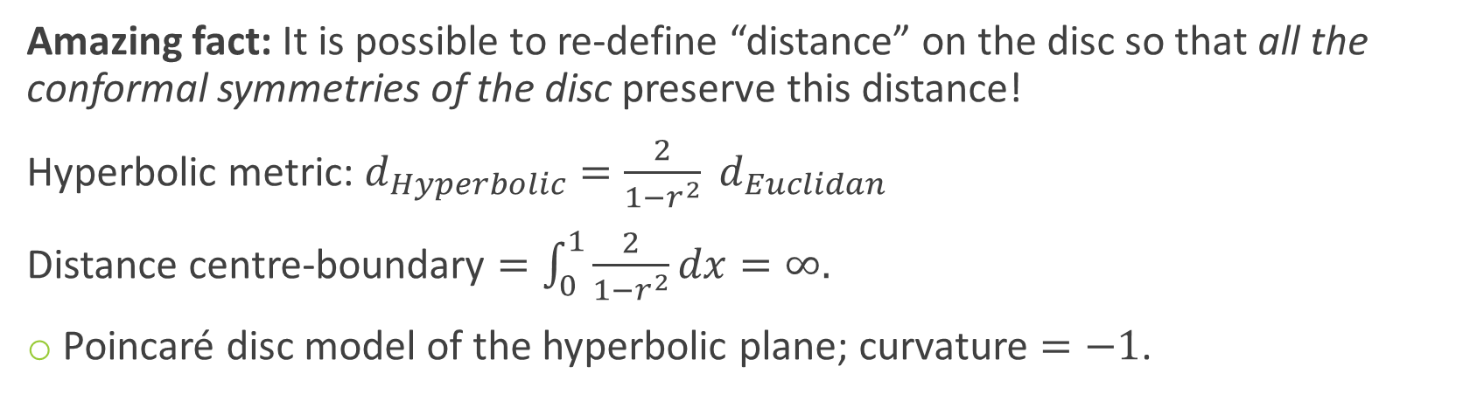

Hyperbolic geometry
Amazing fact: It is possible to re-define “distance” on the disc so that all the conformal symmetries of the disc preserve this distance!
Hyperbolic metric: $d_{Hyperbolic}=\frac{2}{1−r^{2}} d_{Euclidan}$
Distance centre-boundary $=\int_{0}^{1}{\frac{2}{1−r^{2}}dx}=∞.$
Poincaré disc model of the hyperbolic plane; curvature $=−1$.
$→∞$ as $r→1$

Slide 15
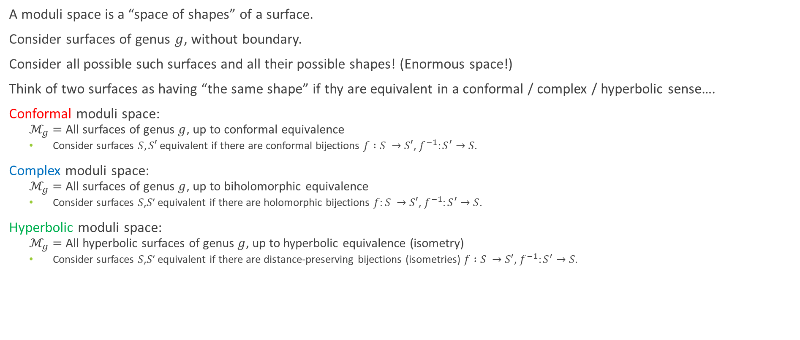
Moduli spaces
A moduli space is a “space of shapes” of a surface.
Consider surfaces of genus $g$, without boundary.
Consider all possible such surfaces and all their possible shapes! (Enormous space!)
Think of two surfaces as having “the same shape” if thy are equivalent in a conformal / complex / hyperbolic sense….
Conformal moduli space:
  $ℳ_{g}=$All surfaces of genus $g$, up to conformal equivalence
  Consider surfaces $S,S′$ equivalent if there are conformal bijections $f :S →S′$, $f^{−1}:S^{′}→S$.
Complex moduli space:
  $ℳ_{g}=$All surfaces of genus $g$, up to biholomorphic equivalence
  Consider surfaces 𝑆,𝑆′ equivalent if there are holomorphic bijections $f:S →S′$, $f^{−1}:S^{′}→S$.
Hyperbolic moduli space:
  $ℳ_{g}=$All hyperbolic surfaces of genus $g$, up to hyperbolic equivalence (isometry)
  Consider surfaces 𝑆,𝑆′ equivalent if there are distance-preserving bijections (isometries) $f :S →S′$, $f^{−1}:S^{′}→S$.
All the same thing!
(More or less…)

Slide 16
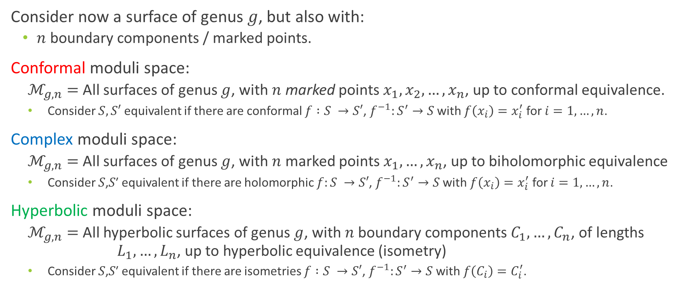
Moduli spaces – now with boundary!
Consider now a surface of genus $g$, but also with:
  $n$ boundary components / marked points.
Conformal moduli space:
  $ℳ_{g,n}=$All surfaces of genus $g$, with $n$ marked points $x_{1},x_{2},…, x_{n}$, up to conformal equivalence.
  Consider $S,S′$ equivalent if there are conformal $f :S →S′$, $f^{−1}:S^{′}→S$ with $f\left(x_{i}\right)=x_{i}^{′}$ for $i=1,…,n$.
Complex moduli space:
  $ℳ_{g,n}=$All surfaces of genus $g$, with $n$ marked points $x_{1},…, x_{n}$, up to biholomorphic equivalence
  Consider 𝑆,𝑆′ equivalent if there are holomorphic $f:S →S′$, $f^{−1}:S^{′}→S$ with $f\left(x_{i}\right)=x_{i}^{′}$ for $i=1, …, n$.
Hyperbolic moduli space:
  $ℳ_{g,n}=$All hyperbolic surfaces of genus $g$, with $n$ boundary components $C_{1},…, C_{n}$, of lengths $L_{1},…, L_{n}$, up to hyperbolic equivalence (isometry)
  Consider 𝑆,𝑆′ equivalent if there are isometries $f :S →S′$, $f^{−1}:S^{′}→S$ with $f\left(C_{i}\right)=C_{i}^{′}$.
All the same thing!
(More or less…)

Slide 17
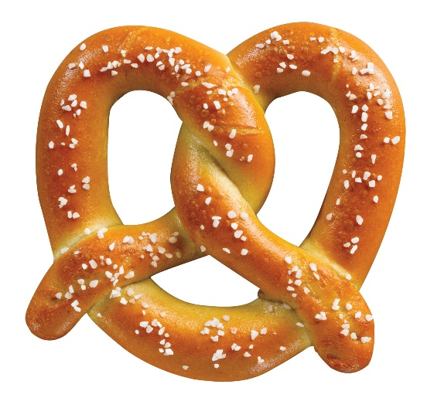
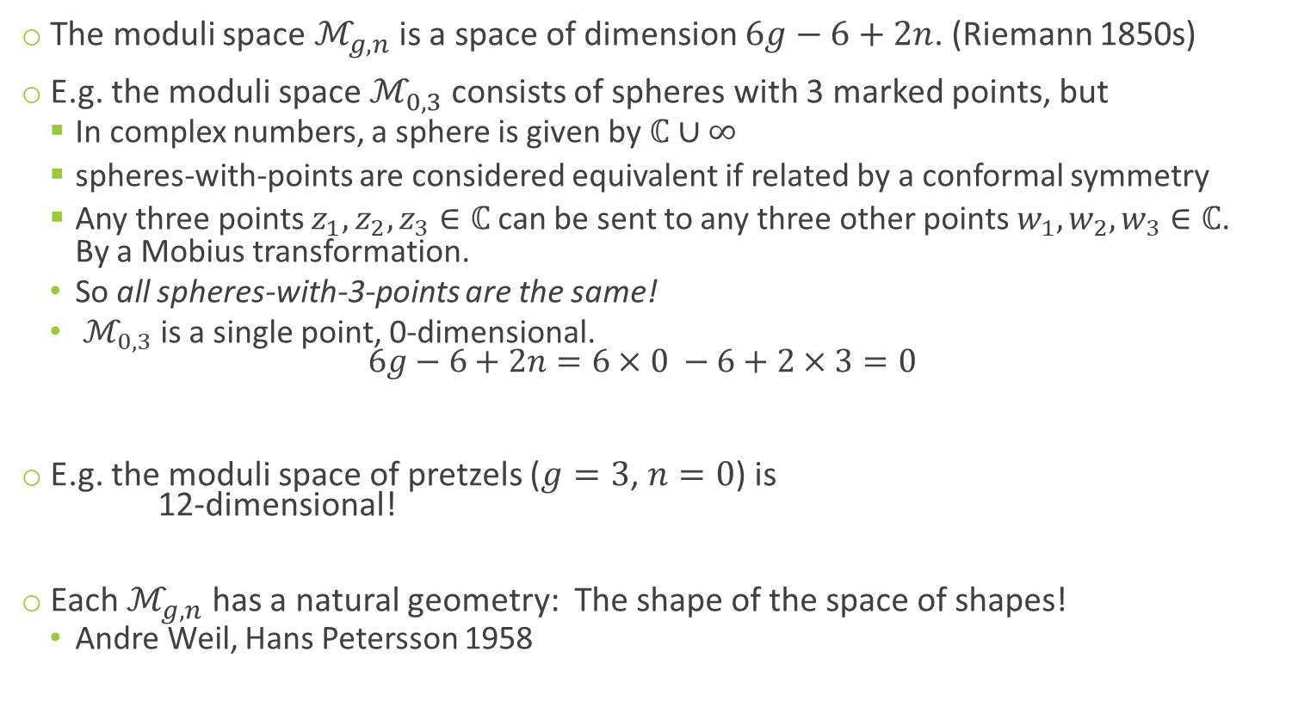
Moduli spaces pre-Mirzakhani
The moduli space $ℳ_{g,n}$ is a space of dimension $6g−6+2n$. (Riemann 1850s)
E.g. the moduli space $ℳ_{0,3}$ consists of spheres with 3 marked points, but
  In complex numbers, a sphere is given by $ℂ∪∞$
  spheres-with-points are considered equivalent if related by a conformal symmetry
  Any three points $z_{1},z_{2},z_{3}∈ℂ$ can be sent to any three other points $w_{1},w_{2},w_{3}∈ℂ$.
  By a Mobius transformation.
  So all spheres-with-3-points are the same!
  $ℳ_{0,3}$ is a single point, 0-dimensional.
  $6g−6+2n=6×0 −6+2×3=0$
E.g. the moduli space of pretzels ($g=3$, $n=0$) is
12-dimensional!
Each $ℳ_{g,n}$ has a natural geometry: The shape of the space of shapes!
  Andre Weil, Hans Petersson 1958
Sources: foodimentary.com, lamington.wordpress.com

Slide 18
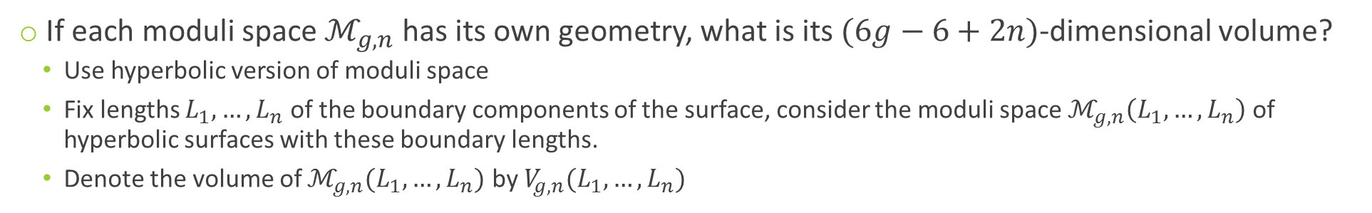
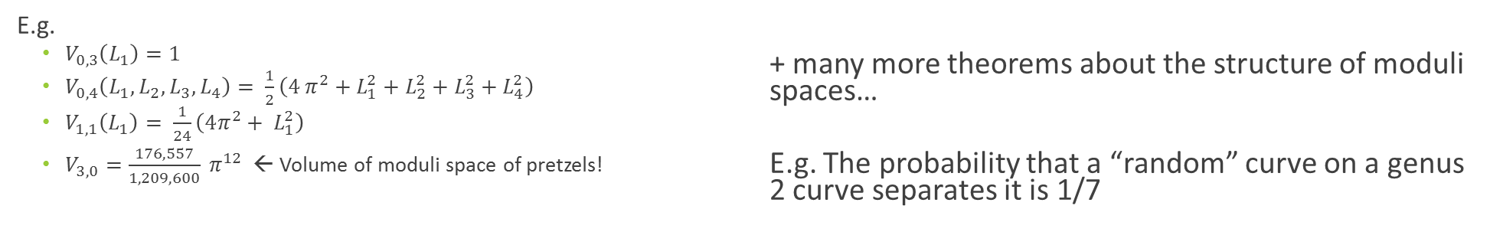
Moduli spaces post-Mirzakhani
If each moduli space $ℳ_{g,n}$ has its own geometry, what is its $(6g−6+2n)$-dimensional volume?
  Use hyperbolic version of moduli space
  Fix lengths $L_{1},…, L_{n}$ of the boundary components of the surface, consider the moduli space $ℳ_{g,n}\left(L_{1},…, L_{n}\right)$ of hyperbolic surfaces with these boundary lengths.
  Denote the volume of $ℳ_{g,n}(L_{1},…, L_{n})$ by $V_{g,n}(L_{1},…, L_{n})$
Theorem (Mirzakhani 2007):
Each $V_{g,n}(L_{1},…, L_{n})$ is a polynomial function of $L_{1},…, L_{n}$.
Moreover, there is a recursive formula to calculate each $V_{g,n}\left(L_{1},…, L_{n}\right)$.
E.g.
  $V_{0,3}\left(L_{1}\right)=1$
  $V_{0,4}\left(L_{1},L_{2},L_{3},L_{4}\right)= \frac{1}{2}\left(4 π^{2}+L_{1}^{2}+L_{2}^{2}+L_{3}^{2}+L_{4}^{2}\right)$
  $V_{1,1}\left(L_{1}\right)= \frac{1}{24}\left(4π^{2}+ L_{1}^{2}\right)$
  $V_{3,0}=\frac{176,557}{1,209,600} π^{12}$ ← Volume of moduli space of pretzels!
  + many more theorems about the structure of moduli spaces…
  E.g. The probability that a “random” curve on a genus 2 curve separates it is 1/7

Slide 19



The prime number theorem & geodesics
  How many loops are there on a surface?
  How many “shortest curve” loops, or geodesics, are there on a surface?
  How many geodesics are there on a surface of distance less than $L$?
Just like the prime number theorem!
Theorem:
The number of prime numbers $≤N$ is approximately $\frac{n }{log n}$ as $n →∞$.
Theorem (Delsarte, Huber, Selberg, …, 1940s):
The number of geodesic loops of length $≤L$ is approximately $e^{L}/L$ as $L →∞$.
Theorem (Mirzakhani 2004):
The number of simple (non self intersecting) geodesic loops of length $≤L$ is approximately $L^{6g−6+2n}$ as $L →∞$.

Slide 20
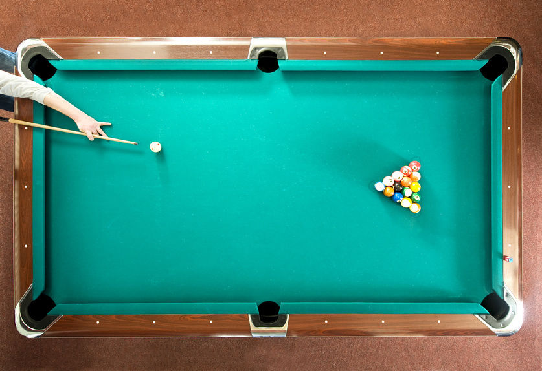
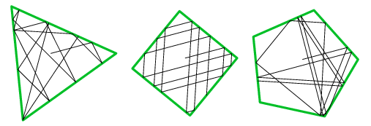
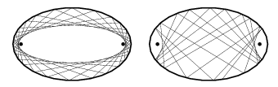
Mathematical billiards
Studies dynamics of billiards balls on billiard tables
No jumping, no spin, no friction
  Balls bounce off walls and continue indefinitely
  But tables can have interesting geometry!
Breakthroughs based on Mirzakhani’s work!
Alex Eskin, Mirzakhani, and Amir Mohammadi (2013) proved a very difficult (“titanic”) theorem about the structure of orbits of certain group actions in certain moduli spaces.
Samuel Lelièvre, Thierry Monteil, and Barak Weiss then used this work to prove a major result in mathematical billiards (2016):
  “Everything is illuminated”
Source: mathworld.wolfram.com

Slide 21
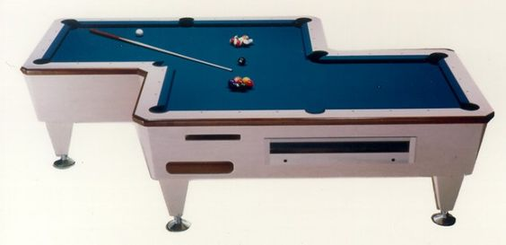
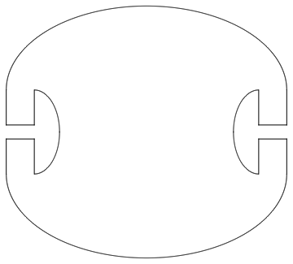
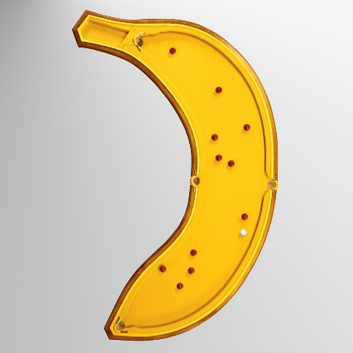
The illumination problem
Problem: Given a billiard table, can you hit a billiard ball from any point to any other point?
Equivalently, given a room with mirrored walls, if you light a candle at one point, does it illuminate the whole room?
On some billiard tables this is easy…
On some it is a little harder…
L & R Penrose, New Scientist Christmas puzzles 1958:
  Can you design a billiard table where
  you can’t hit a ball from any point to any other?
Yes!
The Penrose unilluminable room.

Slide 22
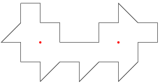
The illumination problem
But the question remains:
  Given a polygonal billiard table, can you hit a billiard ball
  from any point to any other point?
George Tokarsky (1995): There is a polygonal room
with two points that don’t illuminate each other!
But the question still remains:
  Given a polygonal billiard table, can you hit a billiard ball
  from any point to almost any other point?
YES! … sort of
Theorem (Lelièvre-Monteil-Weiss 2016, applying results of Eskin-Mirzakhani-Mohammadi 2015-16):
Let $P$ be a polygonal billiard table with all angles rational multiples of $π$.
Then for all $x∈P$, you can hit a billiard ball from $x$ to every point of $P$, except for possibly finitely many exceptions.

Slide 23
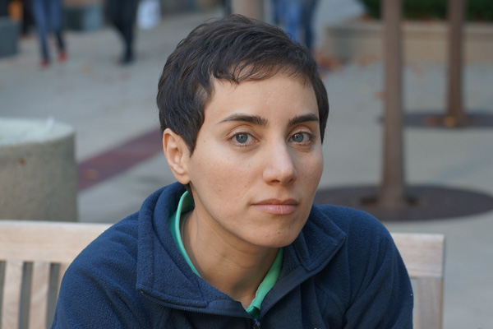
Thanks for listening!
“I don't think that everyone should become a mathematician, but I do believe that many students don't give mathematics a real chance. I did poorly in math for a couple of years in middle school; I was just not interested in thinking about it. I can see that without being excited mathematics can look pointless and cold. The beauty of mathematics only shows itself to more patient followers.”
– Maryam Mirzakhani, 2014

