Slide 1
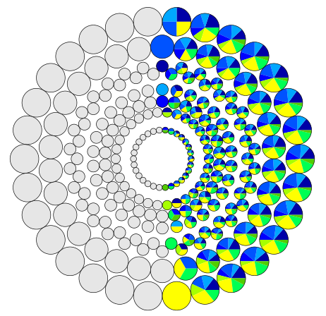
"There is always room for a new theory in mathematics"
Maryna Viazovska and her Mathematics
Daniel Mathews, August 30, 2022

Slide 2
Maryna Viazovska
5 July 2022:

Slide 3
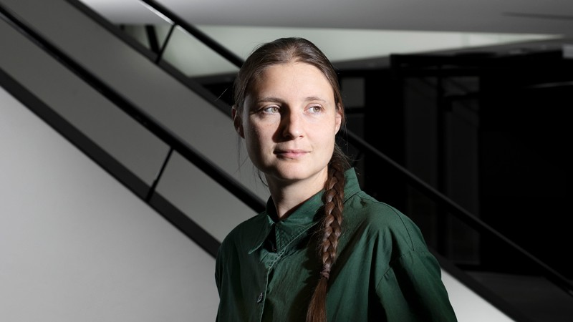
Brief biography
2 December 1984: Born in Kyiv, Ukraine (USSR)
“The late 1980s were a difficult time in the Soviet Union. It took people many, many hours to buy even basic things… The Soviet Union fell apart when I was 6.”
“When everyone goes to sleep, she has her notepad and she draws some formulas”
1998-2001: Attended specialised school in Kyiv for high-achieving students in science and technology - Taught by professional mathematician Andrii Knyazyuk
“In the 11th grade… I didn't qualify for the International Mathematics Olympiad and felt discouraged from becoming a mathematician. That was a huge disappointment.”
Maryna Viazovska and her Mathematics
Source: Nature, Credit: EPFL/Fred Merz

Slide 4
“Always room for a new theory”
“We had a neighbor who died a long time ago. He was an old man who had fought in the war and then worked with my grandfather at the same university.
And he had such a huge… collection of different popular books on physics and mathematics at home… he gave them to me… And there, I found an astronomy book that really impressed me.
There were stories about different theories in which everything fit together really well… And then they would find a new star. And the whole theory would go in the trash… Some years go by, this more complicated theory works, and then another discovery happens, forcing it to be thrown out as well…
This really impressed me, because this was so unlike what we were taught at school. The teacher would say: ‘Here is the theory, you should learn it, and it will work’. But it turns out you can invent new theories!”
But that's not how it works in math, right?
“Times change, discoveries are made, maybe some previously overlooked aspects become important, maybe new ideas come from physics or astronomy. There is always room for a new theory in mathematics.”
Maryna Viazovska and her Mathematics

Slide 5
Brief biography
2001-5: Bachelor Degree in Mathematics, KNU (Taras Shevchenko National University of Kyiv)
“I was not interested in anything but mathematics.”
“I lived a ‘double life’ between algebra and analysis”
2002-5: Competed in International Mathematics Competition for University Students - First place 2002, 2005.
“The next crisis happened when those student olympiads came to an end — because I became too old for them. But then, luckily, I realized that there is such a thing as research in mathematics, where one can solve really hard problems and write papers about them.”
2005: First research paper published – (joint w Andriy Bondarenko) “Bernstein type inequality in monotone rational approximation”
Maryna Viazovska and her Mathematics

Slide 6
Brief biography
2007: Masters degree, University of Kaiserslautern (TUK), Germany
2010: Candidate degree, Institute of Mathematics of National Academy of Sciences of Ukraine - Thesis “Inequalities for polynomials and rational functions and quadrature formulas in the sphere”
2013: Doctorate, University of Bonn. Supervisors: Don Zagier, Werner Müller. - Studied modular forms - “I realized this is where my two passions meet” - Thesis “Modular Functions and Special Cycles” - Paper “Optimal asymptotic bounds for spherical designs” (w A Bondarenko, D Radchenko), published in Annals of Mathematics
2014-17: Postdocs – IHES (France), Berlin Mathematical School, Humboldt University
2018-present: Professor at École Polytechnique Fédérale de Lausanne (EPFL), Switzerland
February 2022: Russia invades Ukraine - Some family stay, some flee Kyiv for Lausanne
Maryna Viazovska and her Mathematics

Slide 7
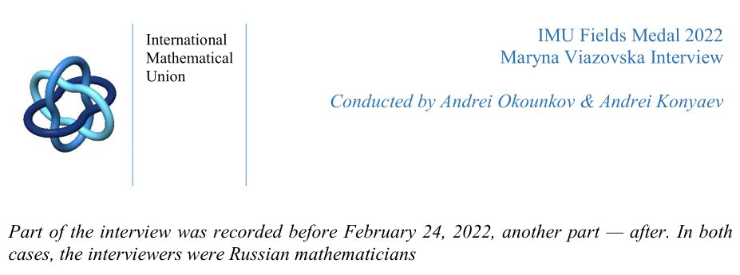
“There is a war going on right now, the war to destroy my home country, my nation. This is done by the country of which you are citizens. People from your country are either doing this or supporting these actions…
“I know people in Moscow, educated and well-read people, who at the same time support everything that is going on at the moment, everything that Russia does… Unfortunately, neither education nor profession can prevent people from turning into cannibals...
Maryna Viazovska and her Mathematics

Slide 8
“If we talk about what can and should be done, then we need to talk about the plight of the refugees. The crisis created a huge humanitarian problem…
“Let me speak only about one aspect close to my personal experience - the plight of refugees and the effect of war on Ukrainian education. For example, Kyiv did not suffer as much as cities in the East, but 25% of students left Kyiv University. A huge number of children from Ukraine have now left for Europe, and they have to adapt to a completely different education system in a different language. And if school education is free almost everywhere, the situation with university students is more difficult… It is especially hard for those who have just graduated from school, or who are in their first year of university…
“it is impossible to replace what is lost and we will suffer the consequences of this war for generations.
“I would like to thank everyone who helps refugees.”
Maryna Viazovska and her Mathematics

Slide 9
On mathematics education
“It always surprises me — if you look at the math curriculum, it changes all the time.
“When my son started learning geometry, I bought the textbook that I used. Written by Pogorelov back in the 60s. It's a great textbook, why would you need another one? …
“The plane geometry taught at school, it is still the same plane geometry as invented by Euclid, nothing has changed… A maximum is beautiful, why change it? …
“Maybe I don't have the same needs as others. And it is obvious that the textbook must be understandable to everyone… But with the old textbooks, I like that there are really a lot of words and explanations in them. There are definitions, there are theorems…
“Modern textbooks are just an outline, a cheat sheet. Lots of pictures, not much text. Literally like in children's books…
“Perhaps one expects the teacher in class to fill in the voids, but it seems to me that the children in general rarely remember… having a book that says it all is actually a very good thing.”
Maryna Viazovska and her Mathematics

Slide 10
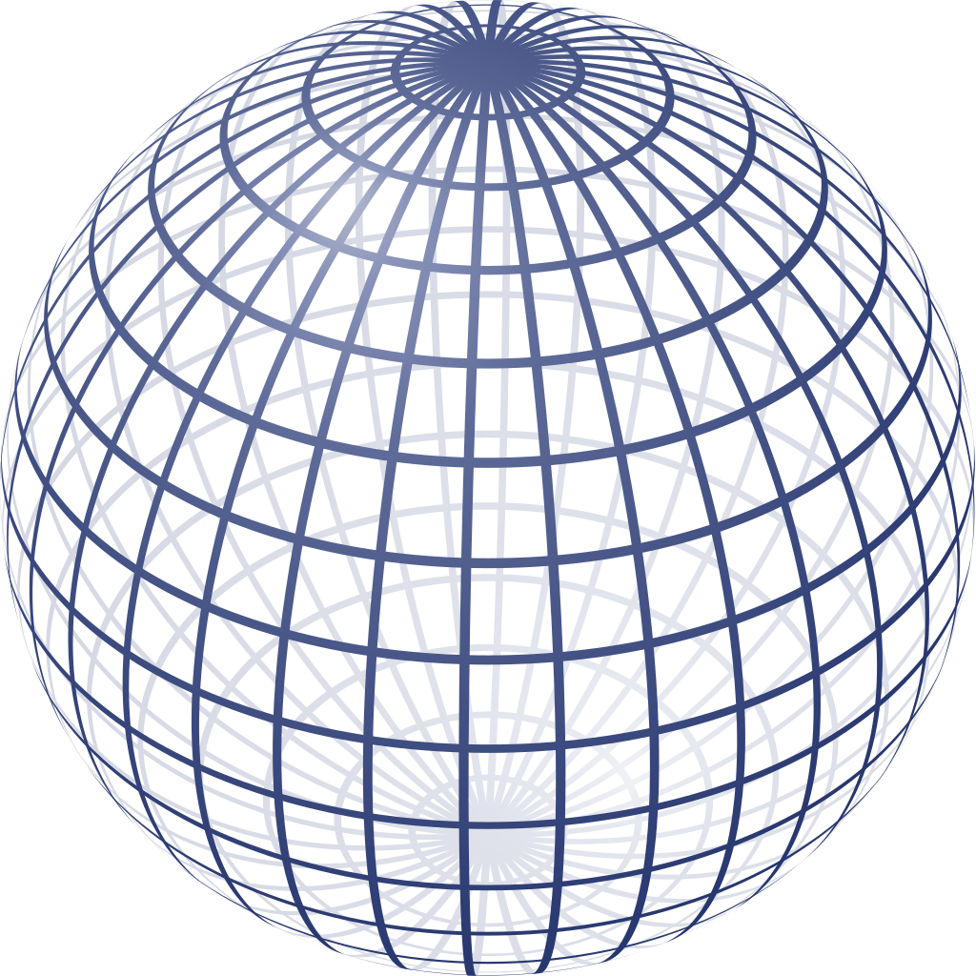
Sphere packing
The sphere packing problem:
What is the densest packing of space with unit balls?
May be asked in any dimension: pack $ℝ^{n}$ with n-dimensional unit balls.
Unit ball: centred at $x∈ ℝ^{n}$
$B\left(x\right)=\left\{p∈ ℝ^{n} :the distance from p to x is less than 1\right\}$ $=\left\{p∈ ℝ^{n} : \left|p−x\right|<1\right\}$
Maryna Viazovska and her Mathematics

Slide 11
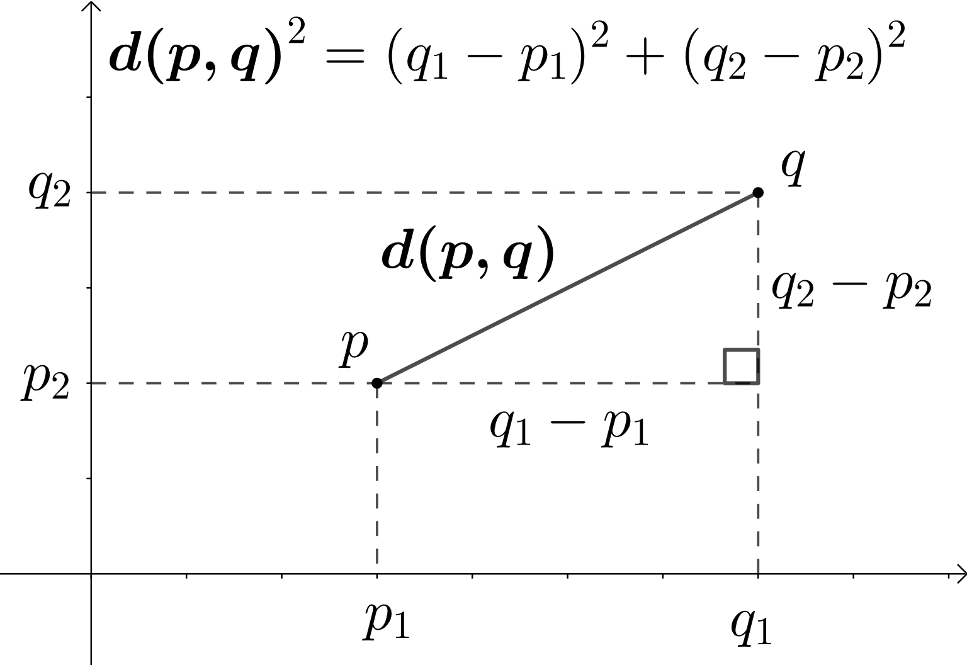
Higher dimensions
Do not be afraid! Just don’t expect to visualise!
A point in $ℝ^{2}$ is given by
$p=\left(p_{1},p_{2}\right)$
And the distance $\left|p−q\right|$ between two points $p=(p_{1},p_{2})$ and $q=\left(q_{1},q_{2}\right)$ is given by
${\left|p−q\right|}^{2}= {\left(p_{1}−q_{1}\right)}^{2}+ {\left(p_{2}−q_{2}\right)}^{2}$
Maryna Viazovska and her Mathematics
Source: Wikipedia, Kmhkmh

Slide 12
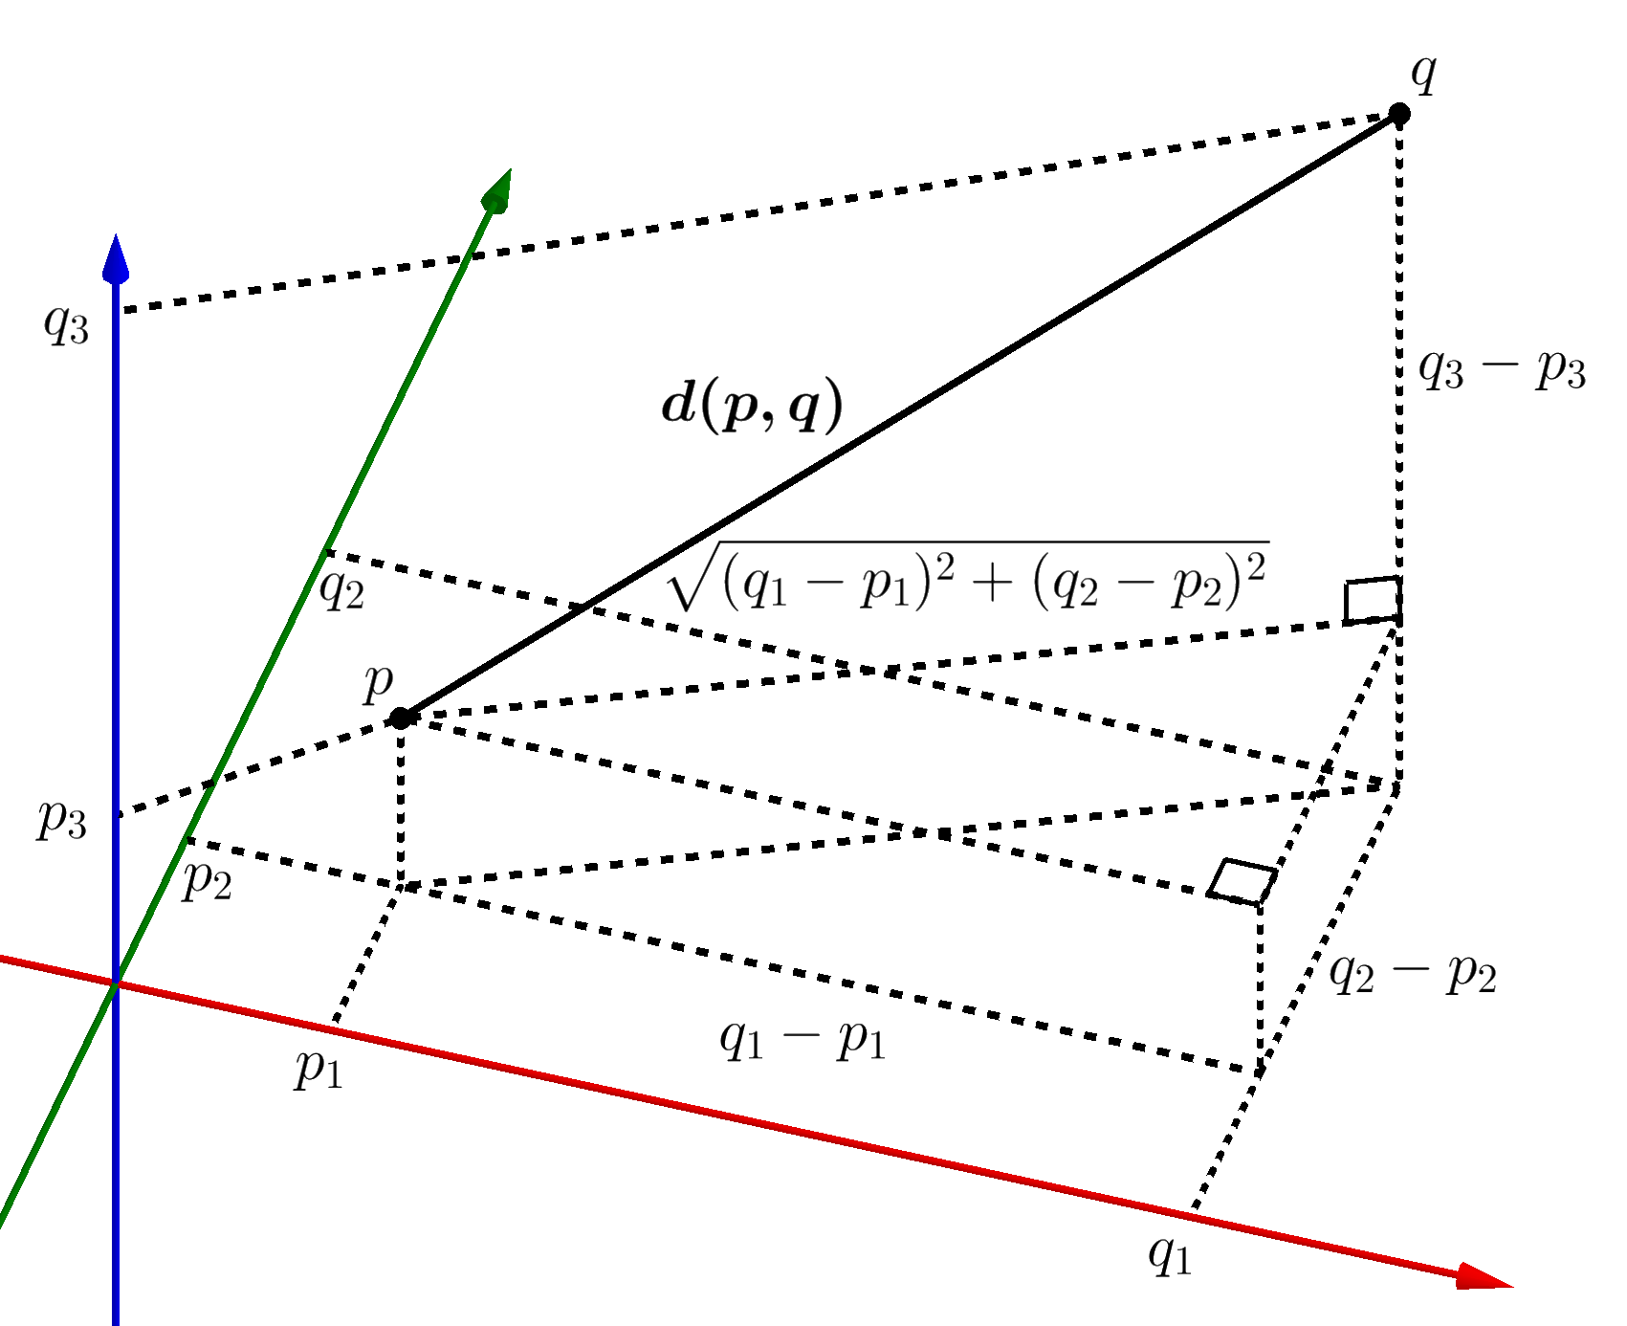
Higher dimensions
Do not be afraid! Just don’t expect to visualise!
A point in $ℝ^{3}$ is given by
$p=\left(p_{1},p_{2},p_{3}\right)$
And the distance $\left|p−q\right|$ between two points $p=(p_{1},p_{2},p_{3})$ and $q=\left(q_{1},q_{2},q_{3}\right)$ is given by
${\left|p−q\right|}^{2}= {\left(p_{1}−q_{1}\right)}^{2}+ {\left(p_{2}−q_{2}\right)}^{2}+ {\left(p_{3}−q_{3}\right)}^{2}$
Maryna Viazovska and her Mathematics
Source: Wikipedia, Kmhkmh

Slide 13
Higher dimensions
Do not be afraid! Just don’t expect to visualise!
A point in $ℝ^{8}$ is given by
$p=\left(p_{1},p_{2},p_{3},p_{4},p_{5},p_{6},p_{7},p_{8}\right)$
The distance $\left|p−q\right|$ between two points $p=(p_{1},p_{2},…,p_{8})$ and $q=\left(q_{1},q_{2},…, q_{8}\right)$ is given by
${\left|p−q\right|}^{2}= {\left(p_{1}−q_{1}\right)}^{2}+ {\left(p_{2}−q_{2}\right)}^{2}+ …+ {\left(p_{8}−q_{8}\right)}^{2}$
Maryna Viazovska and her Mathematics

Slide 14
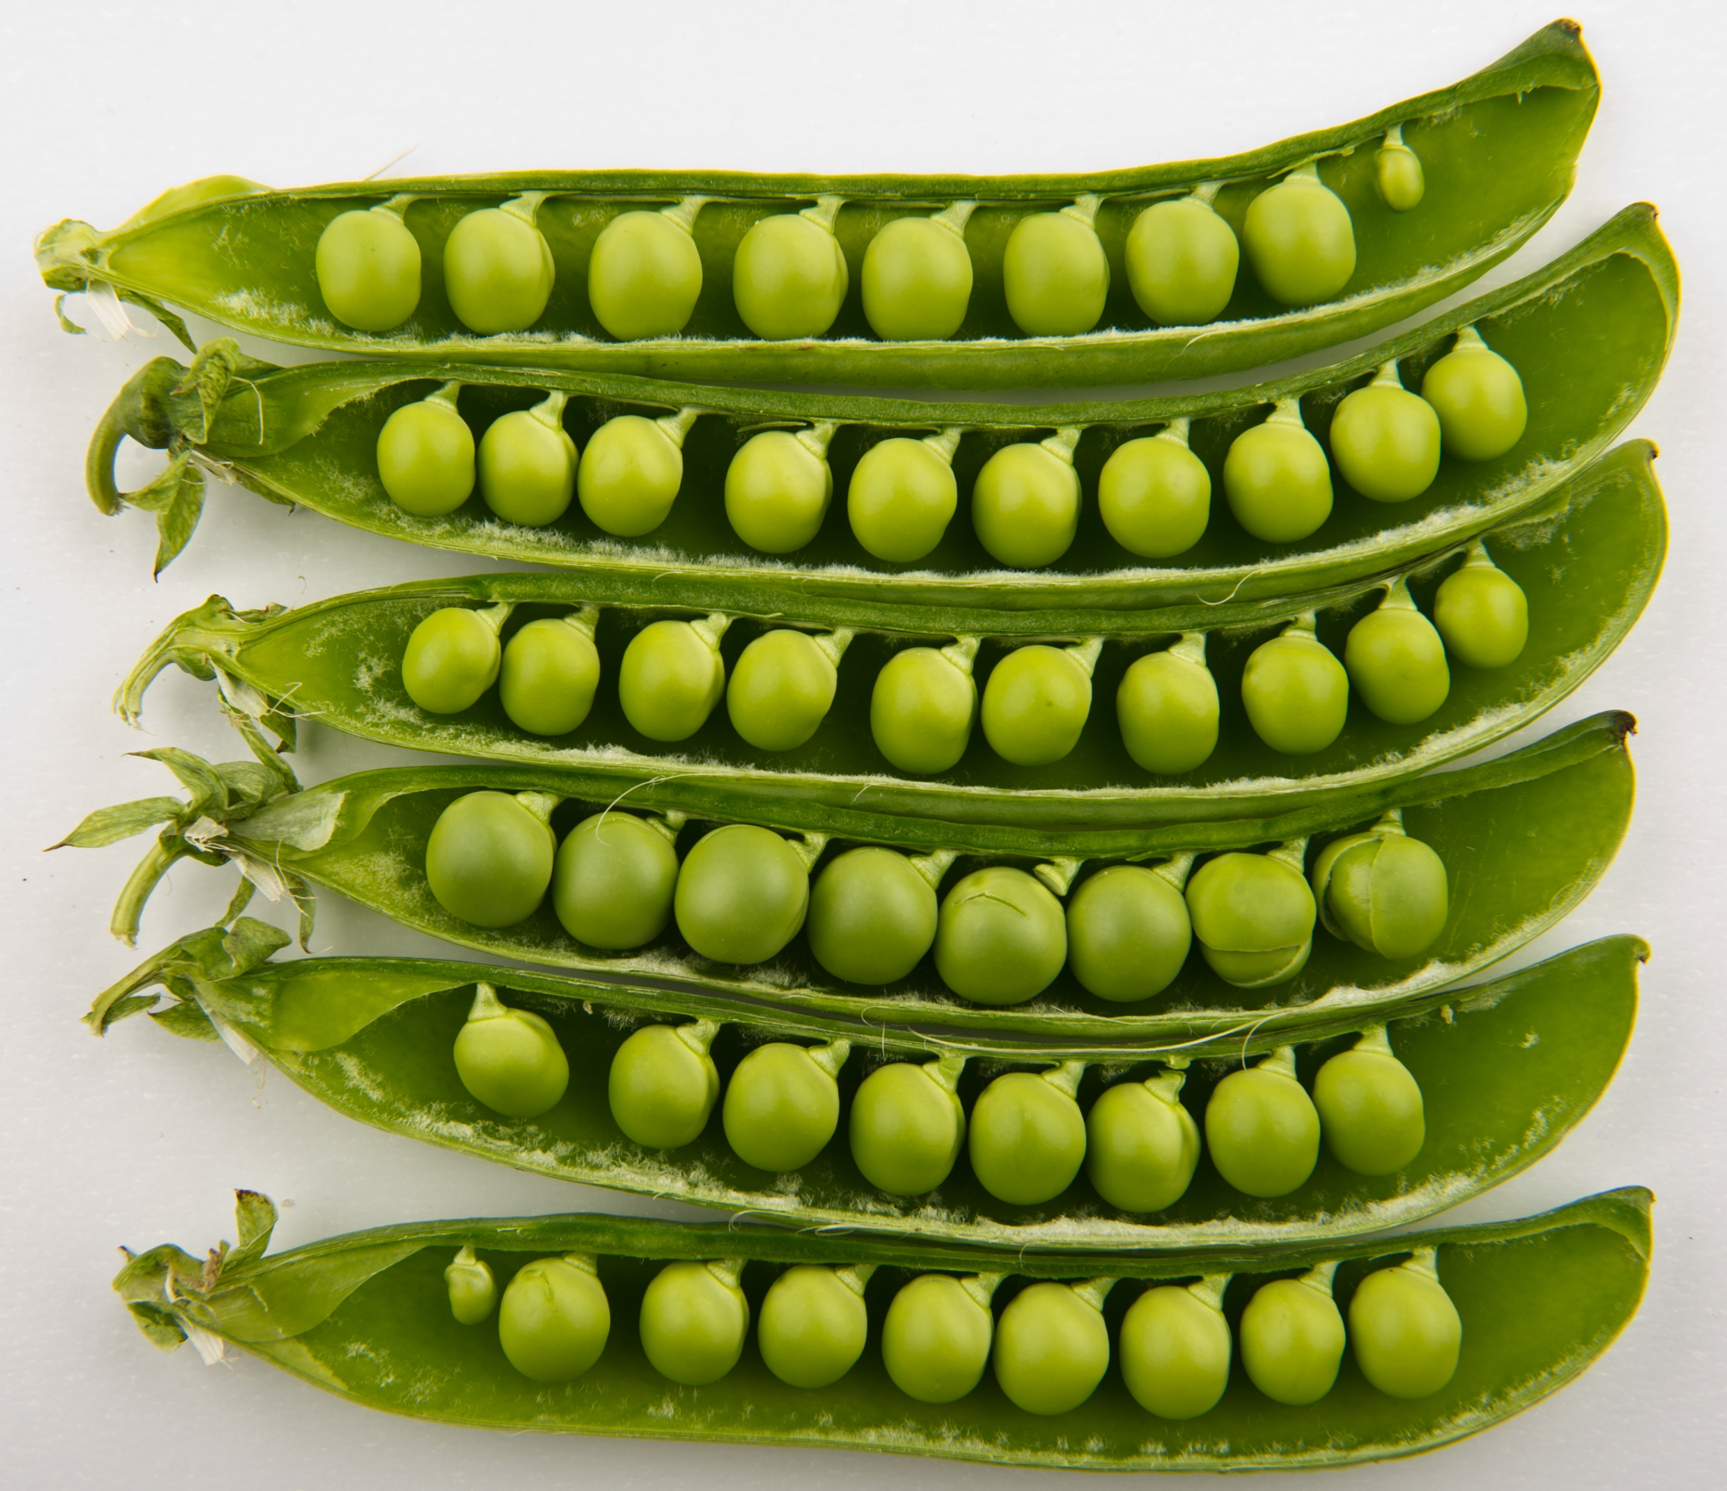
Sphere packing in 1 dimension
Doable!
100% density!
Solved by nature in practice > 90 Mya
Maryna Viazovska and her Mathematics
Source: Wikipedia, Bill Ebbesen

Slide 15
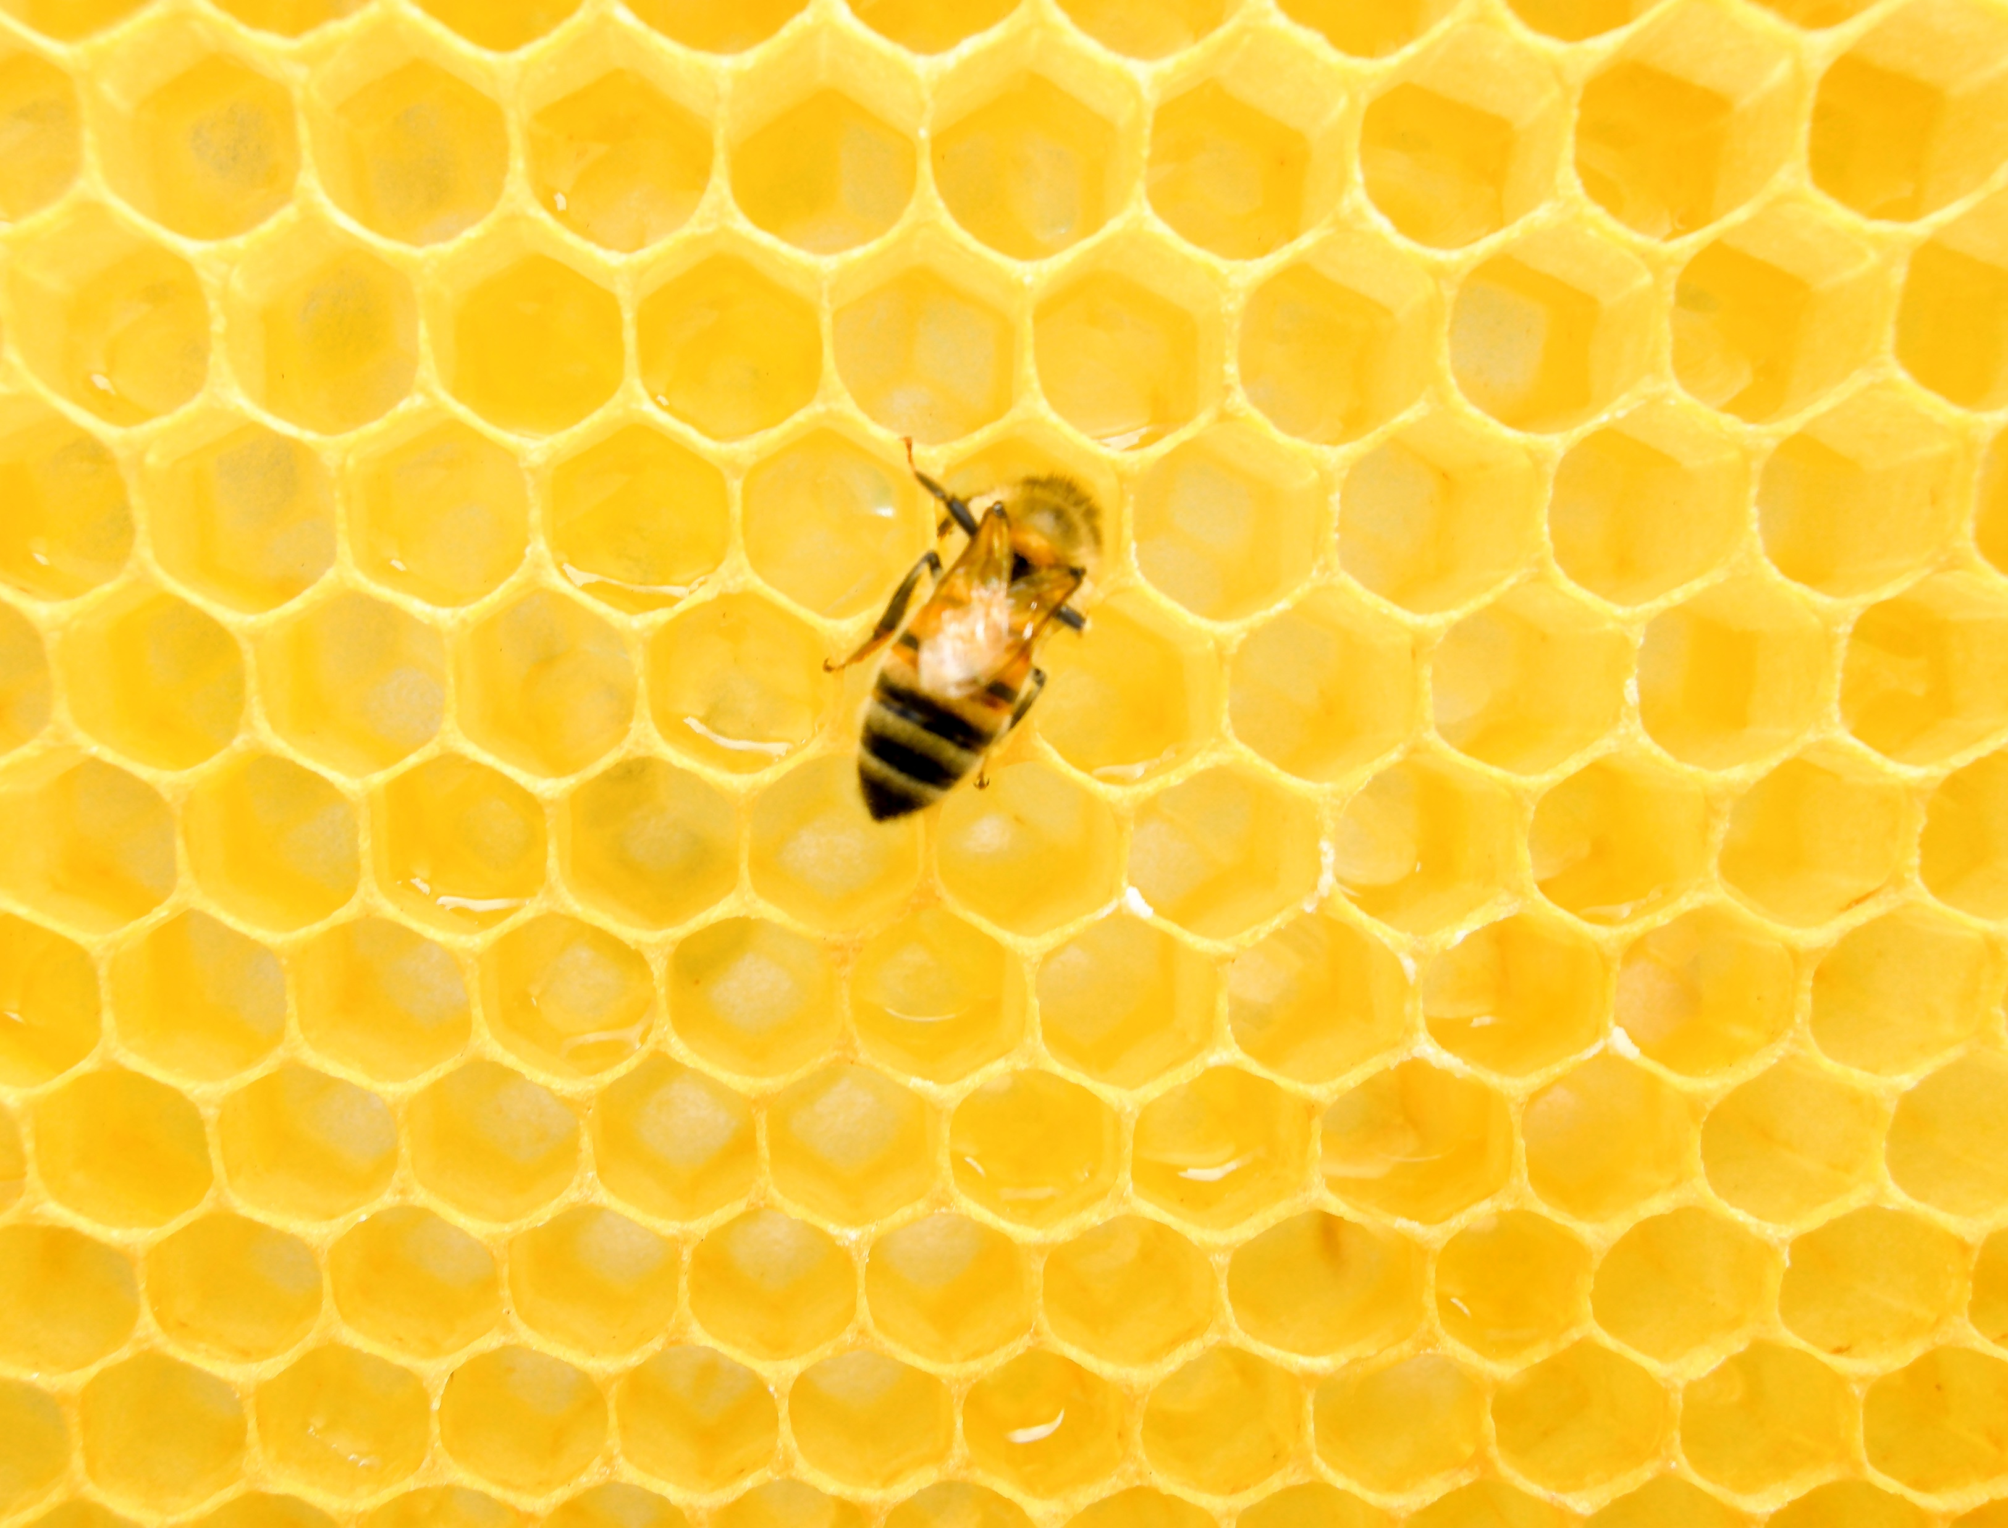
Sphere packing in 2 dimensions
Solved in practice by nature $∼$63 Mya
Harder to prove than it looks!
Thue 1910 gave a proof of optimal packing.
Density: $\frac{π}{2 \sqrt{3}}∼0.9069$
Maryna Viazovska and her Mathematics
Source: Matthew T Rader

Slide 16
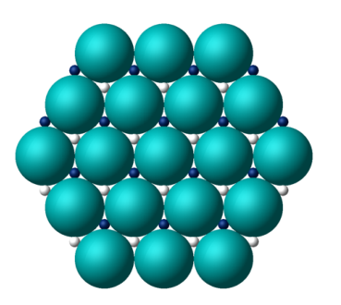
Sphere packing in 3 dimensions
Solved in practice by…
Greengrocers everywhere
Any crystal with a face-centred cubic lattice structure (eg aluminium, copper, gold, silver…)
Asserted as best possible by Kepler 1611: Kepler’s conjecture
Infinitely many packings with equal density!
Rogers 1958: “many mathematicians believe, and all physicists know” the answer
Extremely difficult to prove! Many attempts!
Density: $\frac{π}{3\sqrt{2}} ∼0.7405$
Maryna Viazovska and her Mathematics
Source: Okounkov, The magic of 8 and 24

Slide 17
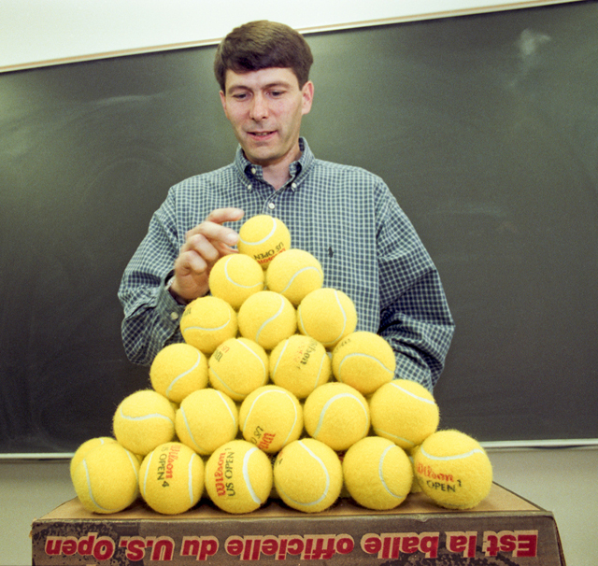
Sphere packing in 3 dimensions
Proved by T Hales – raising philosophical issues
Reduced problem to “100,000 linear programming problems”
1998 proof announcement: 339 pages, 50,000 lines of code
Referees “99% certain” of correctness
Published (abridged) in Annals of mathematics in 2005
Formal proof using computerised assistants completed 2014
Maryna Viazovska and her Mathematics
Source: Quanta.

Slide 18
Current status of the problem
Best sphere packings are currently known in dimensions:
1
2 (Thue 1910)
3 (Hales 1998-2014)
8 (Viazovska 2016)
24 (Cohn, Kumar, Miller, Radchenko, Viazovska 2017)
No proof in any other dimension is known.
There are widely believed conjectures for optimal packing in dimensions 4-7.
For all dimensions 9 and above (except 24), all bets are off.
Best known upper & lower bounds in large dimension differ by large factors.
Maryna Viazovska and her Mathematics

Slide 19
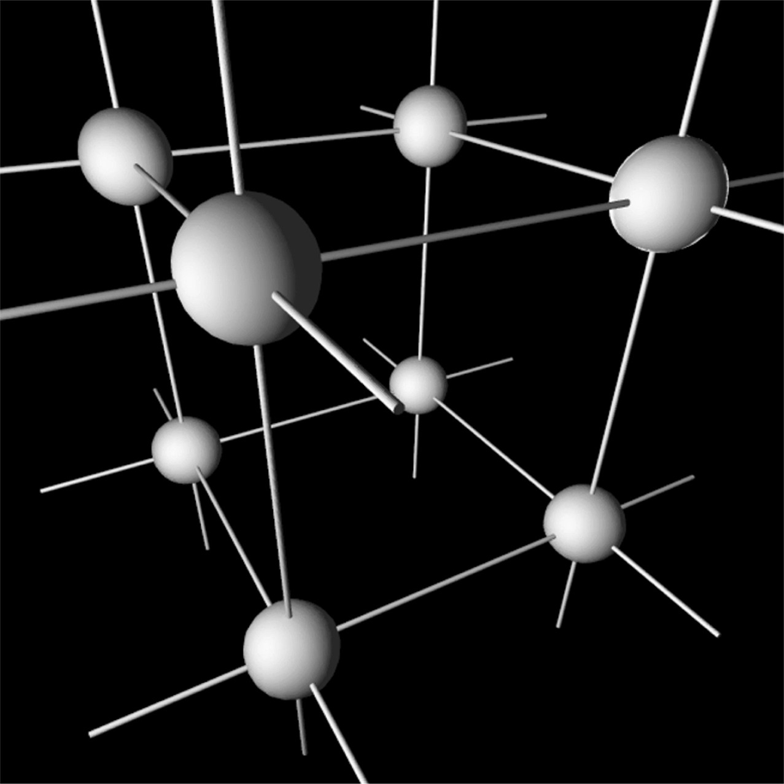
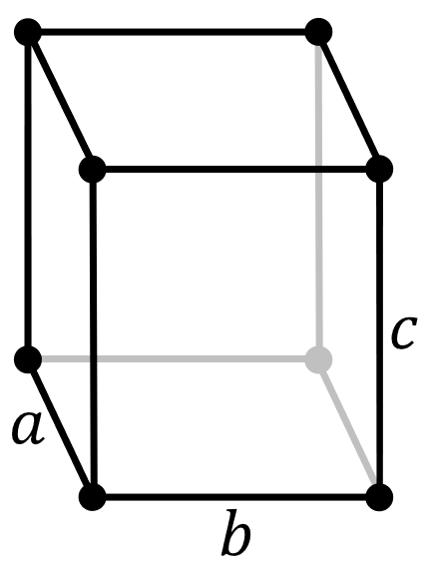
Lattices
Consider a set of linearly independent vectors $v_{1},v_{2},…, v_{n}∈ℝ^{n}.$
Taking integer combinations of them yields a discrete set of points called a lattice $Λ$.
$Λ= ℤ v_{1}+ℤ{ v}_{2}+…+ℤ v_{n}= \left\{a_{1}v_{1}+a_{2}v_{2}+…+a_{n}v_{n}:a_{1},a_{2},…, a_{n}∈ℤ\right\}$
(A discrete additive subgroup of $ℝ^{n}$.)
Points are arranged regularly! Space is divided into fundamental cells!
If points are all distance $≥2r$ apart then we obtain a lattice sphere packing of radius $r$.
Maryna Viazovska and her Mathematics
Sources: Wikipedia; Melcom; Wikimedia, Daniel Mayer, Stannered

Slide 20
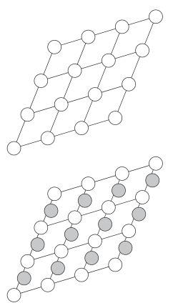
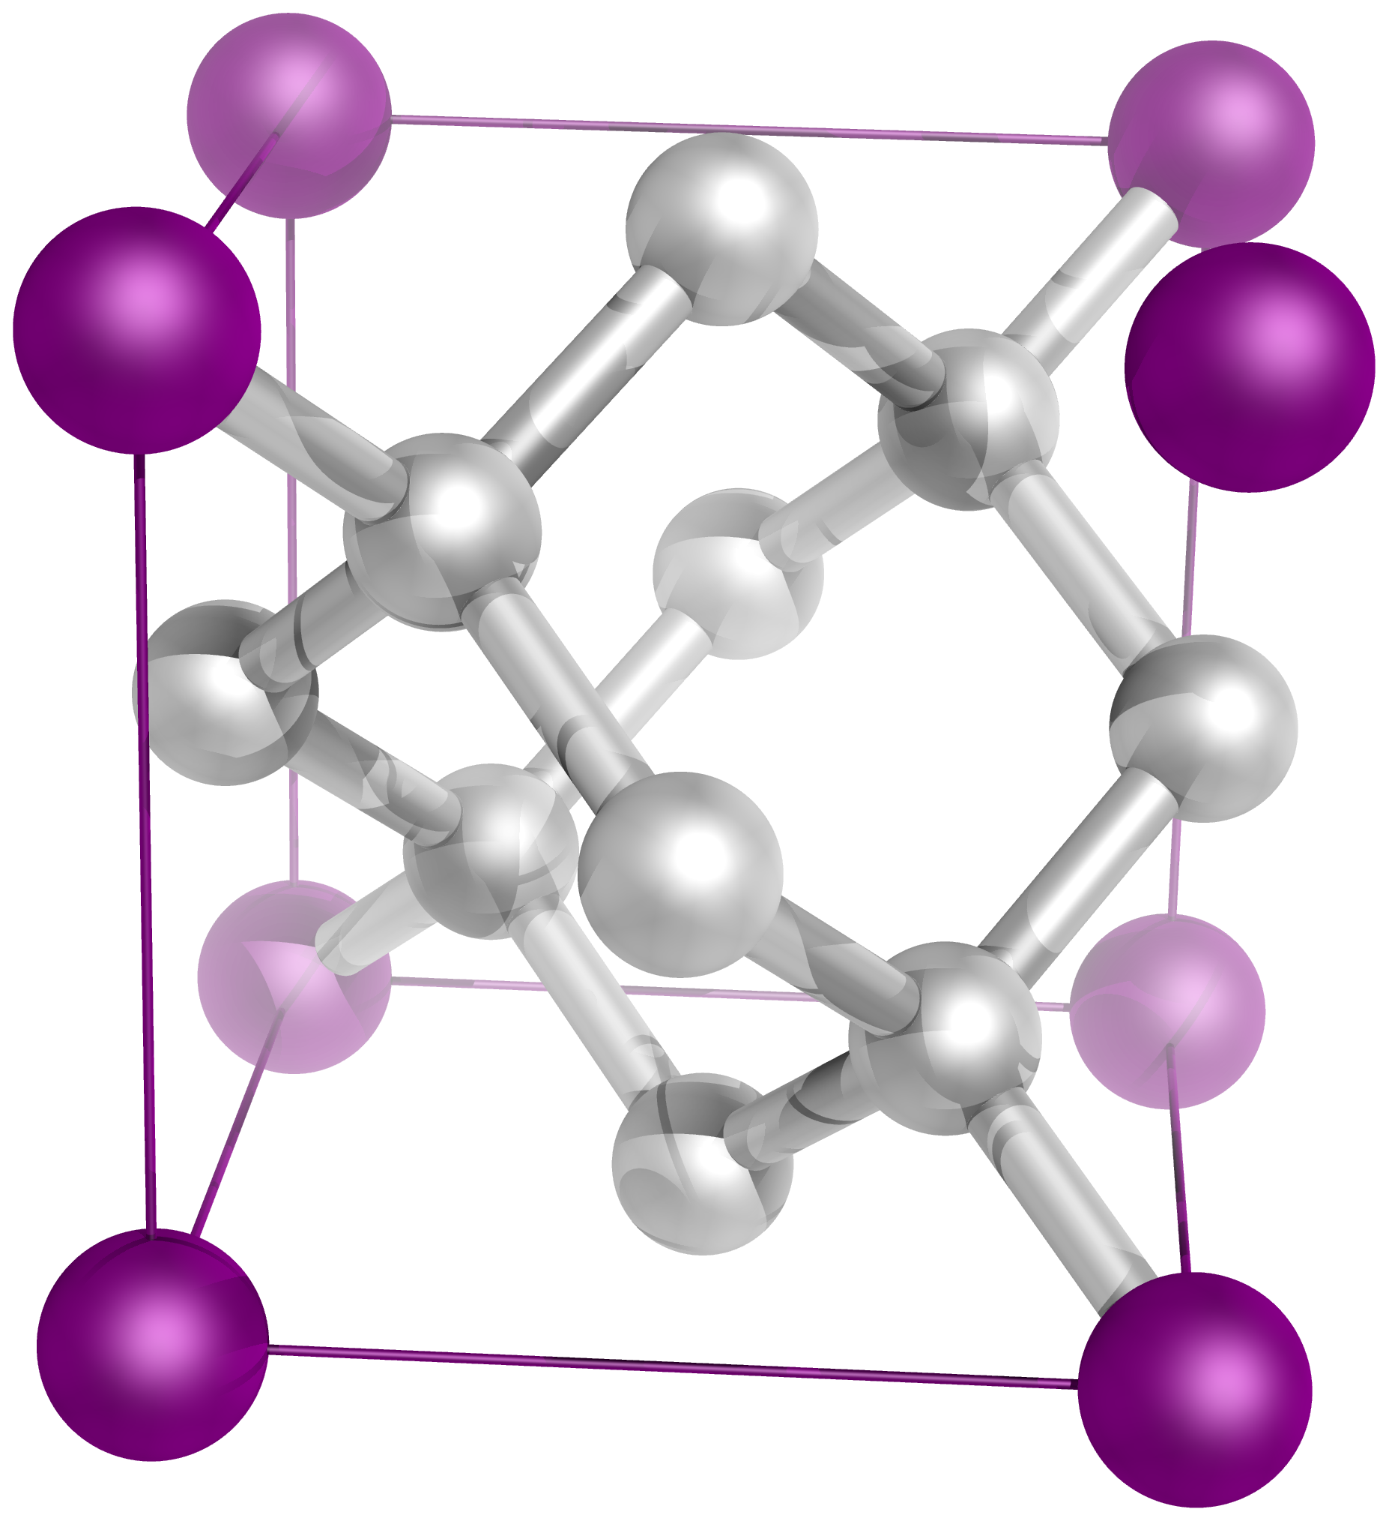
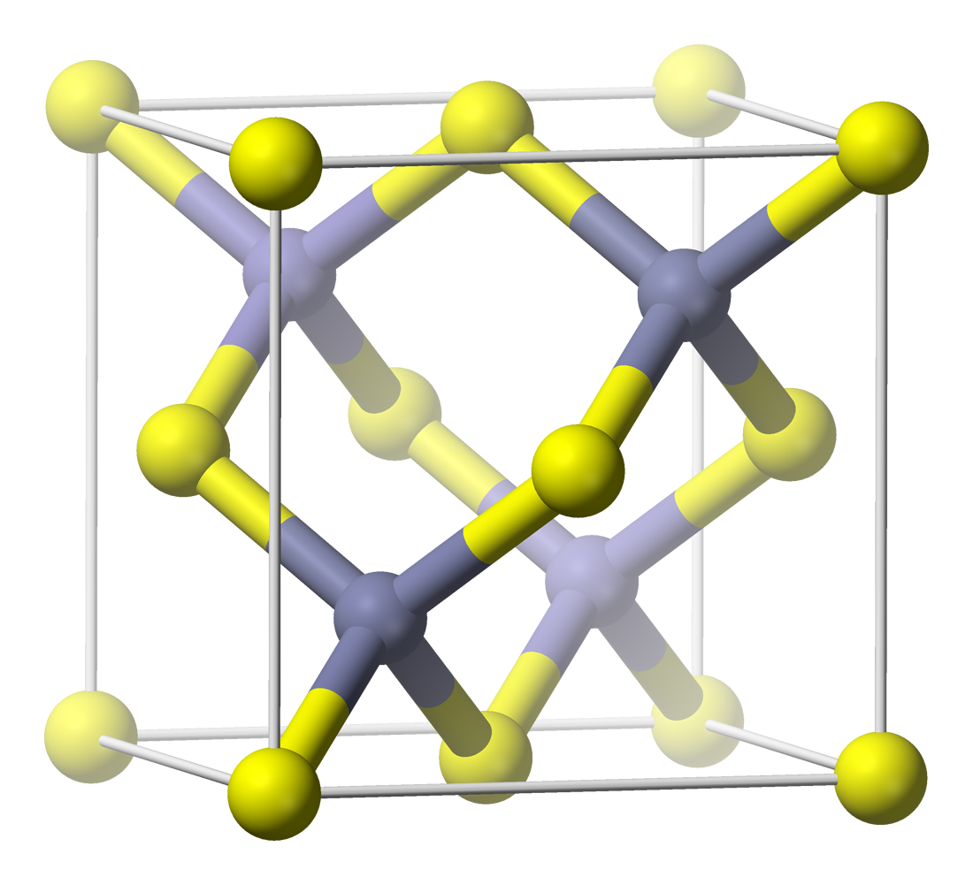
Lattices vs periodic packings
A periodic sphere packing is obtained by placing spheres in the fundamental cell of a lattice, and translating them through space by the lattice.
$\{$Lattice packings $\}⊂\{$ Periodic packings $\}$
Efficient sphere packings can sometimes be obtained from lattice packings by placing spheres in interstitial sites / holes.
Maryna Viazovska and her Mathematics
Sources: GYassineMrabet, Wikimedia; Cohn, A conceptual breakthrough; Benjah-bmm27, Wikimedia

Slide 21
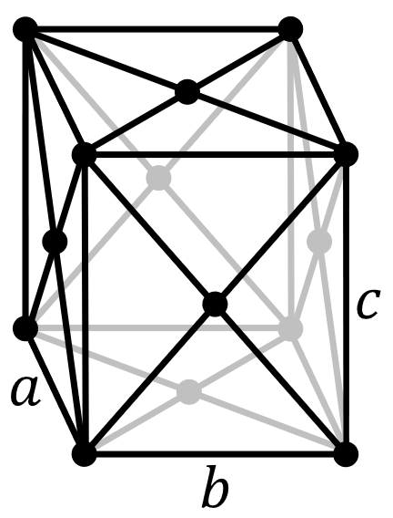
The $D_{n}$ lattice
$D_{n}= \left\{\left(x_{1},…, x_{n}\right)∈ ℤ^{n} : \sum_{i=1}^{n}{x_{i}} is even\right\}$
E.g. $D_{3}=\left\{\left(even,even,even\right),\left(even,odd,odd\right),\left(odd,even,odd\right),(odd,odd,even)\right\}$
$=\left\{\left(0,0,0\right),\left(0,1,1\right),\left(1,0,1\right),\left(1,1,0\right) mod 2\right\}$
= Face-centred cubic lattice! Optimal!
Minimal separation $\sqrt{2}$ - yields sphere packing with radius $\frac{1}{\sqrt{2}}$ .
Maryna Viazovska and her Mathematics
Source: Wikimedia, Rocha, Stannered

Slide 22
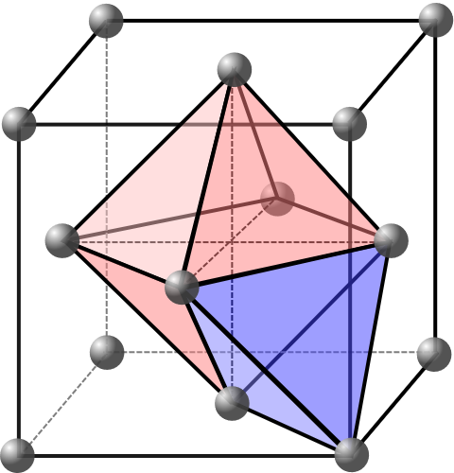
$E_{8}$ is 8-dimensional diamond
The $D_{n}$ lattice (separation: $\sqrt{2}$; sphere radius $1/\sqrt{2}$) has two types of holes:
Shallow holes: $\left(1,0,0,…\right),\left(0,1,0,…\right),(1,1,1,…)$ etc, distance $1$ from other points
Deep holes: $\left(\frac{1}{2},\frac{1}{2},\frac{1}{2},…\right)$, distance $\sqrt{{\left(\frac{1}{2}\right)}^{2}+{\left(\frac{1}{2}\right)}^{2}+…+{\left(\frac{1}{2}\right)}^{2}}=\sqrt{\frac{n}{4}}$
Adding $\left(\frac{1}{2},\frac{1}{2},\frac{1}{2},…\right)$ to the lattice yields the diamond lattice.
When $n=8$, spheres at deep holes fit perfectly!
Two copies of $D_{8}$ perfectly interleave!
This is the $E_{8}$ lattice.
Maryna Viazovska and her Mathematics
Sources: Benjah-bmm27, via Wikimedia; Wikimedia, Rocha, Stannered; Wikimedia, cdang

Slide 23
The $E_{8}$ lattice
Lattices like $D_{n}$, $E_{8}$, appear all over mathematics
Classification of finite groups, Lie algebras ($A_{n}, B_{n}, C_{n}, D_{n}, E_{6},E_{7},E_{8},F_{4},G_{2}$)
Differential topology, number theory, modular forms, cluster algebras, superconformal gauge quiver theories…
$E_{8}$ has many interesting / amazing properties:
Fundamental cell has volume 1 (unimodular)
The dot product $x⋅y$ of any $x,y∈E_{8}$ is an integer (integral)
Any $x=\left(x_{1},…, x_{8}\right)∈E_{8}$ has $x⋅x={\left|x\right|}^{2}$ even (even lattice), and all even numbers appear this way
The number of $x∈E_{8}$ such that $x⋅x=2n$ is $240\sum_{d|n}{d^{3}}$ (?!!!!!!!)
There are $240$ shortest nonzero vectors $x$ in $E_{8}$, i.e. with $x⋅x=2$, forming a semiregular polytope
When projected onto a certain Coxeter plane, it has 30-fold symmetry
Maryna Viazovska and her Mathematics

Slide 24
The $E_{8}$ lattice
Maryna Viazovska and her Mathematics
Sources: Wikimedia, Claudio Rocchini; Okounkov, The magic of 8 and 24

Slide 25
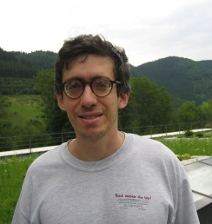
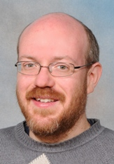
A sharp upper bound?
In 2003, Henry Cohn and Noam Elkies developed a technique for upper bounds on sphere packing density, using harmonic analysis / Fourier transforms.
$f:ℝ^{n}→ℝ$ has Fourier transform $\hat{f}:ℝ^{n}→ℂ$. If the functions are sufficiently nice then
$\hat{f}\left(y\right)=\int_{ℝ^{n}}{f\left(x\right) e^{−2πi x⋅y} dy}$,
$f\left(x\right)= \int_{ℝ^{n}}{\hat{f}\left(y\right) e^{2πi x⋅y} dy}$
Theorem: If $f$ is sufficiently nice and
$f\left(0\right)= \hat{f}\left(0\right)>0$
$f\left(x\right)≤0$ for $\left|x\right|≥r$
$\hat{f}\left(y\right)≥0$ for all $y$
Then the sphere packing density in $ℝ^{n}$ is at most vol($B_{r/2}^{n}$).
Maryna Viazovska and her Mathematics
Sources: Wikimedia, Renate Schmid; H Cohn

Slide 26
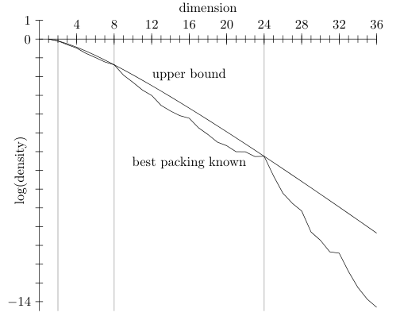
Search for the magic function
Cohn-Elkies conditions can be investigated numerically!
Can find $f$ that matches $E_{8}$ packing to 60 decimal places!
Hales: “I felt that it would take a Ramanujan to find it”
Heisenberg uncertainty principle: It’s hard to control both $f$ and $\hat{f}$ !
What is the magic function in 8 dimensions?
In 2016, Viazovska found it.
Maryna Viazovska and her Mathematics
Sources: Cohn, Packing, coding and ground states; Cohn, A conceptual breakthrough in sphere packing

Slide 27
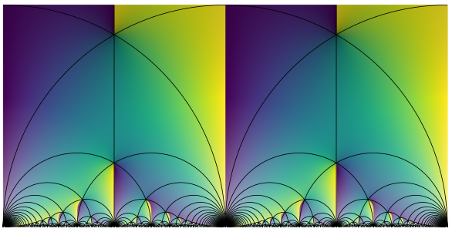
Viazovska’s magic function
Theorem (Viazovska 2016). The magic function in $ℝ^{8}$ is given by
$f\left(x\right)=\sin^{2}\left(\frac{π{ \left|x\right|}^{2}}{2}\right) \int_{0}^{∞}{\left(t^{2}φ\left(\frac{i}{t}\right)+ψ\left(it\right)\right) e^{−π{ \left|x\right|}^{2}t} dt}$
where $φ=\frac{4π{\left(E_{2}E_{4}−E_{6}^{2}\right)}^{2}}{5\left(E_{6}^{2} −E_{4}^{3}\right)}$ and $ψ=−\frac{32 Θ_{ℤ}^{4}{\left.​\right|}_{T} \left(5Θ_{ℤ}^{8}−5 Θ_{ℤ}^{4}{\left.​\right|}_{T} Θ_{ℤ}^{4}+2Θ_{ℤ}^{8}{\left.​\right|}_{T}\right)}{15π Θ_{ℤ}^{8} {\left(Θ_{ℤ}^{4}−Θ_{ℤ}^{4}{\left.​\right|}_{T}\right)}^{2}}$
where $E_{k}=\frac{1}{2ζ(n)} \sum_{\left(m,n\right)∈ℤ^{2}}{\frac{1}{{\left(mz+n\right)}^{k}}}$
where $ζ(n)$ is the Riemann zeta function
where $Θ_{ℤ}\left(z\right)=\sum_{x∈ℤ}{e^{πi {\left|x\right|}^{2}z}}$
and $f{\left.​\right|}_{T}\left(z\right)=f(z+1)$.
Therefore $E_{8}$ is the optimal sphere packing in $ℝ^{8}$!
Maryna Viazovska and her Mathematics
Source: Cohn, The work of Maryna Viazovska

Slide 28
Viazovska’s magic function
Viazovska: “It took several steps to reach the solution. The first one, and it gave me the confidence that I will solve it, was when I managed to reduce the problem to a functional equation. I was coming home from a conference in Bonn…
On the train, I thought, since nothing seems to work, let me write the problem out one more time. In school, they taught us that your head is full of rubbish until you write things down to put them in order. So, I am writing it out, and I get this functional equation. I look at it and I think: “I should be able to solve it”. And, indeed, I solved it, it only took a couple of months.
…in the summer, [I] wrote long, long formulas on pieces of paper in the evening… Obviously, I made every possible mistake in these notes. But the final time I wrote it, I didn't make any mistakes, and there was the solution.”
Peter Sarnak: “It’s stunningly simple, as all great things are. You just start reading the paper and you know this is correct.”
Akshay Venkatesh: “Wow! How on earth did they find this function?”
Andrei Okounkov: “Viazovska’s solution is truly striking. She gives an extremely nontrivial explicit formula for the magic functions in terms of modular forms… I would guess that seeing the solution would have made Ramanujan extremely, extremely happy.”
Maryna Viazovska and her Mathematics

Slide 29
Why pack spheres?
Natural problem!
Has interesting solutions!
Models for crystalline / granular materials
Most practical application: communication over noisy channels – error correction.
$ℝ^{n}=$ space of possible signals / communications
Signal sent may not be the same as signal received! May be perturbed by noise, errors, etc.
Build a vocabulary of signals $S⊂ℝ^{n}$, an error-correcting code. Only send signals from $S$.
If all points of $S$ are $>2r$ apart, then even if a signal is perturbed by noise up to distance $r$, we can tell the original signal.
Centres of spheres in sphere packings provide error correcting codes!
Denser sphere packing means more possible signals to send, more accuracy!
E.g. Used in Voyager probes
Maryna Viazovska and her Mathematics

Slide 30
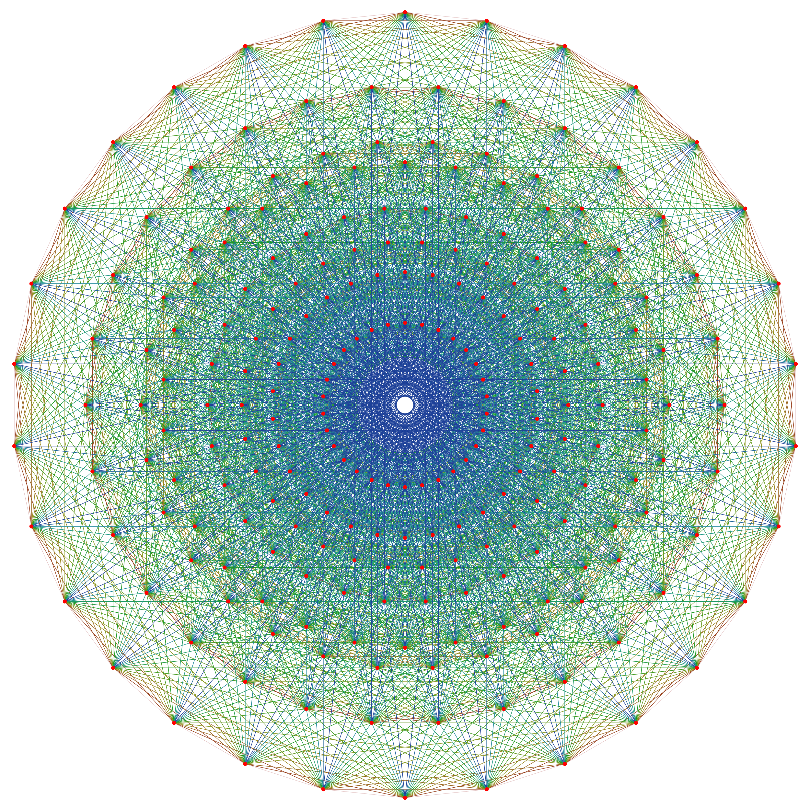
Thanks for listening!
References:
Henry Cohn, A conceptual Breakthrough in Sphere Packing, Notices of the AMS Feb 2017
Henry Cohn, The work of Maryna Viazovska, Proceedings of the ICM 2022
Henry Cohn, The work of Maryna Viazovska, youtube 26/10/20
John H. Conway and Neil J. A. Sloane, Sphere Packings, Lattices and Groups (2nd ed) 1993
Andrei Okounkov, The magic of 8 and 24, Proceedings of the ICM 2022
Maryna Viazovska, The sphere packing problem in dimension 8, Annals of Mathematics 2017

